Slide 1

SoFanTES : HOLISTIC Solution for Sustainable Buildings
Imagine your building façade storing solar energy with NO COST!
Project «SoFanTES»
Company : TOPRAK SMART FACADE SYSTEM ENGINEERING LTD.COM.
Ercan Başer, CEO

Slide 2
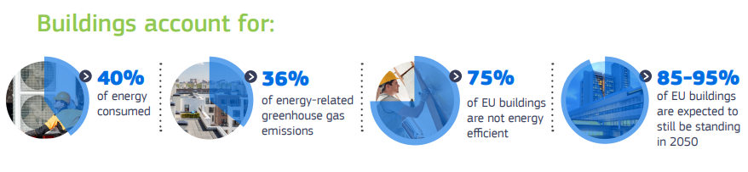
SoFanTES: Solar Facade for An Affordable TES System.
PROBLEM: MISSING HOLISTIC Solutions For Sustainable Buildings…
Efficient HVAC
Efficient Envelope
RES
Energy Storage
Holistic and
Scalable
Systems?
+
+
+
URGENT
SOLUTION: Building Integrated TES
SoFanTES, offers a solution to these challenges by combining building envelopes, energy-efficient HVACs (LowEx System) and thermal energy storage techniques through an integrated design approach for affordable energy efficient buildings.
SMART FACADE
Low temp. TES
Renewable Energy Storage for Buildings
SoFanTES

Slide 3
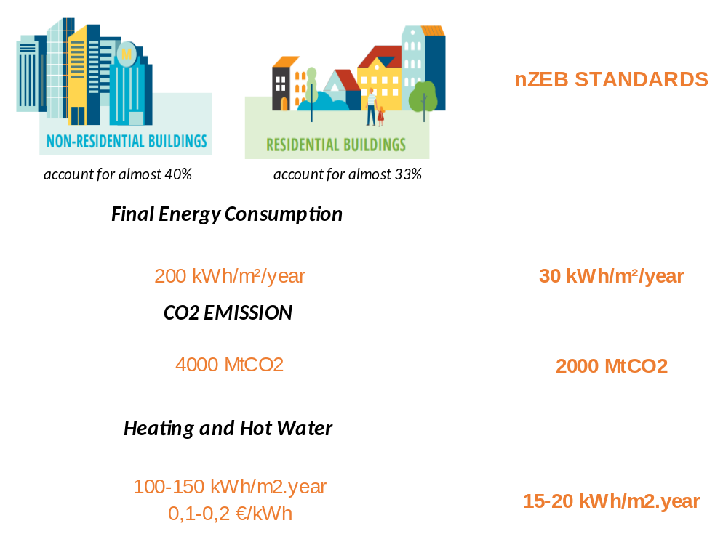
SoFanTES: How Big Is The Problem?
Today's Building Energy Needs:
Heating and Hot Water:
100-150 kWh/m²/year
By 2050, the Objective is to Achieve:
80-90% Reduction in Energy Consumption
Thermal Energy Need Supported from Renewable Energy Sources (RES), approximately:
100 kWh/m²/year
BUILDINGS TODAY 2050 TARGETS
RES
«Integrating renewable energy sources (RES) into buildings poses several challenges.«
"Inconsistent Energy Supply"
"Intermittent Nature"
"Demand vs. Supply Imbalance«
«Peak Load Problem»
"Grid Dependency Issues"
"Architectural Boundaries"
85% Energy Savings
50% CO2 Savings
TES
may be the answer, but it must be integrated into buildings in a holistic and scalable way.

Slide 4


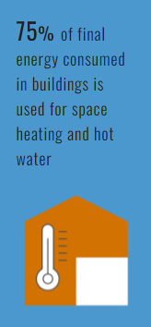
SoFanTES: How Big Is The Problem?
THERMAL ENERGY STORAGE CAPACITY,CHARGING AND CHALLENGES
100-150 kWh/m2.year
Thermal Energy Capacity
Winter solar irradiance in EU, 300-400 W/m2
TES
TES
Daily solar thermal energy: 1.2 kWh/m2.day
✓
100 kWh/m2.year
Thermal Energy Capacity
But Low Temperature
✓
~100 kWh/m2.year
Thermal Energy Capacity
HOW DO WE CHARGE?
Yearly solar thermal energy: 100 kWh/m2.day
✓
30-40 °C
x
x
CHALLENGES:
Thermal Efficiency
Cost-Effectiveness
Scalability
Building Integration
Lack of knowledge and experience
Limited Awareness
We need TES to be charged by RES with a capacity of around 100 kWh/m2.year.
Contrary to popular belief, solar energy can meet a significant portion of a building's energy needs even during winter months.

Slide 5


SoFanTES: Solar Facade for An Affordable TES System.
Second Task;
Drop
TES -TEMPERATURE!
Design Affordable TES!
Third Task;
Building Integration
with
Smart Facade
First Task;
Drop
SUPPLY TEMPERATURE!
HVAC
TES
Wall h/c
Discharge thermal energy
Charge facade solar energy
Wall h/c
Smart Facade
Low temperature heating
High temperature cooling
Optimum PCM + Water Mix
TES
Large surface area - Low temperature heating
30-40 °C
✓
SoFanTES low supply temperature improves efficiency, reduces losses, and enables low-temperature TES.
The most important problems of building integrated TES:Cost, Efficiency, Size and Weight, Durability, Safety:
When it is sunny, TES is charged. When there is no sun, TES is discharged.

Slide 6
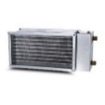

How is Solar Energy Stored During Winter?
THEN,
ALL WE NEED IS SUN!
AHU
Solar
HEAT LOSS:
U=1.0 W/m2.K, DT= 20 °C 20 W/m2.
Heating Load, daily Ploss = 400 Wh/m2.day
HEAT GENERATION:
On a sunny day, Psolar = 1200 Wh/m2.day
It is equal to roughly 3 days' worth of heating energy for the same facade. Of course, if we assume that only half of the building's facade receives sunlight, this value corresponds to approximately one day's worth of heating energy.
The TES system can operate at low heating temperature and can be scaled according to the solar energy coming to the façade and the heat loss from the façade. The HVAC system charged with TES can manage the thermal loads of the façade with air at the appropriate temperature and flow rate. Excess energy can be used for hot water needs.
300 W/m2
Charge (Facade)
Discharge
SMART FACADE
Daily solar thermal energy: 1.2 kWh/m2.day
20 W/m2
Daily heating need because of wall heat loss: 0.4 kWh/m2.day
TES
30-40 °C

Slide 7
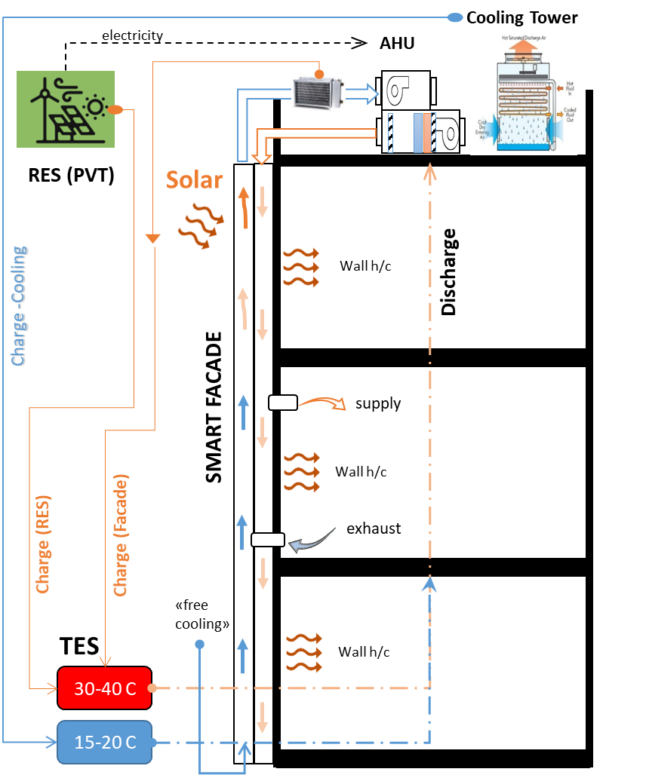
SoFanTES WORKING PRINCIPLES
TRANSFORM YOUR FACADE INTO Renewable Energy Source!
Winter:
Heat storage at a temperature of 30-40 C is sufficient for the winter. The working principle is as follows:
Electricity generation is provided by PVT panels. The primary source for thermal energy is PVT. The secondary source is the Smart Facade. The air circulating in the façade can reach a temperature of 40-50 C even on winter days, and excess thermal heat is stored with TES. TES collects about 3-5 days of energy on sunny days (Charge). In the absence of solar energy, this heat is discharged to the system from the storage. Thanks to the air circulating in the smart façade, the facades that are not exposed to the sun are easily heated. When there's no sun and TES isn't enough, the heat pump (HP) runs.
Summer:
Heat storage at a temperature of 15-20 C is sufficient for the summer. The working principle is as follows:
Electricity generation is provided by PVT panels. Thermal energy is stored with TES. TES stores about 2-3 days of cooling energy with a cooling tower that operates at night. When the outside air temperature is appropriate (e.g. at night), it is supplied to the façade and the façade is prevented from overheating (free cooling). Cooling is provided by daytime TES discharge. When TES is not enough, the heat pump (HP) is activated. For warmer climates, the subsoil temperature (about 15-20 C) is used to cool the façade.
Please note that, Renewable energy sources, which are difficult to utilize normally, are easily integrated into the TES system, thanks to low temperature regime.

Slide 8
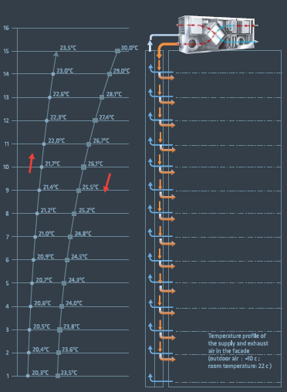
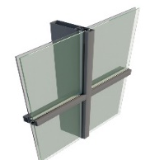
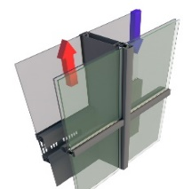
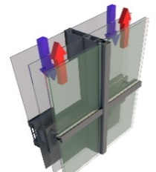
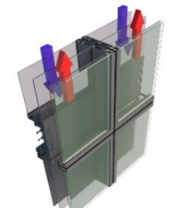
SMART FACADE www.smartfcd.com
What is SMART FACADE?
It is a patented adaptive façade integrated with HVAC system.
INNOVATION?
AHU
Design stages
Step 1: glazed curtain wall façade
Step 2: Create a channels
Step 3: Create a channels (double skin)
Step 4: Convert the facade from a site-built system to a prefabricated modular (unitized) system
Step 5: Integrate with HVAC.
Control the airflow and temperature to provide heating –cooling-ventilation from the facade.
SMART FACADE
Thermal Innovation:
  Integrates Seamlessly with HVAC
  Controls Facade's Thermal Profile
Architectural Innovation:
  Facilitates Air Circulation through Channels
  Features a Modular and Versatile Design
  Built with High Thermal Mass Steel
Wall h/c
Design stages from traditional curtain wall to SMART FACADE
SMART FACADE
Wall h/c
BUILDING
Thermal profile

Slide 9
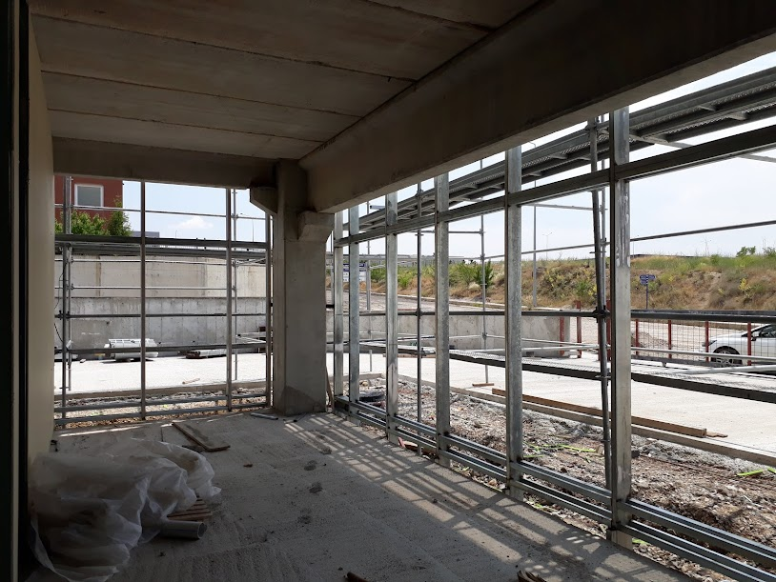
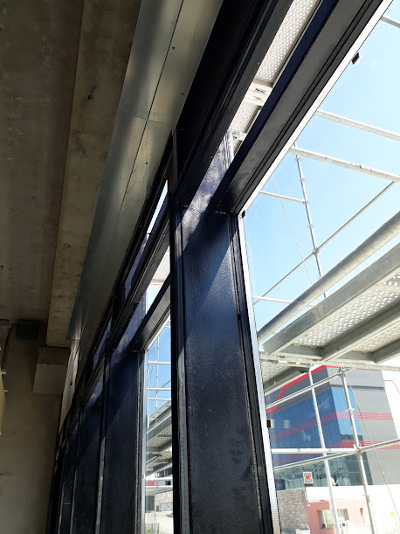
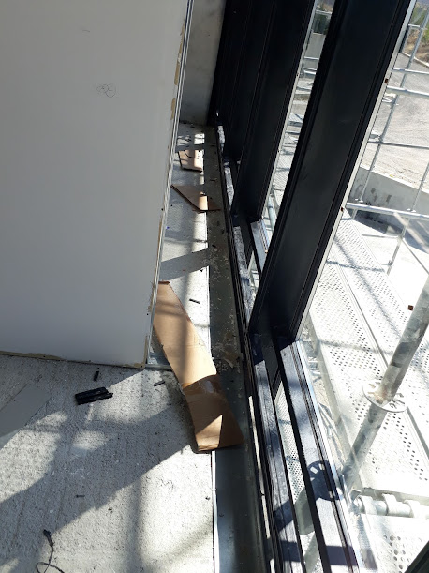
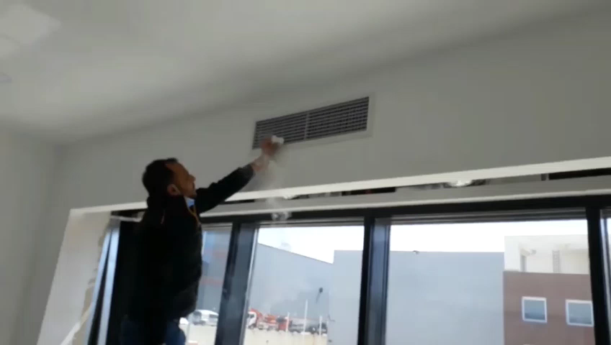
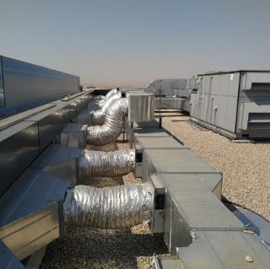
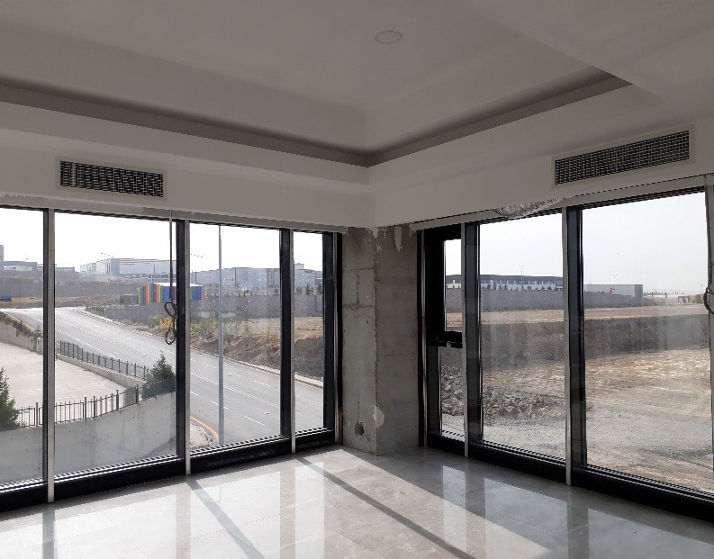
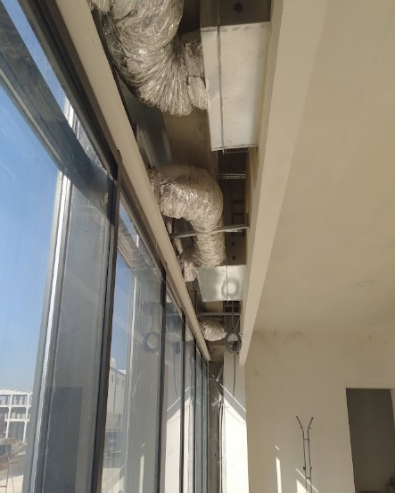
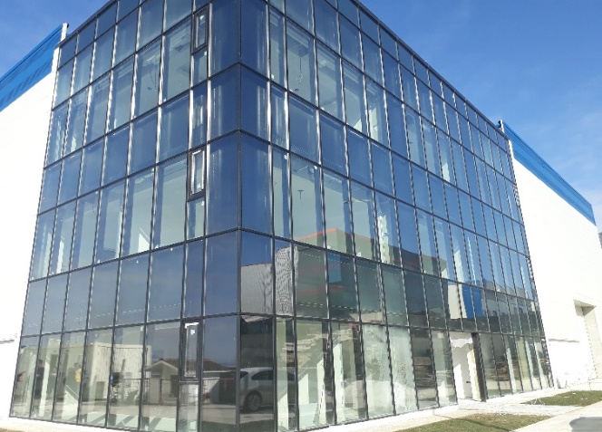
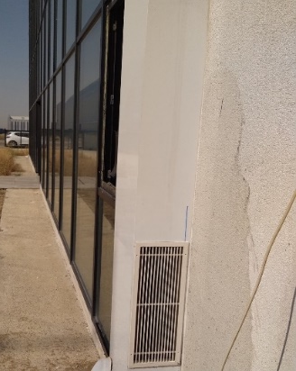
Pilot Building Construction : Adaptive, Economic & Efficient
SMART FACADE
The first pilot application was carried out in Ankara-Turkey in 2020 with all glass, steel construction and accessories, at a cost of 110 Euros/m2, including installation labor.
Steel construction single-walled, dynamic-adaptive air circulation.
"Smart Facade" looks just like regular curtain walls from the outside and inside.
The SMART FACADE pilot building is completed. However, it needs further development to integrate the SoFanTES system, including the setup of automation and measurement systems to ensure comprehensive year-round performance monitoring.

Slide 10
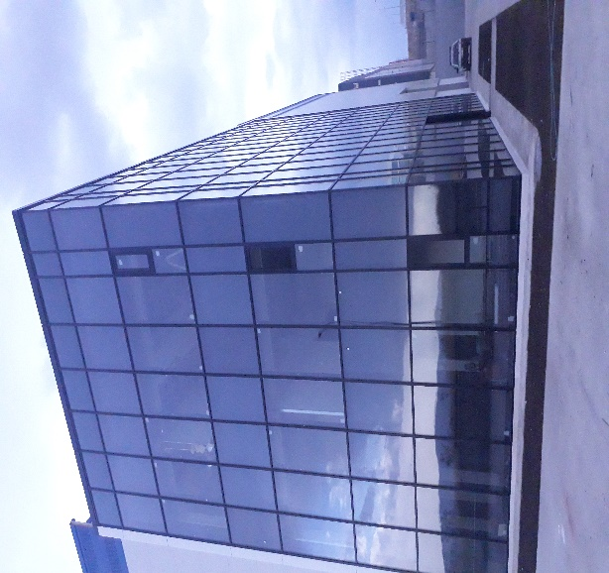
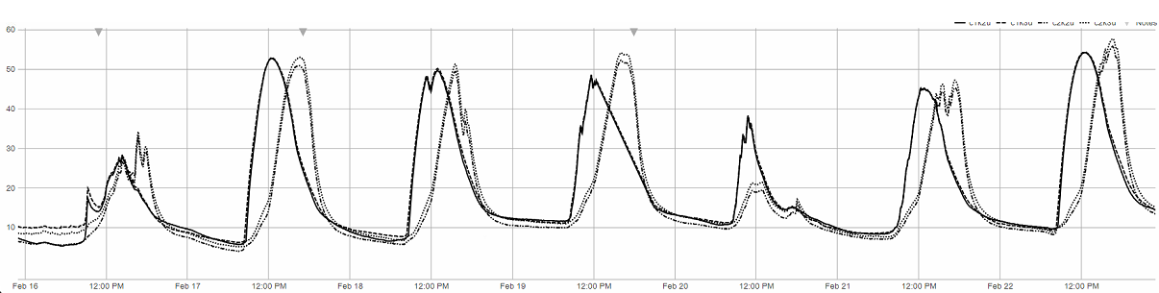
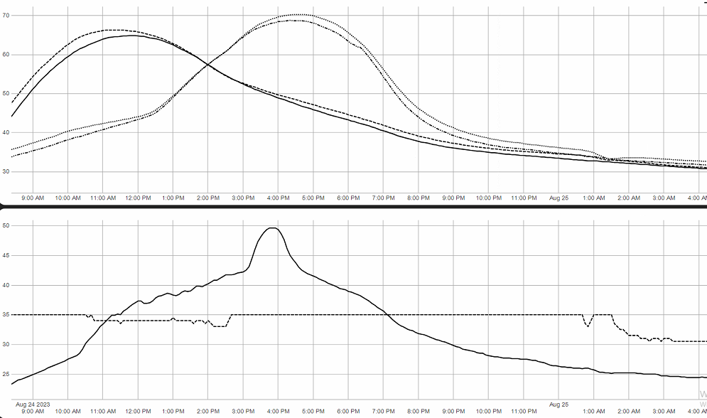
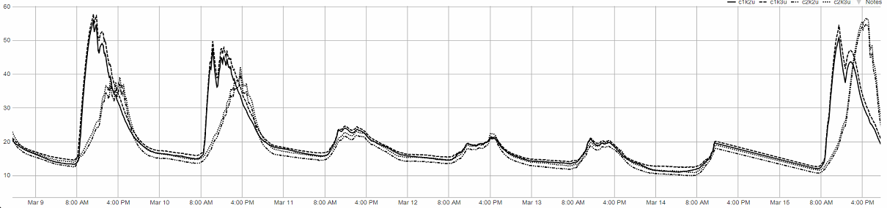
Is It Really Work? "SMART FACADE" has already proven itself to be a good thermal energy storage tool for SoFanTES.»
Facade 2
Winter (FEB.16-24)
In winter, the facade air temperature close to 50 °C was measured for 4-5 hours a day. This shows the solar thermal energy storage capacity of the Smart Facade even in winter.
Facade 1
Facade 1
Facade 2
50 °C line
While the outside temperature in February 16-24 (2023) varies between -5 C and 10 C,
the circulating air temperatures on the roof level are shown in the graph(facade1: southeast and facade2:southwest facades)
Building Southeast & southwest facades
Summer?
Winter (MARCH 9-16)
66 °C
71 °C
50 °C line
Facade 2
mostly cloudy
Night Cooling
35 °C
Facade 1
30 °C
Throughout this week, no heating devices were operated. The exterior temperatures ranged from -1 to 16 °C while the interior temperatures remained between 17°C and 20°C
"SMART FACADE" has already proven itself to be a good thermal energy storage tool for SoFanTES.»

Slide 11
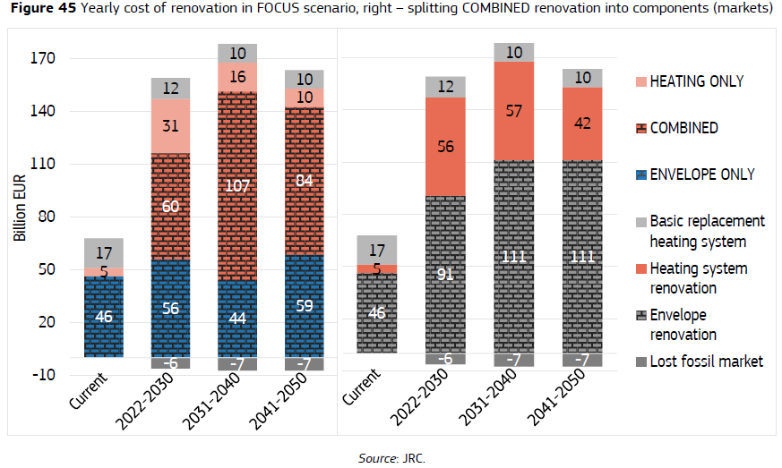
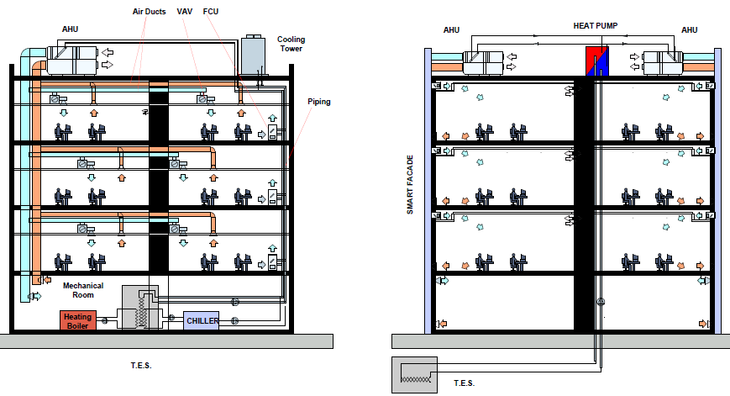
BUSINESS MODEL / High Risk, High Potential
Conventional Energy Efficient Building SoFanTES
Energy Consumption:
80%
CO2 Emission:
80%
Maintenance:
MARKET SIZE
50%
SoFanTES Market Size : 140 billion €
SoFanTES targets (0,1%): 140 million €
SoFanTES business model is B2B.
Entry into the market;
It will first begin with the DESIGN business in "Turkey" (Local Market) with strategic partners consisting of both construction companies and facade manufacturers.
Investment Cost:
33%
Façade Cost: 250 €/m2 275 €/m2
HVAC Cost: 150 €/m2 75 €/m2
TES Cost: --------- 40 -60€/m2
Energy Cost for 20 years: 200 €/m2 15 €/m2
Maintenance Cost for 20 years: 10 €/m2 5 €/m2
Carbon Footprint: Higher Lower
Construction Emissions: Higher Lower
Interior Infrastructure: More Less
Potential Height Gains: Limited Significant Rental Value
TOTAL COST: 610 €/m2 410-430 €/m2
Unique Selling Points:
High energy efficiency, cost efficiency, fast ROI, and environmental friendliness.

Slide 12





SMART FACADE & SMART DISTRICTS (Future Development)
As a smart grid system, SF also offers a different solution to district heating/cooling needs. The operation of SF is as follows: Approximately 15-20 C for cooling and 25-30 C for heating. It works with water regime. Since these temperatures are very close to underground temperatures, both energy storage and insulation costs are very low compared to similar systems. The system does not require any central heating/cooling plant. Energy consumption and carbon footprint are extremely low. SF realises the heating/cooling process in two stages: In the 1st stage, the facade is heated or cooled with the air circulated along the facade. At this stage, a significant part (50-70%) of the building's heat energy requirement is met. Some of the circulating air is supplied to the interior and ventilation needs are also met. In the second stage, the rest of the thermal demand is met by the heat pump device. The waste heat of the heat pump is also used to supply the grid. The system not only transmits the waste heat of the "heat pump" to the grid; it can also charge the "cold line" in winter and the "hot line" in summer directly with the heat of the outside air. Thus, it stores the energy of the outside air in the easiest and cheapest way!
MULTI FAMILY APARTMENT
New or renovated building
HP
OLD/ EXISTING BUILDING
Without facade renovation
SINGLE FAMILY HOUSE
New or renovated building
HP
HEAT STORAGE
Can be connected to RES
WASTE HEAT
Data centers,
Supermarkets…
HP
Facade
HP
HP
HP
Existing heating
COLD LINE (15-20 C)
WARM LINE (20-25 C)

