Slide 1

18 Firefly Street
Rhodesfield
Kempton Park
Reg. no. 2016/303872/07
Cell No. 063 108 5146
Email:
Urban Mining/AST Recycling
[Resource Assessments 2023/24 ]
‘Extraction Process - Design and Development’

Slide 2


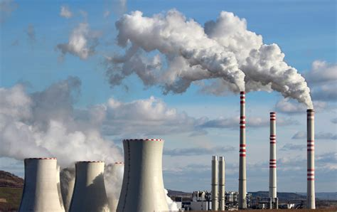
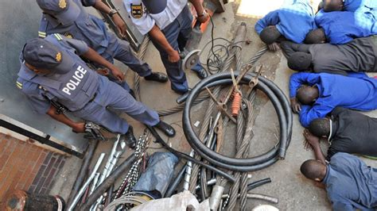
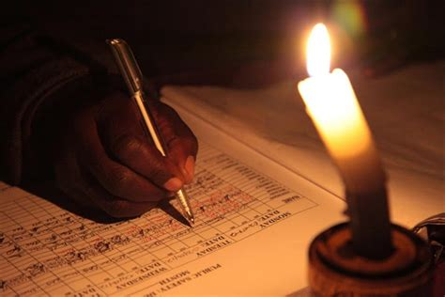
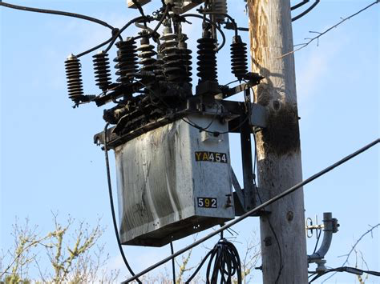
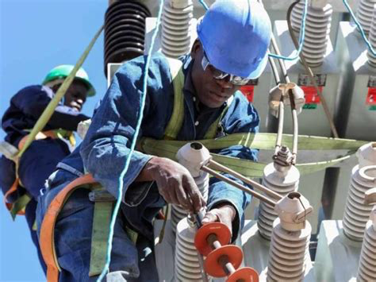
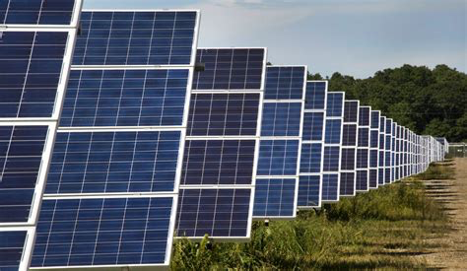

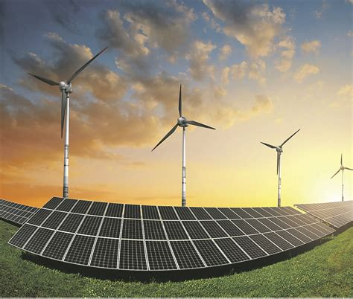
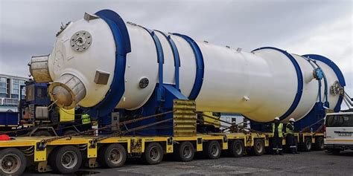
Fossil Fuel-Fired Stations
Theft
E-Scrap
Deteriorating Infrastructure
Loadshedding
The Alternative The Problem
Maintenance
Solar Energy
Energy Mix
Nuclear

Slide 3
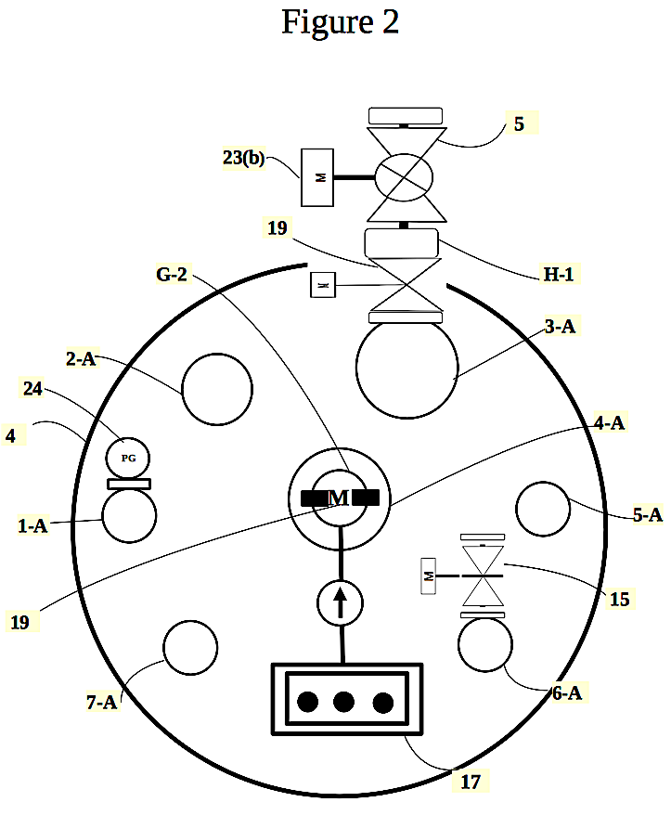
THE AAP-A-CTOR
An Open-Ended Amalgam Renewable Energy Generating Reactor
RSA Provisional Pat. No. 2023/06492
Chemical Hydrogen
Biomass
PREFERRED
APPLICATIONS
The Solution
Fuel Cells
Biofuel

Slide 4
ENERGY
200 000 GWh
Current
Output
200 000 GWh
Current
Deficit
60% LANDFILLED
MARKET
OPPORTUNITY
MARKET SHARE
200 000 GWh
Reserves
100 000 GWh
Security

Slide 5
Aug. 2024
Oct. 2024
Nov. 2024
Submit Full Patent of Apparatus;
Complete prototypes;
Run C/Hydro/Biogas Tests;
Dec. 2024
Feb. 2025
July 2025
Run Hydrogen Fuel Cell Tests;
Hybrid Sustainable Energy prototype dev.
Run Different Energy Generating Modules (Reverse Logistics)
Sep. 2025
Dec. 2025
APPARATUS TRACTION
Nov. 2025
Submit Full Patent of Hybrid Energy Generating Units;
Launch and Market the RERs;
Manufacture and Distribute the RERs
Apr. 2026
Feb 2026
Manufacture and Distribute all Technologies;
Acronyms: RER=Renewable Energy generating Reactors;
Launch and Market all Technologies;

Slide 6
O.Matlhoko
R.Matlhoko
T.Matlhoko
CFO
- Entrepreneur/ Designer;
- Responsible for Funding and Investments Strategies;
- Financials; and
- Software Development;
COO
-Inventor/entrepreneur;
- Responsible for Patent Registration,
- Product Dev;
- Systems Optimisation; and
- Production
CEO
- Entrepreneur;
- Responsible for Product Development and Sales Strategies;
- Inventory; and
- Business Development;
RSA-TEAM

Slide 7
Eskom
Other EDF
THE COMPETITION
- Monthly Payment Collection Strategy;
- Electric Meters
(Pre-paid Tokens)
- Monthly Payment Collection Strategy;

Slide 8
EQUIPMENT
PROTOTYPE
TESTS
UTILISATION OF FUNDS
PATENT REG.
MANUFACTURING
DISTRIBUTION

Slide 9
THANK YOU

