Slide 1



Philip Hargreaves
Chief Executive Officer
+44 (0) 7967 569 855
philip.hargreaves@carbonbit.com

Slide 2
Solution
Proprietary, low-cost Carbon Dioxide Removal and
Point Source Capture technology

Slide 3


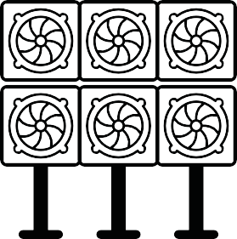


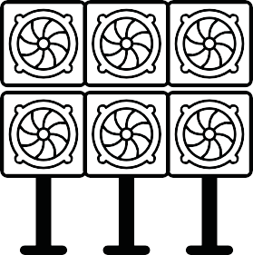
The Problem with DAC
Energy consumption and Degradation are the leading issues facing DAC
Traditional DAC methods are ^{effective in CO}2 capture but require large amounts of thermal energy
Ambient Air
^{CO}2 ^{Depleted Air}
Energy Sources Geothermic, Natural Gas, Solar
Liquid Sorbent
^{Reuse of CO}2
Synthetic Fuel
Contractor
(~900^{O}C)
Building Materials
Existing sorbents have high degradation and are inefficient.
Filter saturated with CO2 is heated to release CO2
(~100^{O}C)
Enhanced Oil Recovery
Solid Sorbent Filter
^{CO}2
Depleted Air
Carbon Sequestration

Slide 4
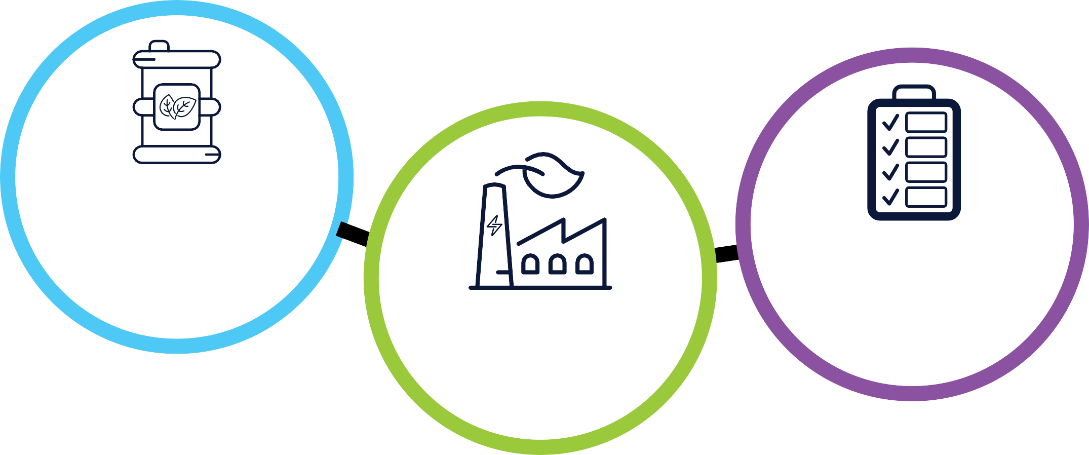
The Value Proposition
Patent Pending
UK Patent Application No.: 2318008.6
CT’s DAC Technology
Highly selective process
^{for CO}2 ^{capture and a} “modular” reactor design for scalability
A strategic technology to target the removal of 40
^{MtCO}2^{/pa by 2045}
and beyond
Proprietary process aiming for lowest cost
^{($100/tCO}2⁾

Slide 5





DAC > eFuels Market Opportunity
License/Build
AMBIENT AIR
DAC
CO₂
eFuels

Slide 6






DAC-to-eMethanol
_{H} H
Renewable Energy & Water Source
Direct Air Capture
Carbon Monoxide Fabrication
Fuel Synthesis
eMethanol
CO₂ Lean Air

Slide 7
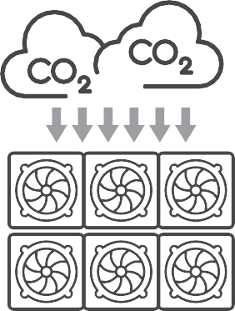




DAC-to-SAF
_{H} H
Renewable Energy & Water Source
Direct Air Capture
Carbon Monoxide Fabrication
Fuel Synthesis
Fuel Refining
Aviation eFuel
CO₂ Lean Air

Slide 8







Traction - Financial Support to date
Net Zero Catalyst iXs
£50k
Won “Transformational Technologies” Grant Competition in 2023
£190k
Won “Industry Impact Fund” support from STFC and from 24/25
£20k
Main Supporter in the Build Phase of the Prototype in 2024
£25k
Design Support in 2024 for Industrial Growth phase
£15k
Forging commercial pathway into India market
Other investment to date of £132k

Slide 9





Traction - Technical Journey
Leading Novel Technology
JAN 2022
DEC 2023
DEC 2024
2026
Orders 2027
Desktop R&D & PoC
Design & IP
Prototype (TRL4)
Commercial
Pilot (TRL7)

Slide 10
Go To Market
1. University Research
(2022)
Instigated research into DAC following report by VCMi, to have real impact on reducing CO₂ from the atmosphere.
3. Patent Application
(2022 Q4)
Following successful trials and IP audit, applied for patent through Barker Brettel.
5. Commercial Pilot
(2026)
2no 40ft Containers – 1 for DAC > SAF; 1 for DAC > emethanol
Build Phase
Growth Phase
2. Feasibility Study
(2023 Q2)
Entered into partnerships with AMRC and STFC. Results showed DAC was technically feasible.
4. Prototype
(2024 - DEC)
Build of demo unit and videos at AMRC - baseline performance data at Lab
6. Tech Enabled Scale (2027)
AI & Robotics - continual enhancements to process and design

Slide 11
World Leading Advisors
Dr Ya-Wen H
Computational Chemistry
Dr Ubaid Q
Computational Fluid Dynamics
Martyn G
Design Engineering
Computational Chemistry Scientist with 25 years in protein structural determination, macromolecule interactions, and scripting scientific analysis skills.
CFD Scientist CFD methods in multi-phase flow and heat transfer to microflows, environmental flows and fluid-structure interactions.
40 years’ experience in developing and implementing multi-disciplinary engineering solutions through focus on data management and M&V.
Dr Kathryn T
Sustainable Energy Materials
Dr Karl G
Consultant Engineer
Ged. H OBE
Engineering
Research focused on developing flexible, low-cost “green” fuels (hydrogen, CO2 reduction) and sustainable energy storage systems.
50 years’ experience in O&G and new technology assessments – with broad background in CO2 Capture & Geologic Storage “Colored” Hydrogen, and e-Fuels.
Blue Chip M&E and process engineering specialist with agile development experience and knowledge of start-up process .

Slide 12
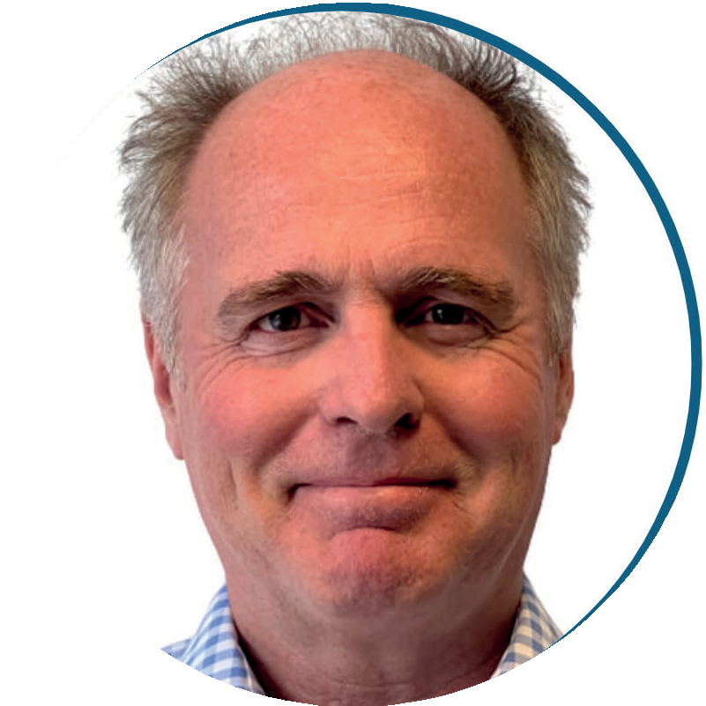
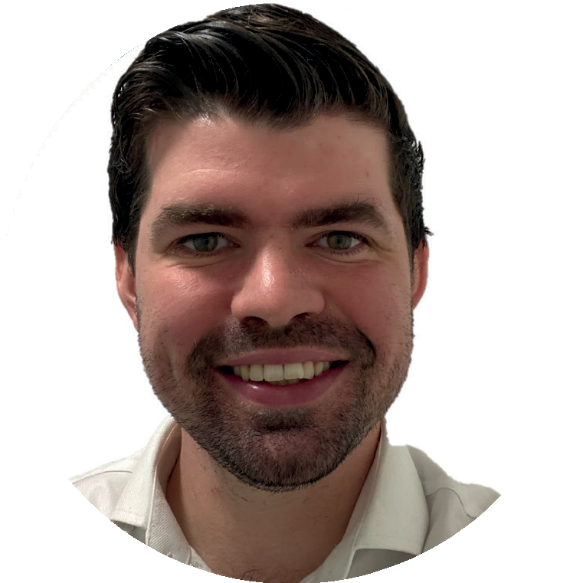
Leadership Team
Philip Hargreaves
Chief Executive Officer
Dr Dylan Jordan
Chief Innovation Officer
• +20 years in sustainability management & +15 years of C-Suite experience
Sustainability and engineering consultants
Recent successful innovation spin off to Series A (Thallo.io – Carbon as a Service)
• +5 years of experience in engineering development projects
• +3 years of technical research experience in process design and management
BSc, MSc. Chemical Engineering PhD, Nuclear Engineering

Slide 13
Impact
Carbonbit Technology’s patent pending DAC technology is aimed to be
Low Cost
Modular
Scalable
Less Downtime
Less Waste
A vision to capture ≈20 MtCO₂ /pa by 2050
for utilisation and storage

Slide 14










Low-cost, modular
Carbon as a Service
Contacts
Philip Hargreaves
Chief Executive Officer
Dylan Jordan
Chief Innovation Officer
+44 (0) 7967 569 855
philip.hargreaves@carbonbit.com
+44 (0) 7746 944 845
dylan.jordan@carbonbit.com
STRICTLY PRIVATE & CONFIDENTIAL

