Slide 1

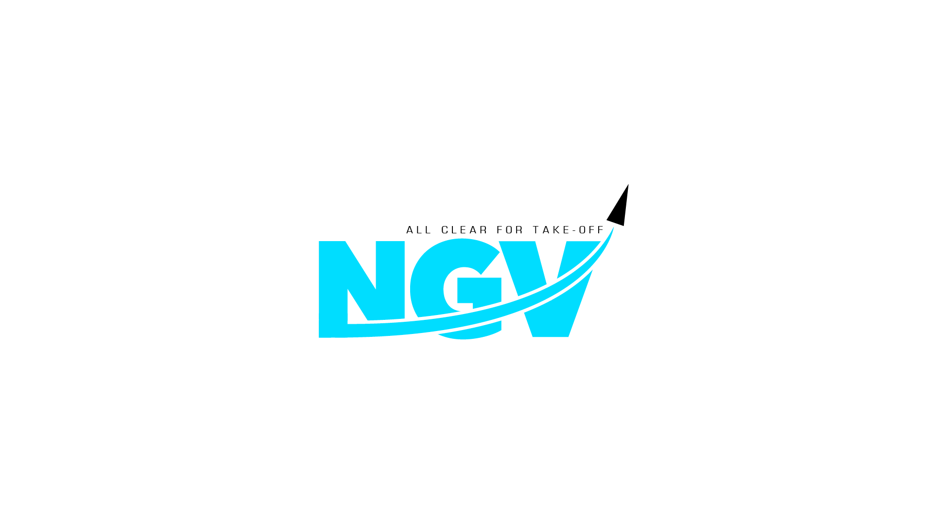
INTRO DECK
February 2025
NGV.EARTH INFO@NGV.EARTH

Slide 2
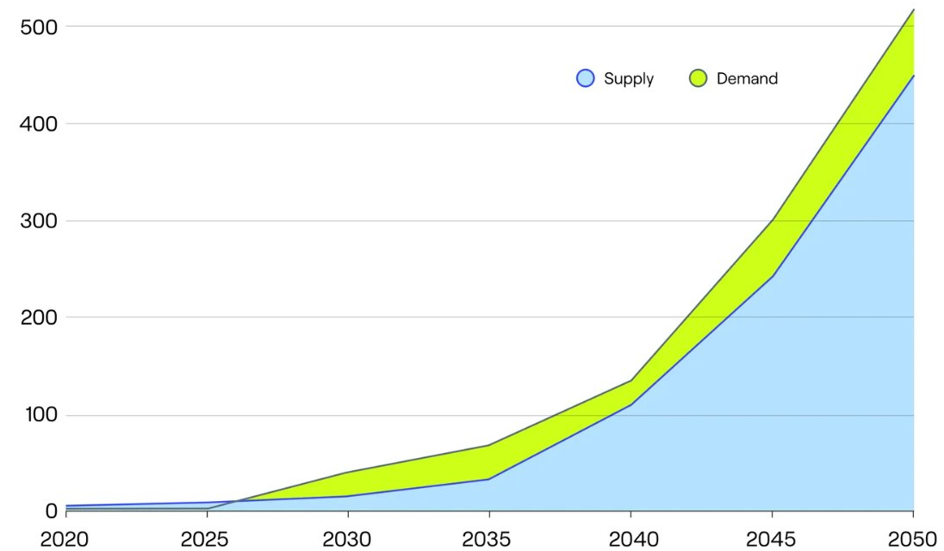

A SHORTFALL IN SAF SUPPLY COULD ARISE BY 2027
Sustainable Aviation Fuel (SAF) is widely recognized as the only viable solution to decarbonizing aviation, particularly for mid- and long-haul flights, where alternative propulsion technologies remain infeasible.
Yet high production costs, limited feedstock availability, and insufficient scalable technologies hinder its widespread adoption.
Global predicated SAF demand and supply (millions of tonnes)

Slide 3
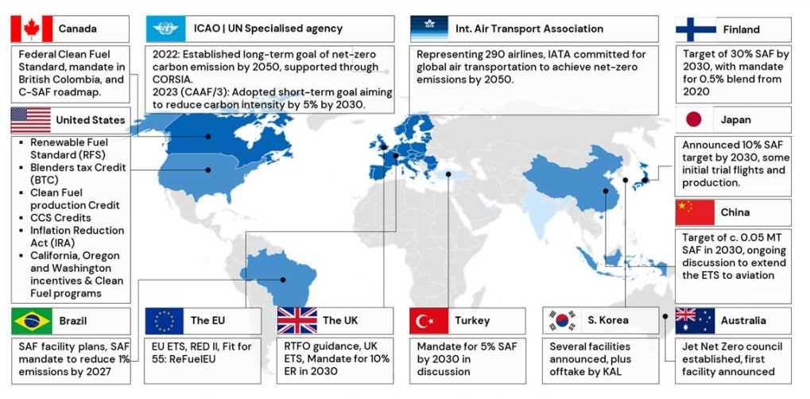
SAF BLENDING MANDATES ARE ADOPTED GLOBALLY
NGV pathways are favored by regulations and economics​
EU regulations mandate a minimum blending requirement of 20% SAF, including a sub-target of 5% e-SAF (PtL) by 2035
ICF, ITF-OECD, IATA, ICAO

Slide 4
CURRENT TECHNOLOGIES FOR PRODUCING SAF FACE SEVERAL DRAWBACKS AND LIMITATIONS
COMPLEX
WASTEFUL
EXPENSIVE
Require hydrogen enrichment and CO2 separation stages
Require extensive wastewater treatment and consumption of steam
Use expensive catalysts with low selectivity towards middle distillate hydrocarbons

Slide 5
A MORE COMPETITIVE SOLUTION FOR CARBON REMOVAL IS NEEDED

Slide 6
NGV NOVELTY
NGV technology meets today’s sustainable feedstock and market demands, providing a more diverse, simple, and cost-effective process for sustainable feedstocks such as CO₂, Biogas, Biomass residuals, and municipal and industrial waste.
Instead of producing hydrogen, which primarily converts to water, NGV directly transforms carbon emissions into hydrocarbons within the SAF range without costly syngas conditioning or wax hydrocracker steps, reducing the loss of valuable resources.
Besides SAF, the process can produce road transportation fuels, renewable naphtha, solvents, and alpha-olefins. Its modularity and adaptability allow production to be efficiently scaled, making it an ideal fit for industries seeking sustainable, high-yield alternatives.

Slide 7
NGV
ALL CLEAR
PROCESS
Syngas enhancement
Renewable feedstock
SIMPLER
Syngas generation unit
CO
Hydrogenation
Tail gas
Syngas
SMARTER
Upgrading
SAF
>20% reduction in production costs
Syncrude
CHEAPER
Transportation fuels
Renewable Naphtha
Aqueous

Slide 8
NGV PROCESS ADVANTAGES
The catalyst, protected by patents, was produced following a commercial method from low-cost materials and has the proper features to keep a low ratio of H₂/CO along the reactor, consequently, presenting
High activity (>85% syngas conversion);
High selectivity toward hydrocarbons (>85wt%C₅₊);
High stability (4000h).
H2 enrichment, CO2 separation and hydrocracking of heavy wax fraction are not needed.
Wastewater production and steam consumption are significantly reduced.

Slide 9
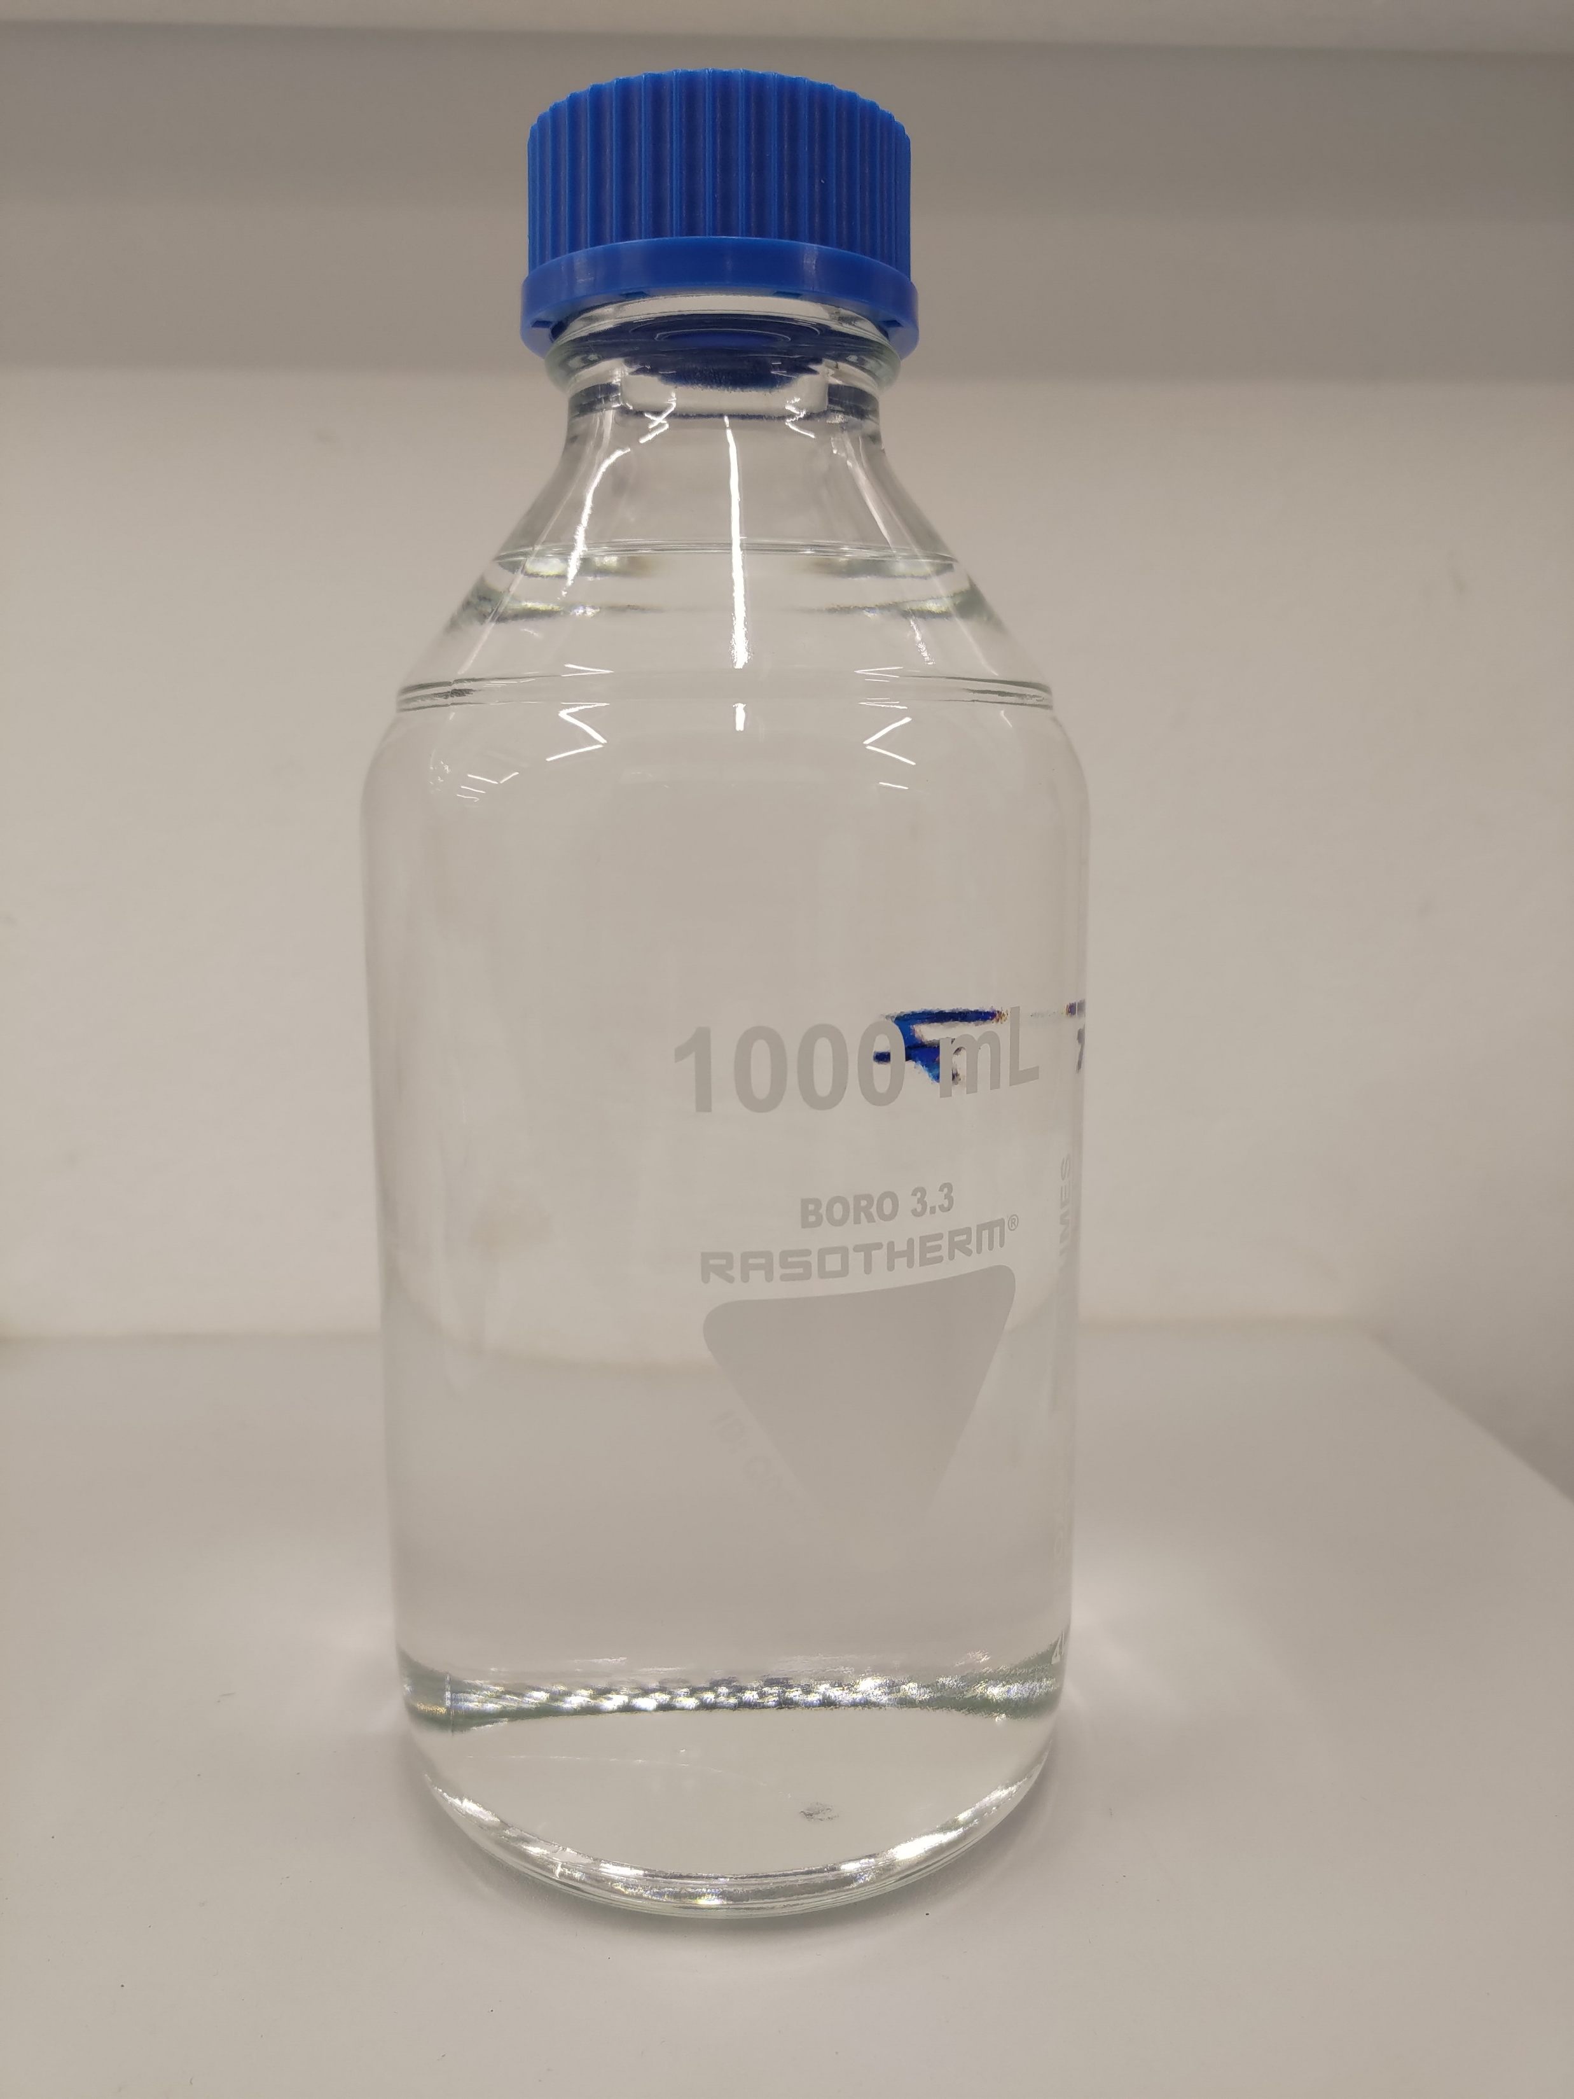

JET FUEL PROPERTIES ARE COMPLIANT WITH ASTM D7566
Over 95% of the product falls within the transportation fuels range.
>70% of the product can be upgraded into SAF, which reduces SAF and eSAF production cost to below 1,300$/tonne and $2,000/tonne, respectively, excluding CO2 credits.
The light fraction can serve as renewable naphtha or a gasoline blending component.
Property | ASTM D7566 requirements | NGV Results
Acidity, total mg KOH/g | <0.015 | 0.006
Distillation temperature, °C:
10 % recovered, temperature (T10) | <205 | 176.7
50 % recovered, temperature (T50) | Report | 205.6
90 % recovered, temperature (T90) | Report | 256.3
Final boiling point, temperature | <300 | 291.6
T90-T10, °C | >22 | 79.6
Distillation residue, percent | <1.5 | 1.2
Distillation loss, percent | <1.5 | <0.1
Flash point, °C | 38 | 48
Density at 15 °C, kg/m3 | 730-770 | 758.9
Freezing point, °C | <-40 | -49
Thermal Stability (2.5 h at control temperature)
Filter pressure drop, mm Hg | <25 | 0.0
Tube rating: VTR, VTR Color Code | <3 | 1
Hydrocarbon Composition
Cycloparaffins, mass % | <15 | 0.5
Aromatics, mass % | <0.5 | 0.2
Paraffins, mass % | Report | >99
Carbon and Hydrogen, mass % | >99.5 | 99.7
According to laboratory tests completed in February 2025

Slide 10
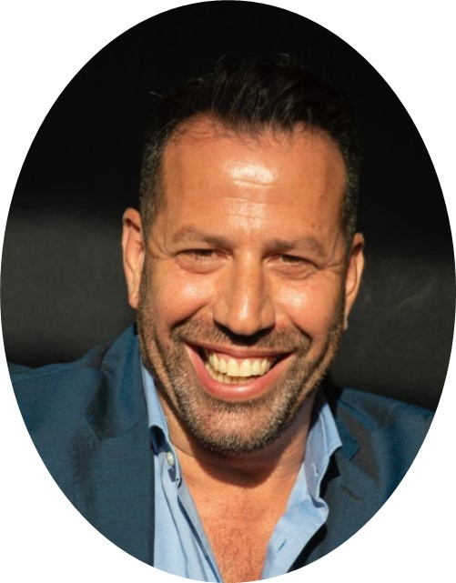

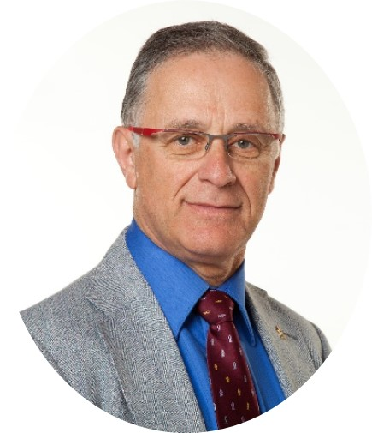
NGV LEADERSHIP
Arie Sussely
Tomy Hos
Prof. Moti Herskowitz
CEO & Co-founder
CTO &Co-founder
Senior advisor &Co-founder
Entrepreneur. Former senior executive in the public sector
EMBA graduate from Northwestern University Kellogg Business School of Management
Inventor of NGV. Holds MSc in Engineering, with over 10 years of experience in developing renewable processes
Highly knowledgeable in the field of renewable fuels
Inventor of NGV. Researcher with over 40 years of expertise in advanced materials, heterogeneous catalysis, and reaction engineering
Has published over 160 papers and 27 patents

Slide 11
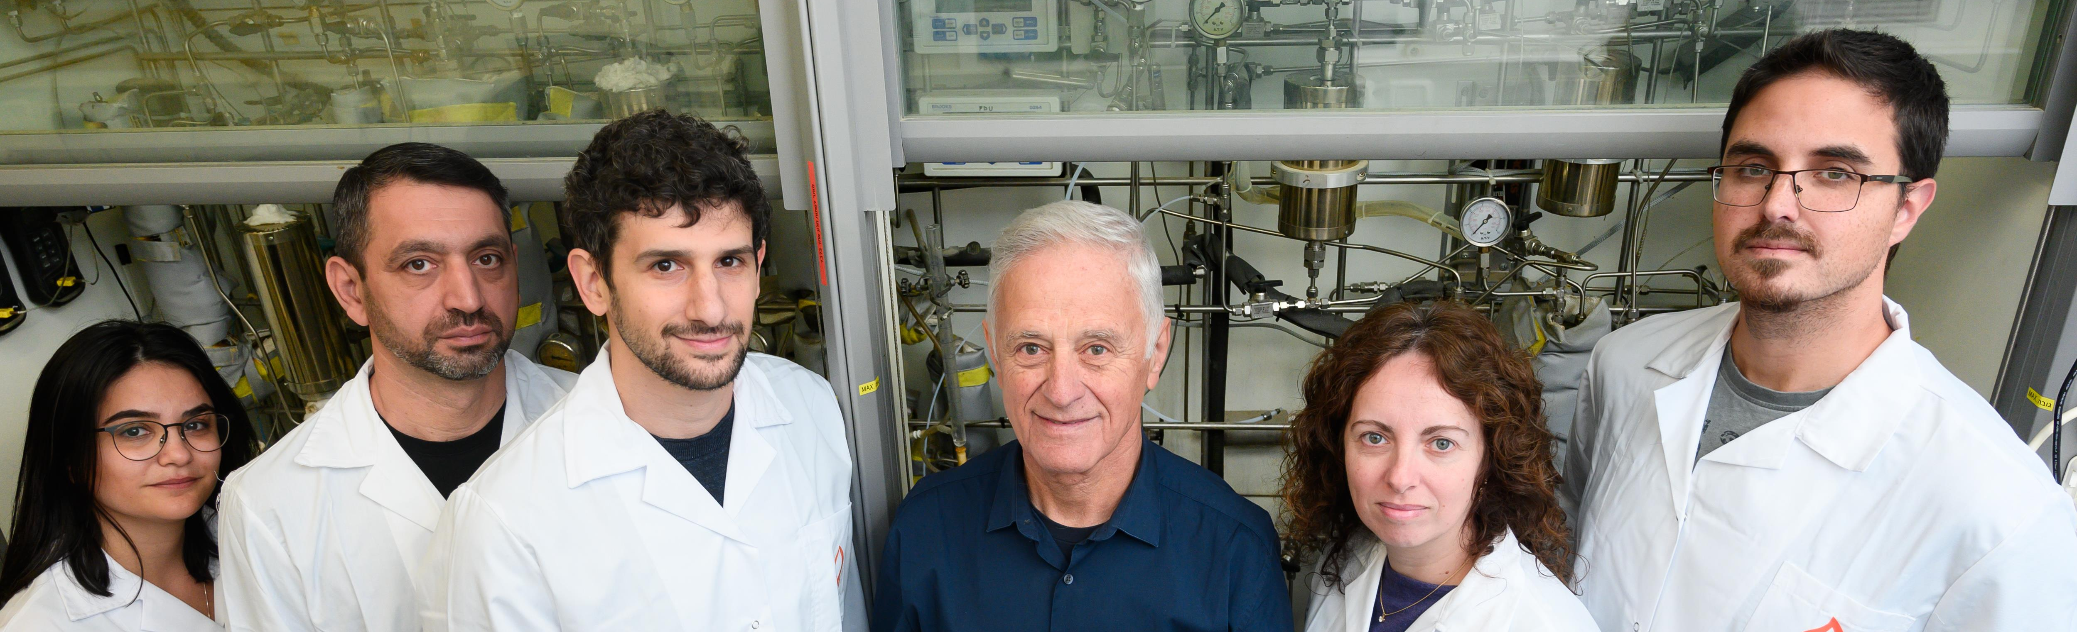
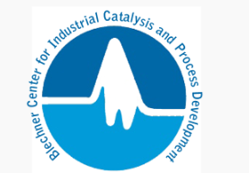

THE RESEARCH TEAM
The technology is the result of more than 10 years of R&D, with the team combining over 100 years of academic and industrial experience in core technologies, gained through collaborations with leading companies in the fuels sector. Its expertise in advanced materials, renewable fuels, and catalytic processes has led to numerous scientific publications, patents, and commercial applications

Slide 12
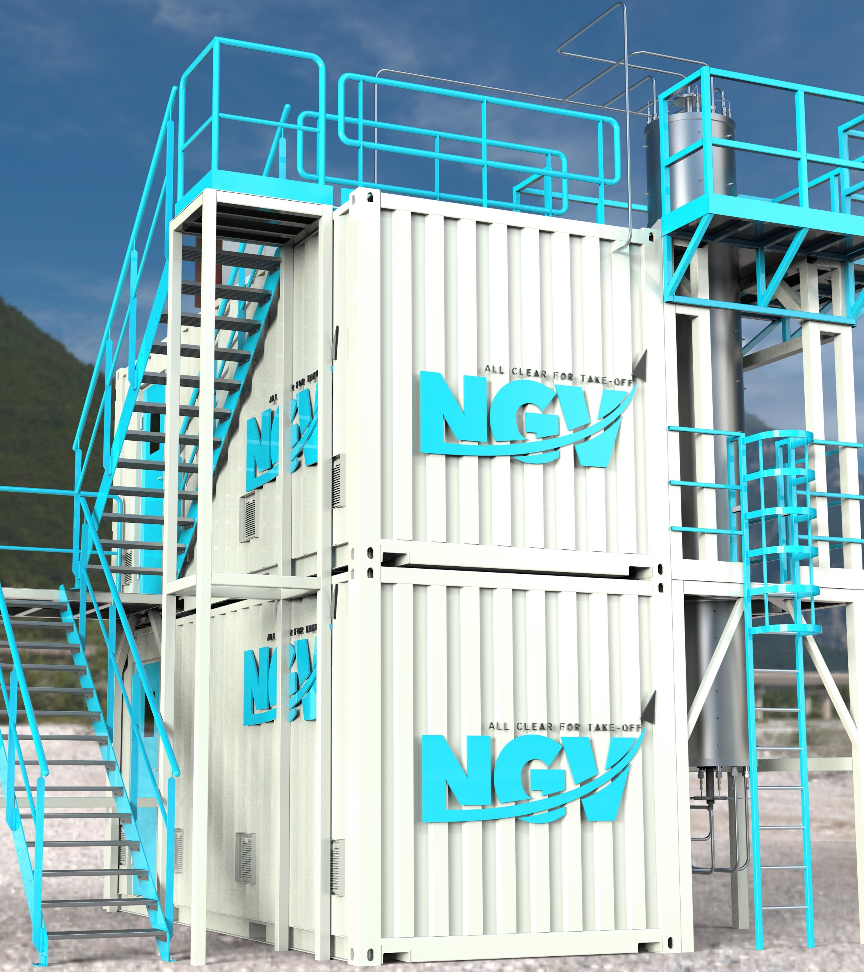
PILOT PLANT FOR SAF PRODUCTION
A pilot plant for producing renewable fuels and naphtha is expected to commence by the end of 2025.
The pilot unit is designed to process various types of feedstocks (primary Biomass residues and CO₂) for the production of sustainable products, mainly SAF (>50 liters per day).
The pilot will be operated for >1 year (end of 2026) and will provide essential information for successful scale-up.

Slide 13
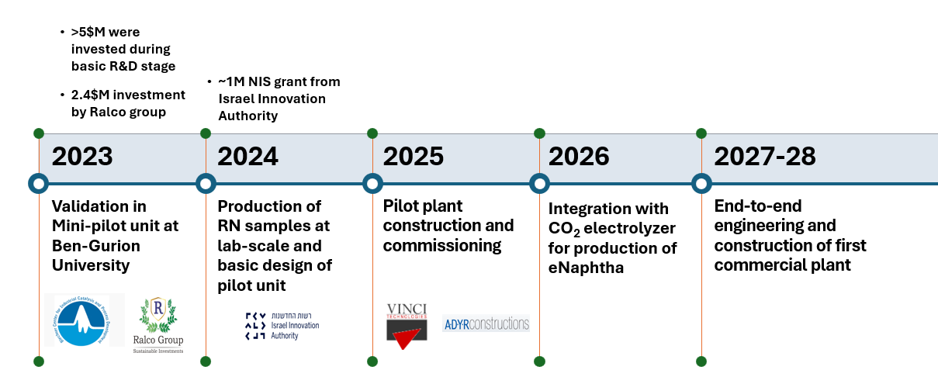
NGV ROADMAP
INTRO DECK

Slide 14
