Slide 1



EUREKA – Eurogia 2030
UK Scope & Eligibility

Slide 2
UK Scope & Eligibility
Innovate UK is a member country of the Eureka network, the world’s largest public network for international cooperation in R&D&I, present in 48 countries.
Innovate UK has always been an active member of Eureka and we see participation in the funding streams, that Eureka provides, as a valuable tool to help UK organisations scale up their approach to international collaboration.
The theme of Global Opportunities is one of our key themes set out in our Plan for Action and is all about inspiring, involving and investing. Our plan also ties in with the UK’s Innovation Strategy as set out by the Department of Business, Energy and Industrial Strategy

Slide 3
UK Scope & Eligibility
Your project
UK applicants can apply for total grant of up to £500,000 for each project.
All types of UK registered organisations can apply for funding.
Your project can:
Earliest start by TBC
Expected duration 12 – 36 months
Your project must be collaborative.
If your project’s duration falls outside of our eligibility criteria, you must provide justification by email to support@innovateuk.ukri.org at least 10 working days before the competition closes. We will decide whether to approve your request.
Further guidance

Slide 4
UK Scope & Eligibility
Funding
We have allocated up to £4,000,000 to fund innovation projects in this call.
For industrial research projects, you could get funding for your eligible project costs of:
up to 70% if you are a small enterprise
up to 60% if you are a medium enterprise
up to 50% if you are a large enterprise
UK registered research organisations in your consortium can share up to 30% of the UK total eligible UK business project costs. If your consortium contains more than one UK research organisation, this maximum will be shared between them.
Of that 30% you could get funding for your eligible project costs of up to:
80% of full economic costs (FEC) if you are a Je-s registered institution such as an academic.
Subcontracting is limited to 20% of UK costs.

Slide 5
UK Process
Project Outline (PO) or Full Project Proposal (FPP) Application submitted into Call 28
PO evaluated and if recommended submits Full Project Proposal (FPP) into Call 29, which goes through the same process of evaluation as the PO stage.
Innovate UK will hold a consensus meeting for those projects that have been labelled for Calls 27 & 28 and make a decision on those projects we will fund.
Those projects who we will fund will be sent a private link to complete an Innovation Funding Service (IFS) application.
The IFS application is reviewed and moves into project setup (90 days) after which a Grant Offer Letter (GOL) is issued.
UK partners sign the GOL and return it to Innovate UK with the project start date (once consortium is ready to start project activities).

Slide 6
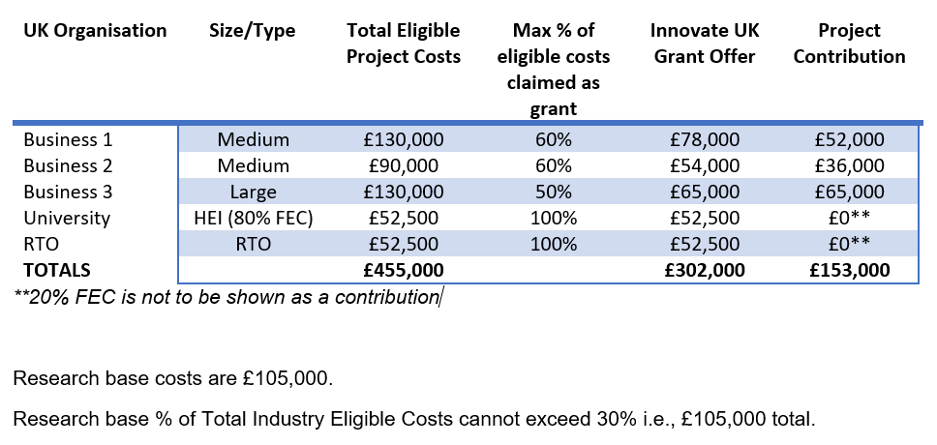
UK Scope & Eligibility
Costing Example

Slide 7
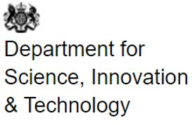
UK engagement in EUREKA
Contact Details:
eurekanpc@iuk.ukri.org

