Slide 1
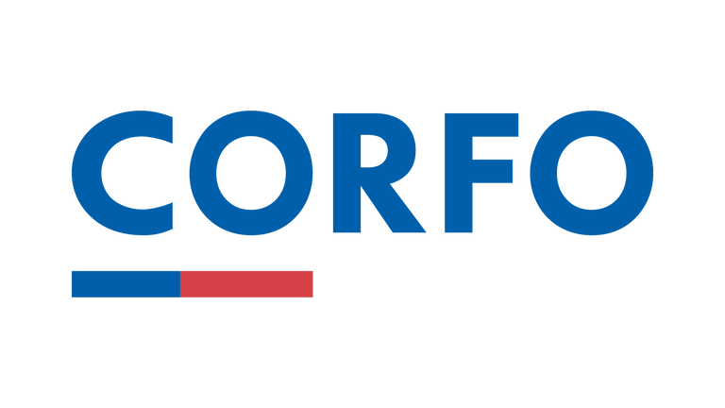


Chile’s funding requirements
February, 2025

Slide 2
What’s Corfo?

Slide 3

Chilean economic development agency that works daily to improve the competitiveness and the productive diversification of the country by encouraging investment, innovation and entrepreneurship.
Strategy:
1
2
3
Finance for
Development
Entrepreneurship, Innovation and Promotion
New Industrial
Policy

Slide 4




Promoting a model of Sustainable Productive Development
Towards a sustainable productive transformation of our country through innovative projects contributing to achieve the following challenges:
Resilience against
Climate
Change Crisis
Decarbonization
Productive
Transformation
At the Innovation Department of Corfo, we incentivize companies to perform R&D projects and innovations to empower national and regional ecosystem, enhancing productivity and competitiveness, within a context of the sustainable productive development.

Slide 5
International
Collaboration

Slide 6
International collaboration strategy
Promoting International Collaboration
  Corfo is leading an internationalization process of Chilean companies through R&D and innovation projects.
  We support companies looking for international collaboration to develop of goods, processes and services in highly competitive markets.
  Chilean companies can contribute to a highly sophisticated productive matrix through international collaboration.
Benefits for the members of Eureka Network:
  Access to know how and technology not available in Chile.
  Increase their competitiveness in highly innovative markets.
  Commercial validation with clients, suppliers and investors.

Slide 7








Corfo at Eureka
NP Calls:
  Austria, Belgium, France and Spain, open to all industrial sectors (2022)
  Belgium, France and Spain in Green Technologies (2023)
  Lightweighting Technologies (2024)
  The Eureka Resilience (2024)
  Canada Semianual Network Project Call (2025)
Network
Projects
Globalstars Call 2024 with Uruguay:
  Clean hydrogen and derivative technologies
Globalstars
Clusters

Slide 8
Application procedure and funding requirements

Slide 9


Application procedure
PHASE I: INTERNATIONAL
APPLICATIONS THROUGH
EUREKA CLUSTER PLATFORM
PHASE II:
NATIONAL FUNDING APPLICATION & FULL PROJECT PROPOSAL
ALTA TECNOLOGÍA EUREKA
1
2
3
4
5
Launch of the call.
Please contact Corfo to be fully advised over the application process. Contact us at difusioninnova@corfo.cl.
Phase 1
closes
International evaluation results. Selected applicants will be allowed to move on to phase 2 and apply to national funding
National application process begins through Alta Tecnología Eureka instrument
National funding decision and activation of next stages
Matchmaking

Slide 10
Funding
available to participate in Eurogia Cluster
Matching grant
All interested Chilean companies, who have successfully declared admissible in the international phase, will be allowed to apply to the financial instrument, Alta Tecnología Eureka.
Goal
Supporting the collaborative R&D projects between Chilean companies and companies from Eureka Countries, which are seeking for the development of deep R&D projects with a technological uncertainty.
With this grant, we want to stimulate international cooperation to provide technological solutions through R&D projects.
Beneficiary
Constituted legal entity in Chile.
3 years old (as registered in the tax office)
Proven record of sales within the last 3 years prior to application (no need to be every month).
Projects can include associates.
Grant
Until 1,010,000 € (aprox).
Extra 10% funding for female-led companies.
Co-funding by company size:
Small company: 70%
Medium company: 55%
Large company: 40%

Slide 11
Contacts
General inquiries
difusioninnova@corfo.cl
Eureka National Project Coordinator
Jocelyn Olivari
jocelyn.olivari@corfo.cl
Eureka Project Officer
Cristián Casanueva B.
cristian.casanueva@corfo.cl

Slide 12
Chile’s funding requirements
February, 2025

