Slide 1

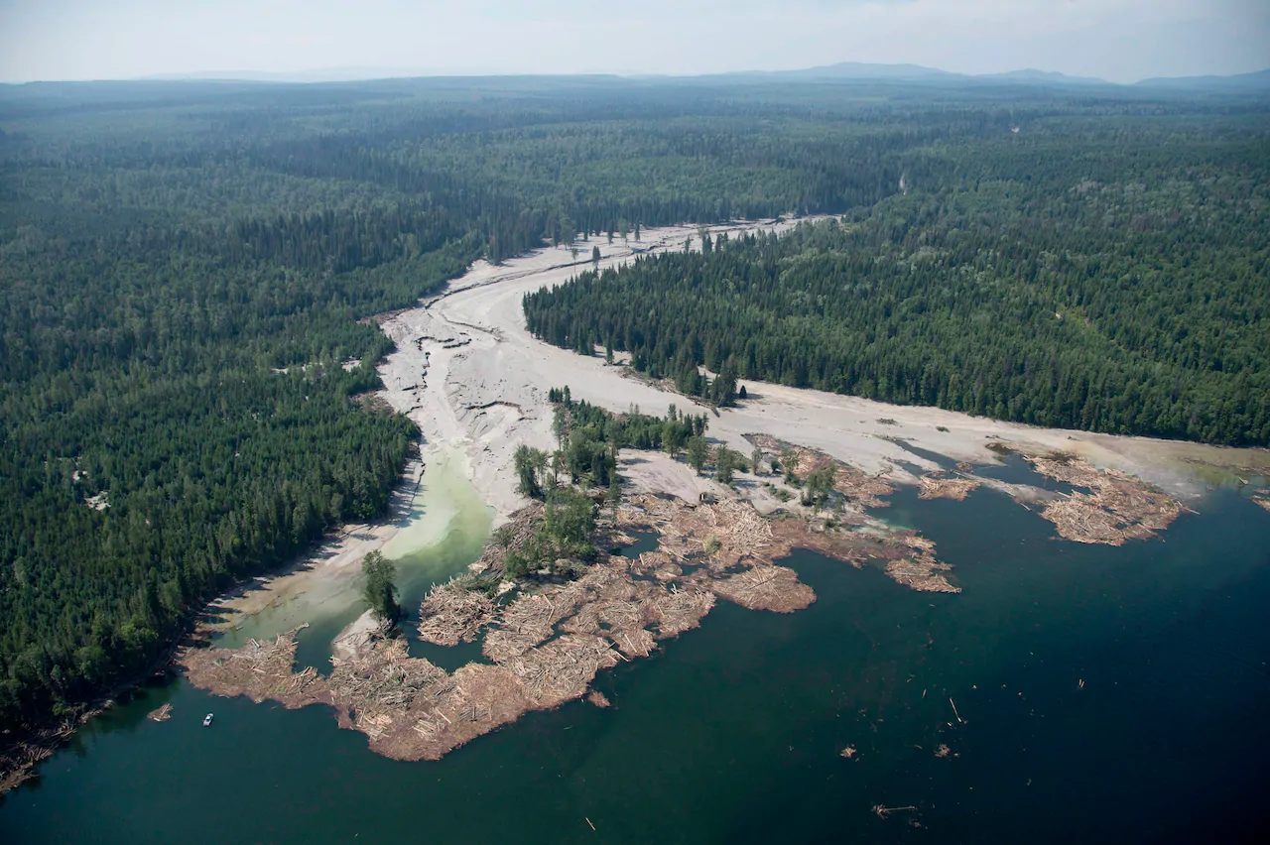




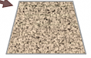
What to do with wastes?
Not Eco-friendly
1st: Store as is
Leaks and Pollutes
or
Not Economic
2nd: Process to store safer
Expenses for No Return
or
Economic
Eco-friendly
3rd Option?
What if, we can turn them into something valuable?
1
Notes:
Before we begin, here is a question as your food for thought: What do you do with wastes?
The 1st option is to store it as is. But it leaks and pollutes!
The 2nd option is to process it into safer form for storage. But it incurs expenses for no return.
What about a 3rd option? What if we can turn them into something valuable instead?

Slide 2



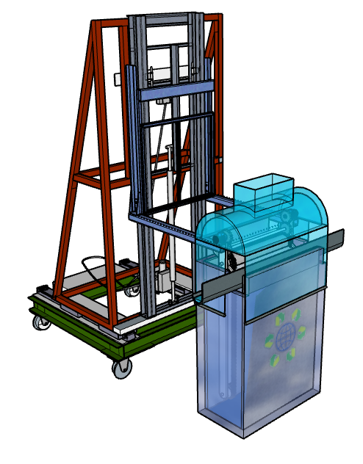

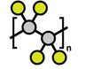
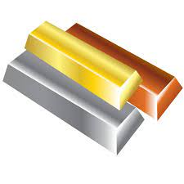



elerGreen ElectroWINNING:
Wastes into Valuable Products
by Renewable Electricity
Hui Huang Hoe
(aka “Triple H”)
何慧煌
Chemical Wastes
Polymers
Metals
Low-cost Chemicals
elerGreen
Chemicals
2

Slide 3









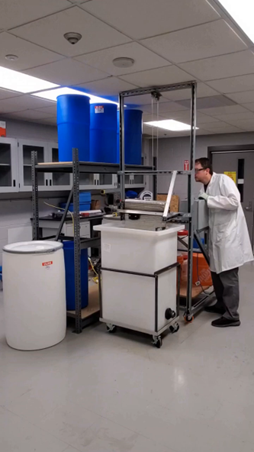


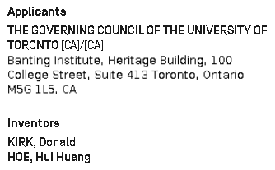

Qualifications
Born in Malaysia
Climate Change: Hot!
Talent: Chemistry and Physics
Olympiads
Come Canada for UofT Chem Eng:
Topped the Class
and others
Business Certificates +
Cleantech Research: UofT Patented
Founded elerGreen:
Patents, Business, Projects, Collaborations
3
Notes:
Describe who you are and who the people who support you are. Investors, bankers, even stakeholders, want to know who does (or is going to) manage this company. This section gives credibility to your plan. Do not restrict yourself to shareholders; consider advisors as well.

Slide 4
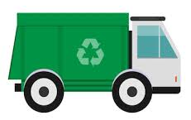





Overview
Waste Management
Economic
Eco-friendly
Reactor
Chemical Wastes
elerGreen
Polymers
Metals
Low-cost Chemicals
Feedstocks
Renewable Electricity
4

Slide 5

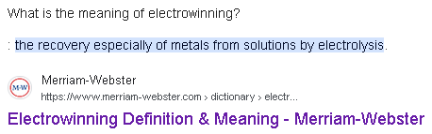


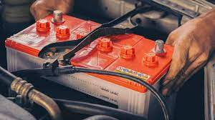



ElectroWINNING
Conventional
Renewable
Electricity
Workers
Robots
+
-
Example: Toxic Lead Battery Wastes in Car
Electrodes
Polymers
Metals
Lead Pollutants
Wastes converted to solid products on electrode surface
Lose IQ
Wastes
Inefficient: Needs shut-down every 1-2 hours
Plastics block electricity as non-conductive
5
Notes:
Focus on the gap

Slide 6

elerGreen ElectroWINNING
Conventional
elerGreen
Renewable
Electricity
Renewable
Electricity
Workers
Robots
+
-
+
-
Electrodes
Polymers
Polymers
Metals
Metals
Metals forms on electrode surface
Electrode movement harvests solid continuously
Wastes
Gap: Inefficient for metals
Doesn’t work for plastics, chemicals, etc
Automated: Much more efficient for metals
Works for plastics, petrochemicals, etc
Notes:
Declutter, focus on main differentiation: what are the main 1-2 points that make the technology better? Make them easy to see

Slide 7






Value and Impacts
Starting Market: Battery and Mining Companies
Fines/Losses
Mount Polley,
Canada
Enforcement
Metals
Polymers
Carbon Tax
Profitability
Affected
Chemicals
Toxic Waste
elerGreen
Affordable
Clean Solutions
Easy to Use
Incentives
Recognitions
7
Notes:
Give example, like specific company?
Take industry that can benefit the most and look at the top 3 average of pollution and show reduction
If no number, give range, like 80% energy and waste reduction

Slide 8


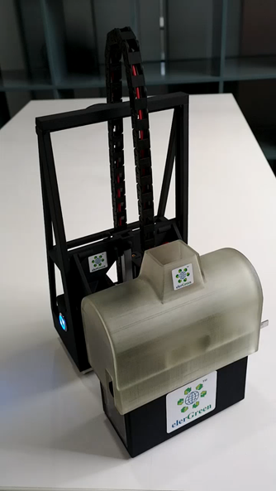





Tractions
Want one?
Support elerGreen ElectroWINNING
Supports $1.15 million Scaleup
Plant Tender
Patent
>111 Countries
(94% of 1367 billion/year globally)
Lab-Scale
Reactor
Full-Scale Reactor in Process Plant
(1 m³ waste conversion/day)
8
Notes:
1 ton/day, try to compare with context

Slide 9
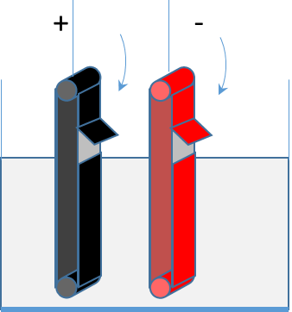


Climate Action
-
Obtain:
$H_{2}$ from
Water Splitting
Obtain:
Fuels/Alcohols
Renewable Electricity
Replaces Fossil Fuel
+
Consume:
$CO_{2}$ or
its derivatives
Obtain:
Metals for Batteries/
Compostable Polymers for Packaging
Efficiency: Energy and Cost
9
Notes:
In terms of clean energy, the electrochemical process by itself is more energy efficient than chemical process, while the continuous nature of the reactor further improves such efficiency.
The other clean energy aspects lies with its compatibility with renewable electricity, contrary to conventional chemical processes that uses fossil fuels combustion. Such replacement of fossil fuels greatly reduces carbon footprint, besides making the air cleaner.
Finally, the electrolysis produces some hydrogen out of water splitting, where the cap, the gas removal device is designed to remove and recover. The hydrogen can be burned directly to produce heat, used in fuel cells, or stored. It is nevertheless safe to discharge the hydrogen for being non-toxic, as long you dilute with air to below 5% concentration so that it is not flammable.

Slide 10



What to do with wastes?
Support
elerGreen ElectroWINNING
Want one?
1st: Store as is
or
2nd: Process to store safer
or
3rd Option?
elerGreen
Electrification Done Green
elerGreen.com
huihuang.hoe@elergreen.com
10
Notes:
Finally, resonating the starting question, this is what we do at elerGreen as the 3rd option, truly “Electrification Done Green”.
Thank you for listening and I hope you can support in this exciting change with the prize. Any question?

