Slide 1


“Environmental and Energy Transition Changemaker”
thanks to technologies developed and implemented enabling groundbreaking versatile solutions at the service of people and the environment

Slide 2



®
We clean the air we all breathe creating better places to live and work. Everywhere.
www.iscleanair.com

Slide 3



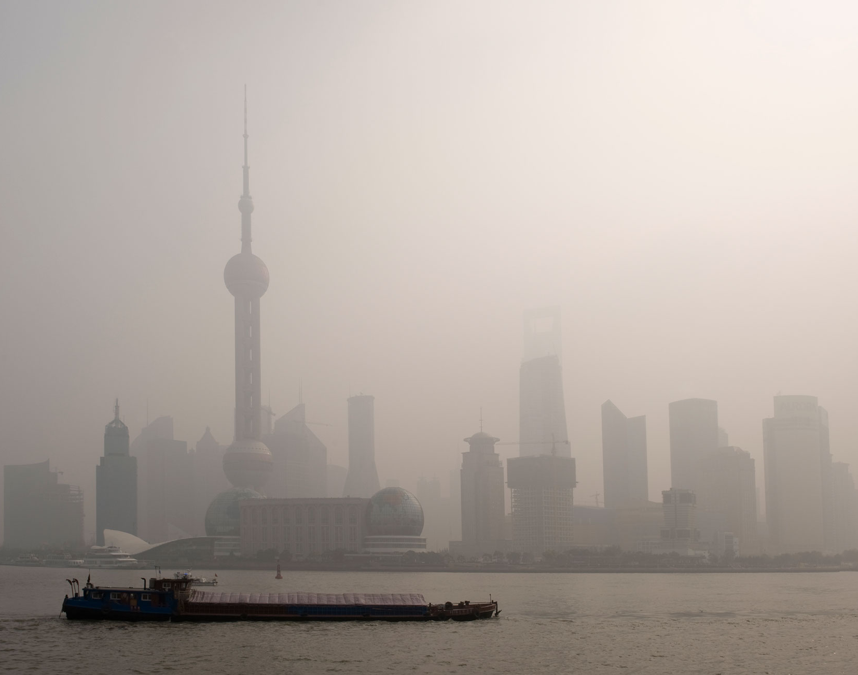
Emissions create significant and wide implications and impacts
over
92%
OF THE WORLD’S POPULATION BREATHS UNSAFE AIR
(indoor & outdoor)
Every year, around
8+ MILLION
PREMATURE
DEATHS
are due to exposure to both
OUTDOOR and INDOOR air pollution
56%
LIVE IN URBAN AREAS
(projected 68 -70% by 2050)
80%
to
90%
TIME IS SPENT INDOOR
$5
Trillion
EQUIVALENT YEARLY COSTS
(Premature death, diseases, severe events implications, and productivity losses)
Source: OECD and WHO, 2015 - 2022
EVERYONE OF US TAKES OVER THAN 20.000 BREATHS A DAY, MAINLY INDOOR

Slide 4




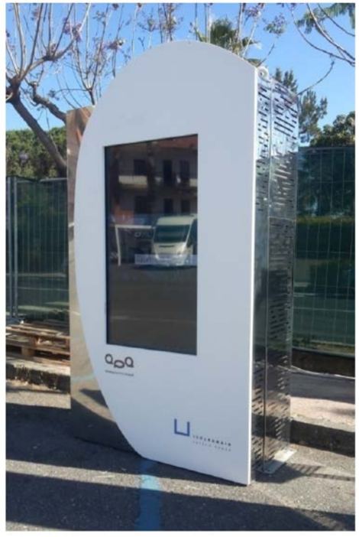
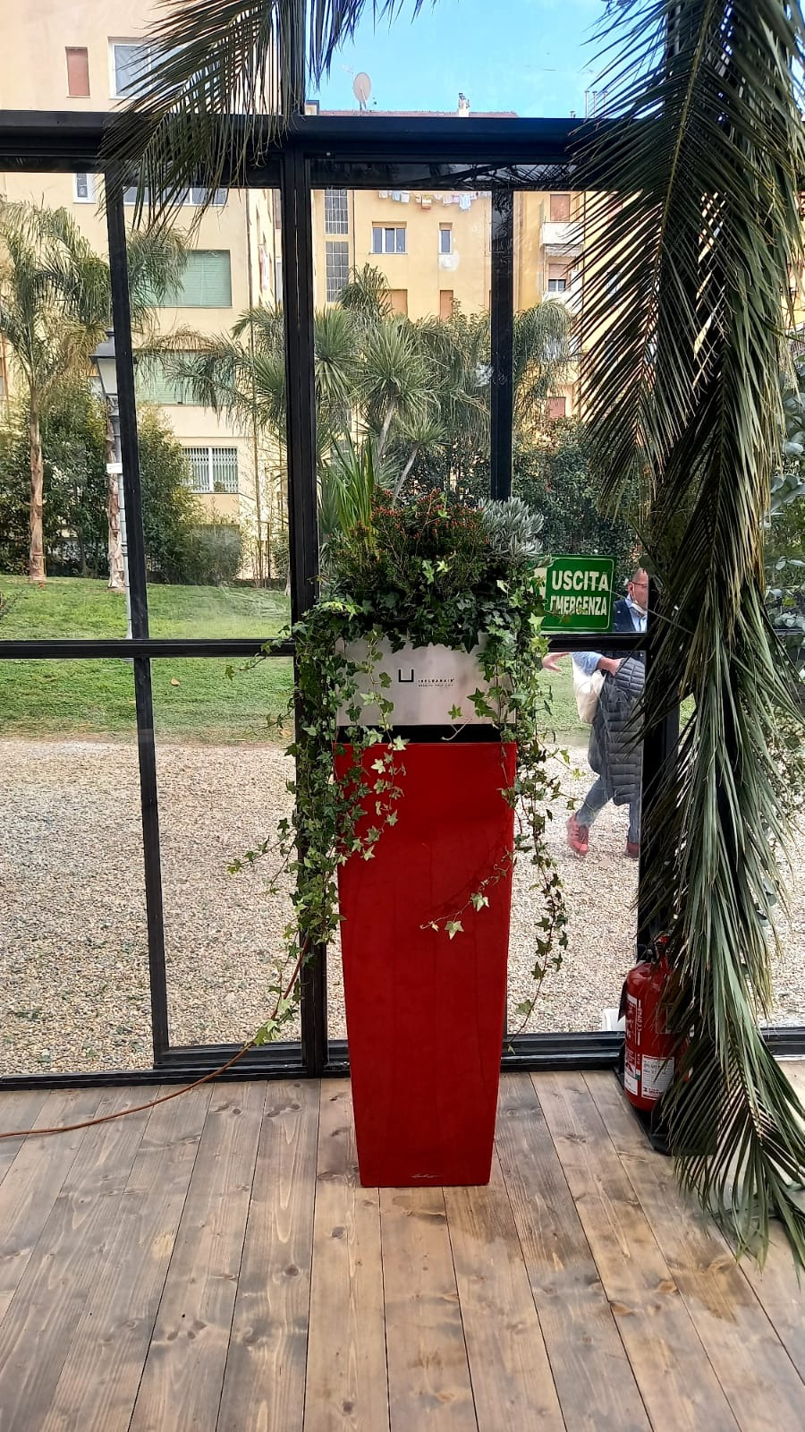
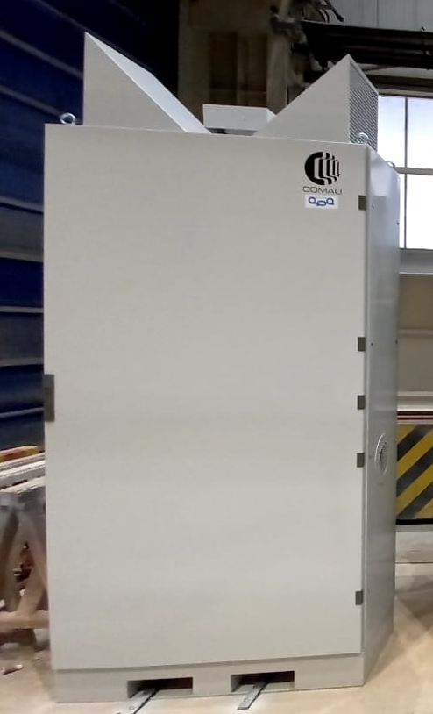
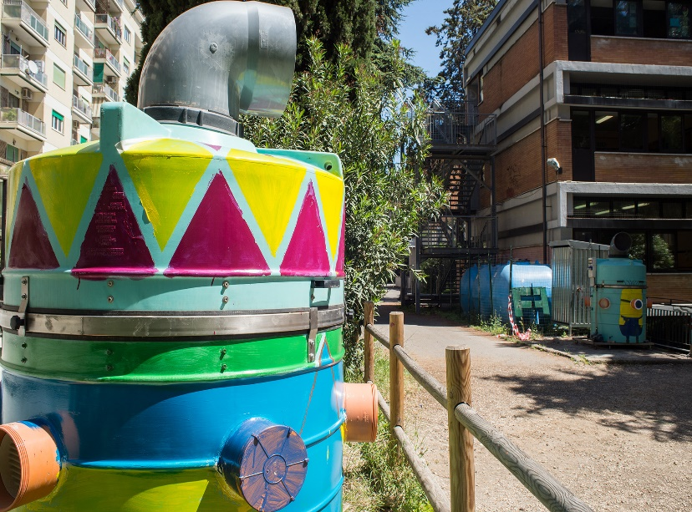


NATURE-BASED solution: AIR POLLUTION ABATEMENT (APA) SYSTEM
OPERATING INDOOR & OUTDOOR
CERTIFIED - MEDICAL DEVICE (CLASS 1 EC)
DECARBONISATION TECHNOLOGY
APA Totem/Panel
(4.000m³/h)
APA Large
Flower pot
(2.000m³/h)
(500m³/h)
4

Slide 5
APA SOLUTIONS ARE BORN TO BE APPLIED EVERYWHERE
APA technology received prominent recognition, many times, for its versatility and clear supremacy and leadership, within the ambient air cleaning/cleantech sector
APA is designed to operate excellently at the surface (ground) level where people live, work and breathe, with extreme scalability and modularity
The distributed strategy (patented) enables flexible installations of bespoke specific solutions and systems, in practice everywhere there are needs
APA special solutions can serve even the Air Treatment Units (HVAC/ATUs) in buildings and similar spaces, and also on some sensitive points of emission, improving the site’s performance and the related "Total Cost of Ownership" (TCO)
5

Slide 6
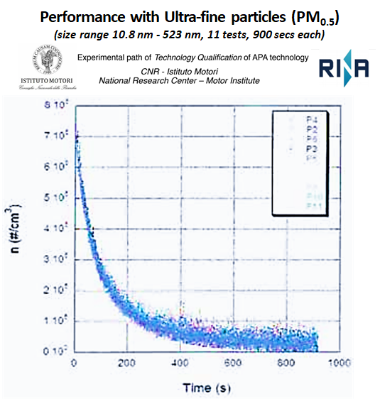
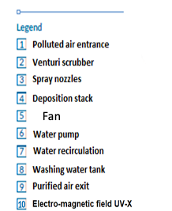
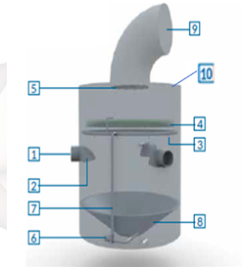

APA TECHNOLOGY STRUCTURE and key TECH CERTIFICATIONS
-95%
10 mins
APA technology effectively removes pollutants up to nano-particles, viruses and harmful microorganisms
from the ambient air we all breathe
6

Slide 7


TECHNOLOGY COMPARISONS
Types of technology | No filter | PM and chemicals |  | Running Indoor and costs Outdoor | Size | Purification power overtime
√ |  | √(1) Simultaneously | $ √ |  | S | Constant (never clogs)
HEPA filters
Only PM
$$$
M
50% in
1.000 hrs
Activated carbon
Only some chemicals
$$$
S/M
HVAC
Only PM
$$$$
XL
< 50%
in 1 year
Standard water showers
√
Mainly PM
$$
M/L
Constant
(1) The widest range of chemicals (NOx, SOx, VOCs, CO, NH3, …)
7

Slide 8
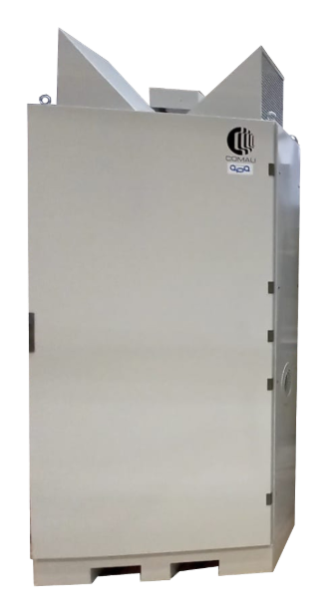


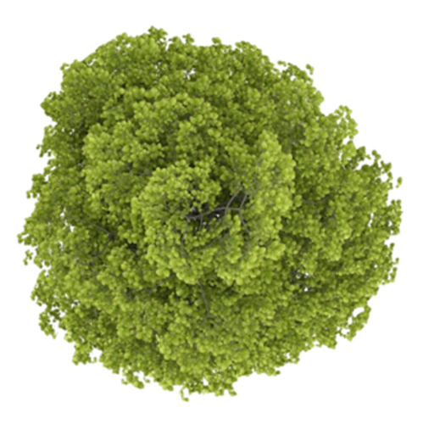
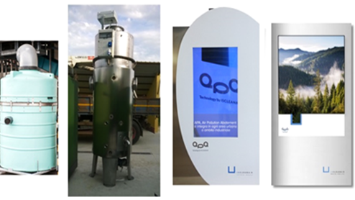
HOW APA COMPARE WITH NATURAL SOLUTIONS
Equivalence with Trees absorption power of one single APA Panel
NOx
CO₂
Water
PMs
1598
2967
500
125
=
3677⁺
Mature trees
APA-Panel
(up to 4000m³/h)
⁺Considering use of renewable energy
Calculations independently performed and validated by
APA System
Maximising the use of space
A Wood for every street
using the footprint of a Mature tree (we can fit 16 APA systems) delivering the benefits of several thousands trees
8

Slide 9





MANY PATENTS OF INVENTIONS GRANTED (additionally to a wide operational know – how)
Our patents already granted
TECH 002 – EP – ITA, UK, GER, FR, SPAIN (January 2021) TECH 002 and TECH 006 – U.S.A. (November 2017 and January 2019) TECH 002 and TECH 006 – CHINA (June 2018 and May 2019) TECH 002 and TECH 006 – INDIA (October 2019 and January 2021) TECH 001 and TECH 002 – MEXICO (April 2018 and July 2019) TECH 001, TECH 002, and TECH 006 – RUSSIA (July 2019, March 2018, and July 2019) TECH 006 – ITA (WO May 2014 and EPO October 2020) TECH 007 (utility model «Flower pot») - ITA (July 2018 )
Enhanced
EUROPEAN PATENT
Network of complex systems for the environmental purification and method for network control (WO 2014072921 A1) IT0001414214 - TECH 001
Method and system for the mix of gas and liquids to collect compounds (WO 2014072922 A1) IT0001414215 - TECH 002
Method and system for the collection-deposition and split of the chemical fluids (PCT/IB2014/064464) IT0001419728 - TECH 006
9

Slide 10


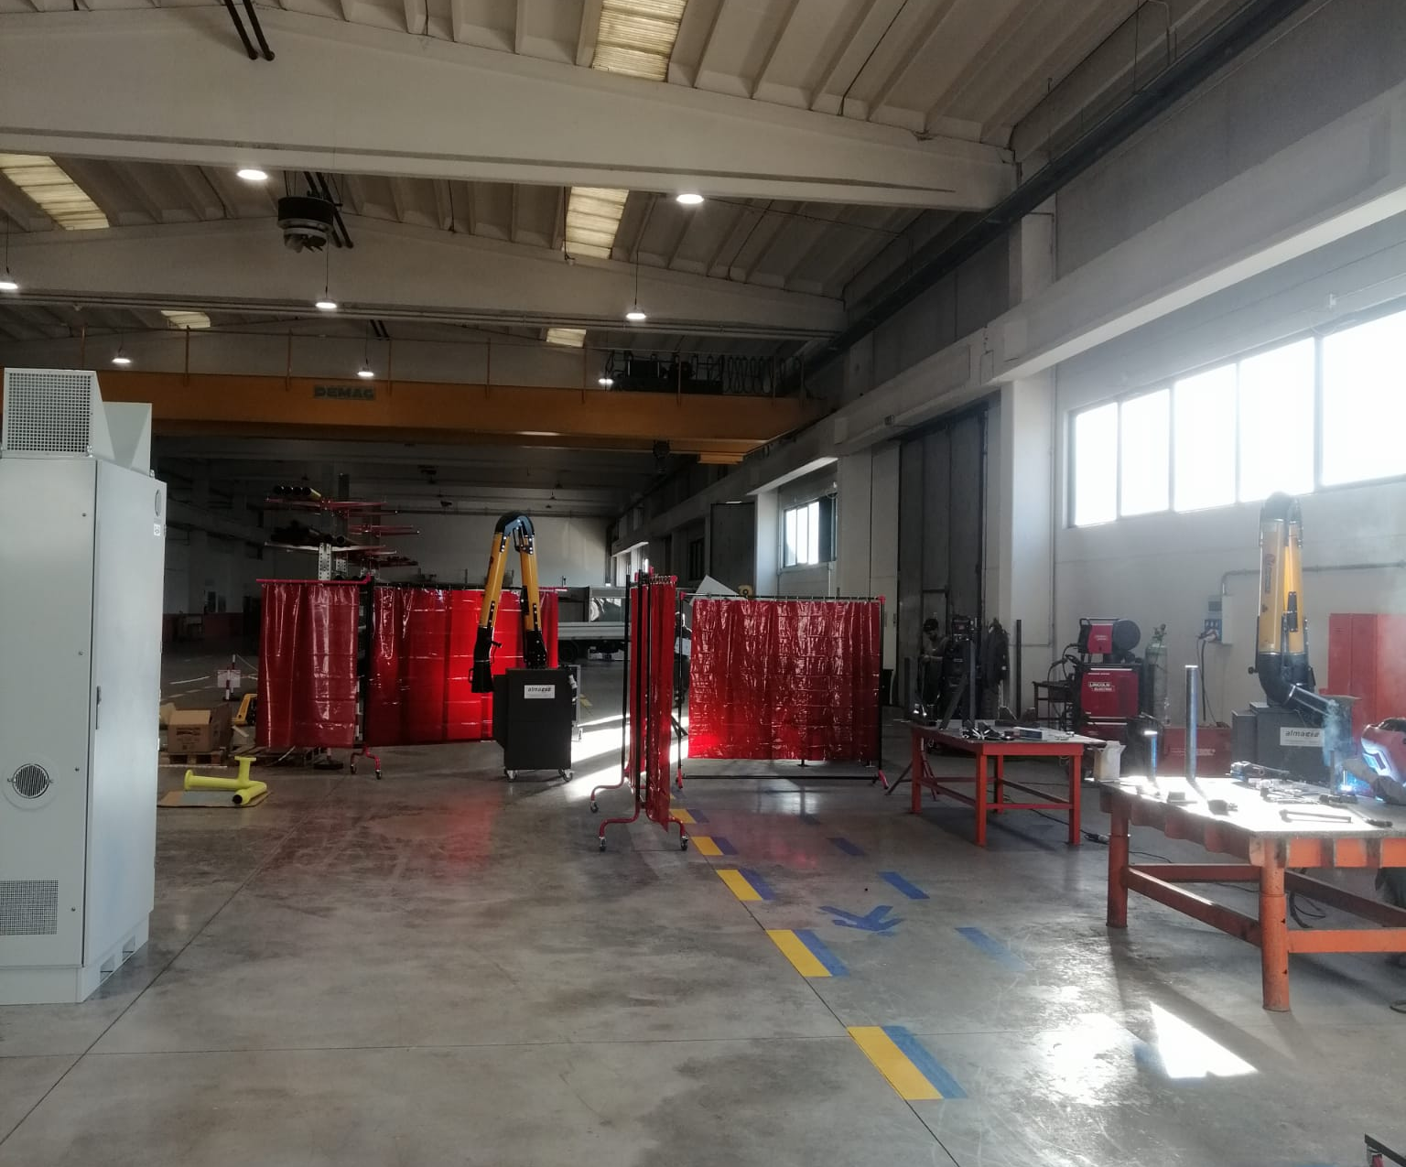
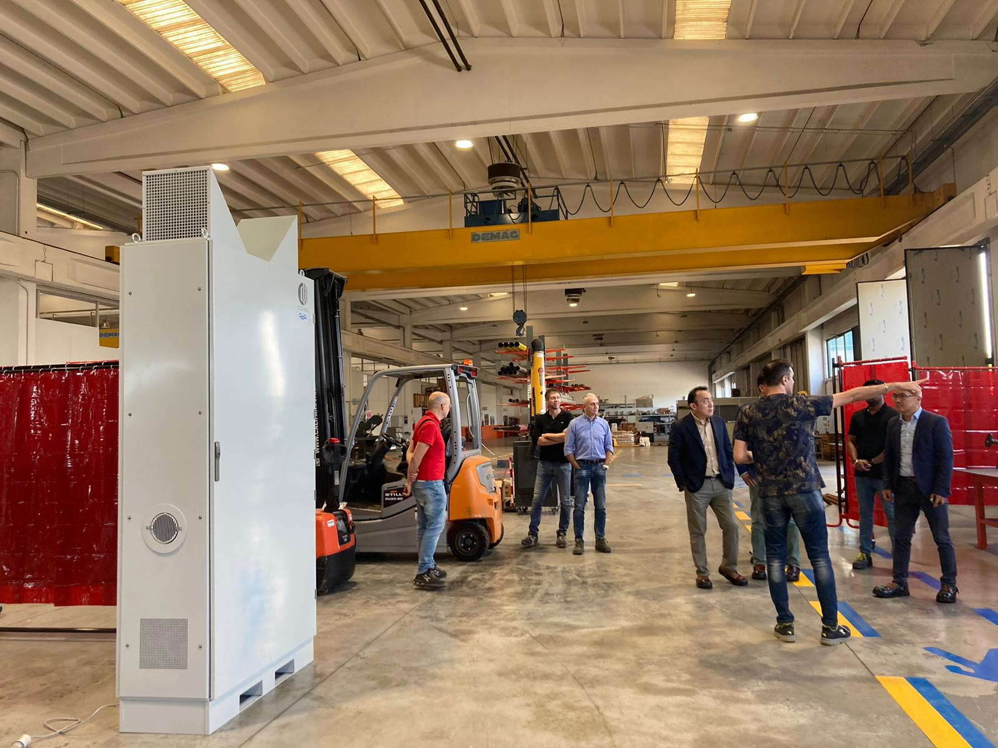
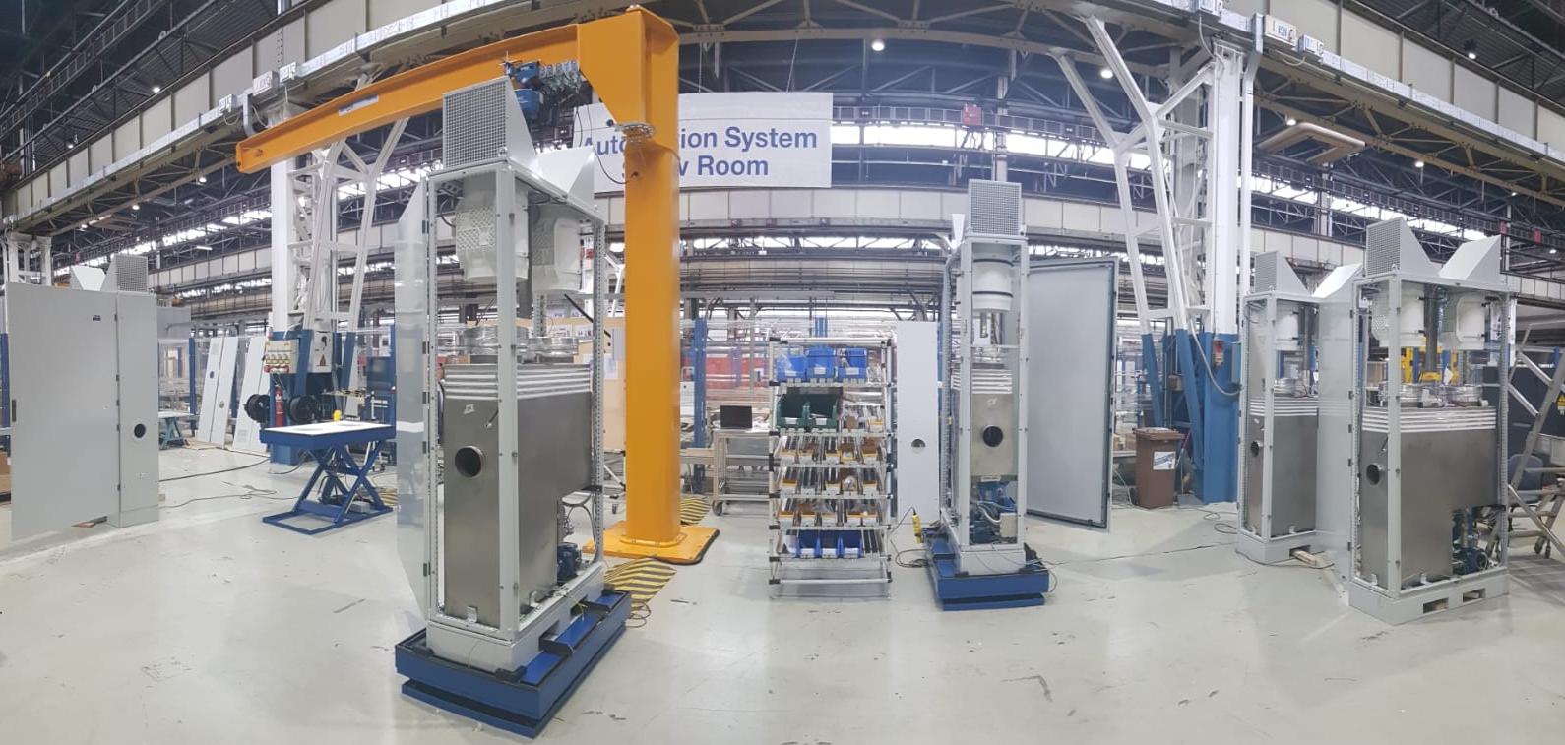








ASSET–BACKED AND SIGNIFICANT MILESTONES AND TRACTION
To date, several 100+ additional installations are planned, mainly in cooperation with large corporates, and business partners
18+ qualified peer recognitions
24+
awards
30+ main deployments, prominent projects and programs worldwide
2016 - 2023
Milan, 2020
Treviso and Padova,
2016 and 2018
UK, 2019
IT (HQ), 2015
Pisa, 2023
L’Aquila, 2017-2023
HK, 2019
4 deployments in Rome
OrMa 2023, Pisticci (MA)
3 main locations worldwide (2+ planned)
200+ APA
installations
totally
(As is and To Be)
15+ main
pipeline initiatives
9+
business and value-chain partners
Raised
€ 8,5 + M (Including 3 M Equity)
G7 Summit 2017, Taormina
Tel Aviv
HaHagana
Train Station
Operations, LABS, and PLANTS in Italy
(RM, CH, NA, and TO, care of COMESVIL and COMAU
within PURE and CLEAN AIR NET projects)
SOME PROMINENT OPEN INNOVATION INITIATIVES WITH LARGE CORPORATES
10

Slide 11

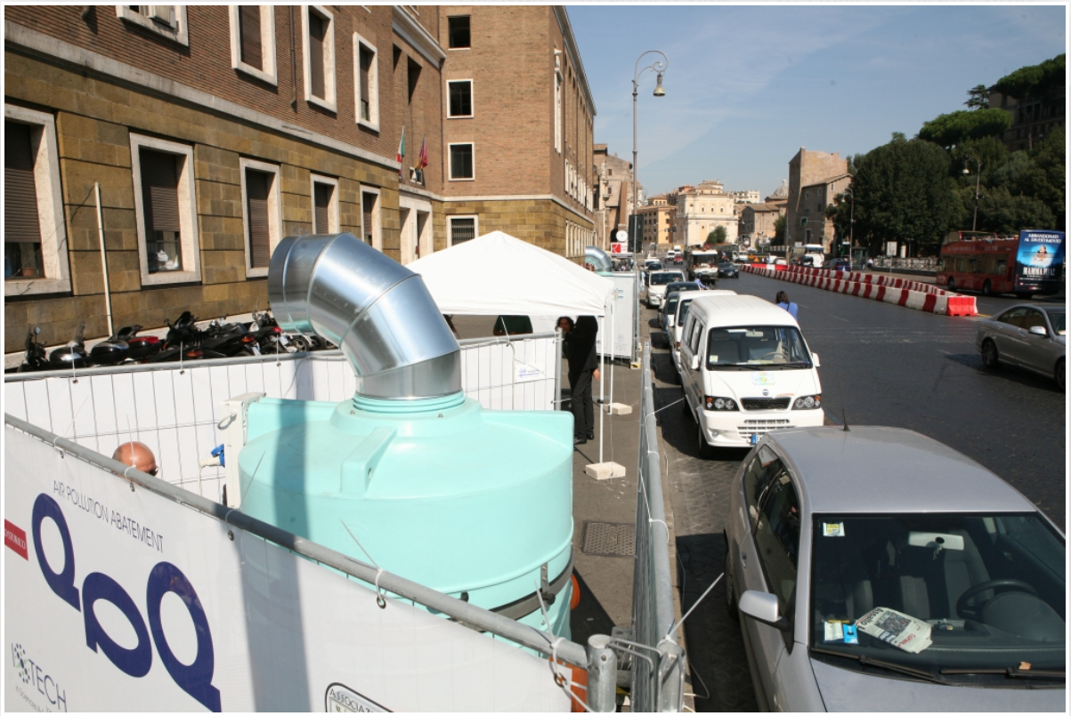

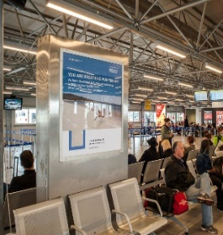
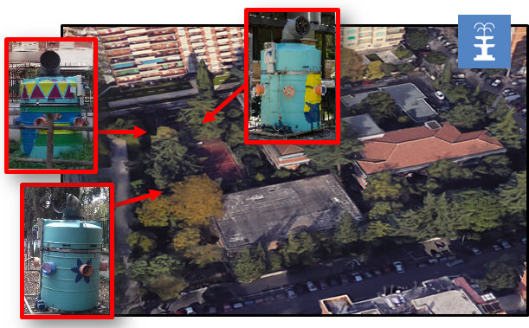
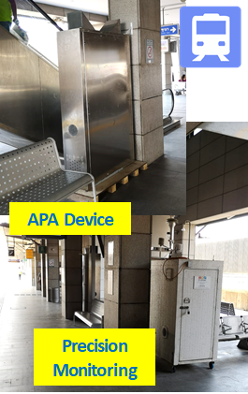
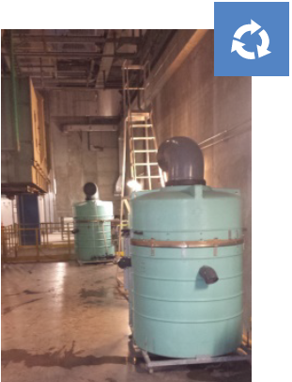
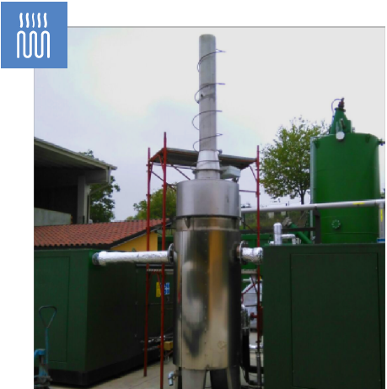
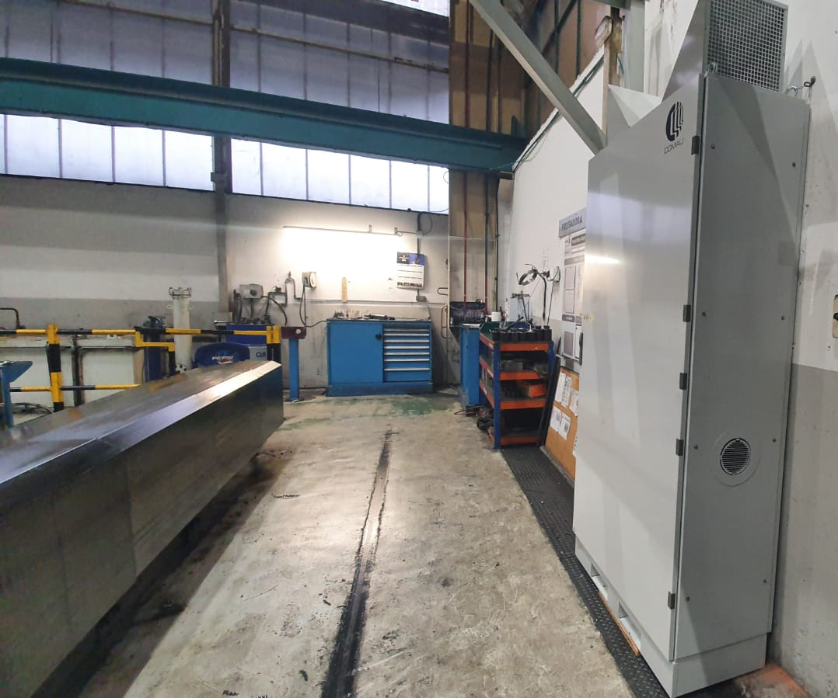
SOME REAL-WORLD DEPLOYMENTs: significant MEASURED RESULTS
APA efficacy is based on ambient air-cleaning cycles, without any detriment over time
Number of APA systems | Abatement rate verified | Initial Concentration |  | Measurement time
 |  | PM | NOx
3 | >70% >45% | 42μg/m³ (average) | 70μg/m³ (average) | 1 year
2 | >40% | confidential | confidential | 1 month
2 | >70% gate area >60% baggage | confidential | confidential | 7 weeks
3 | >55% (PM) >48% (NOx) | 45μg/m3 (average) | 85μg/m3 (average) | 6 weeks
2 | >50% (PM) >35% (NOx) | 33μg/m³ (average) | 400μg/m³ (average) | 4 weeks
1 | >99% (CO) >95% (PM) >90% (SOx) | confidential | confidential | 6 months
3 | >65% (PM) | confidential | confidential | 4 months
5 | >50% (PM) 40-60% (VOC) >60% (CH2O) | confidential | confidential | 6 weeks
URBAN AREA
(1st case)
URBAN AREA
(2nd case)
AIRPORT SPACES
POLLUTION-FREE SCHOOL
POLLUTION-FREE TRAIN STATION
BIOMASS
CO-GENERATION
INCINIRATOR
MILLING – PAINTING
11

Slide 12





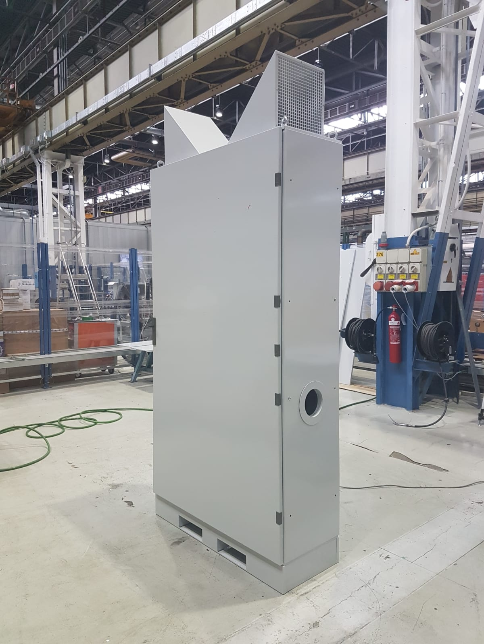


INDUSTRIALisation of APA-Panel (TRL9) – PURE Project
SPECIAL PROJECT – FUNDED BY THE PARTNERS AND THE
EIT MANUFACTURING (European Institute Of Innovation & Technology)
ISCLEANAIR has been engaged by COMAU (STELLANTIS GROUP, the very famous automotive Italian – French Group) and the below mentioned CONSORTIUM in order to launch some air cleaning piloting phases in the FAGOR’s plant in Spain.
industrialize at TRL 9 the APA Technology
cooperate under a new JV, OEM Agreements and Industrialization/commercialization developments phases directly by COMAU
creation of new APA air cleaning integrated solutions, also generating new IPRs in co-development, mainly at the service of the industrial sectors.
planned extension of cooperation on the other technologies owned by the founders, on the «in-car» solutions, «buildings» and «Smart Cities».
Measured results of APA Technology efficacy
>50% abatement of all PMs, during painting operations
>60% TVOC abatement observed for polishing and putty filling and >40% for painting
Abatement of light VOCs was also very efficient in all scenarios
Abatement of 64.4% in formaldehyde concentration and styrene Pollutant Detection inside water.
12

Slide 13
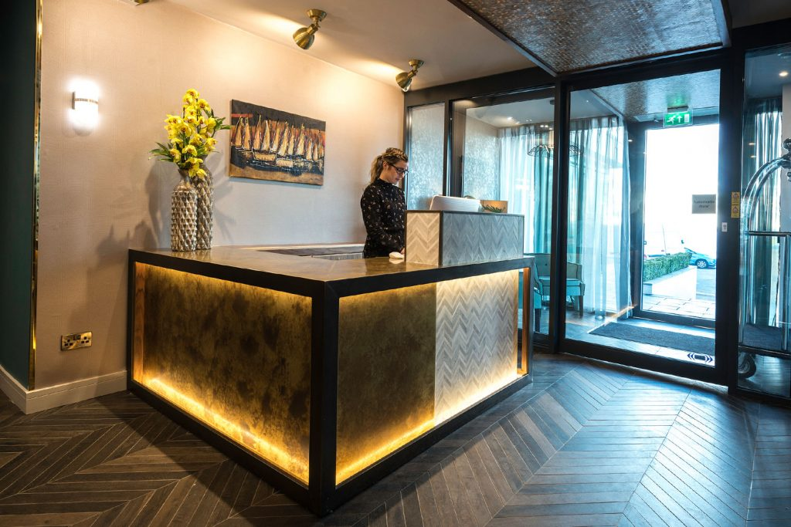
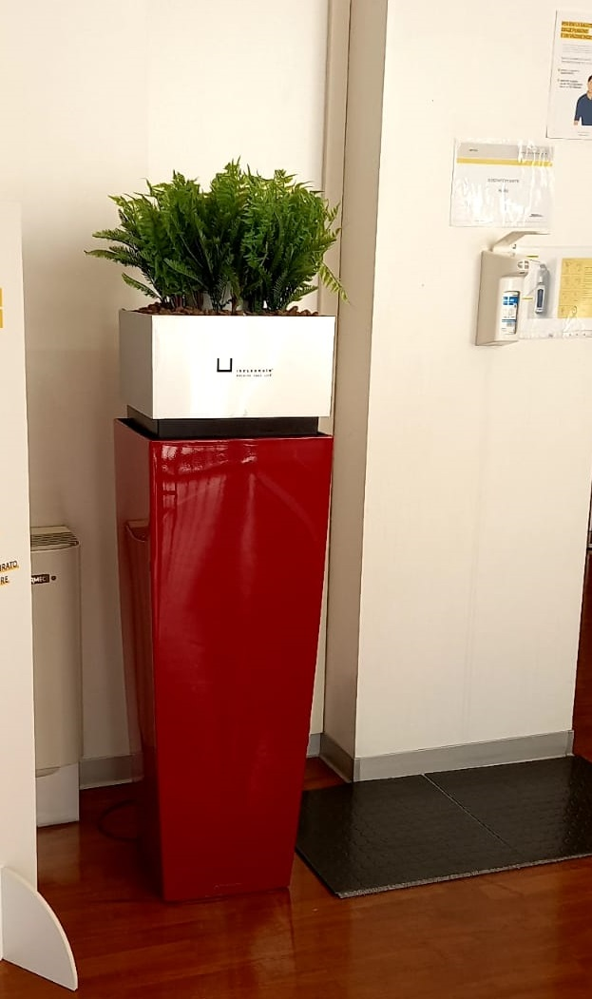
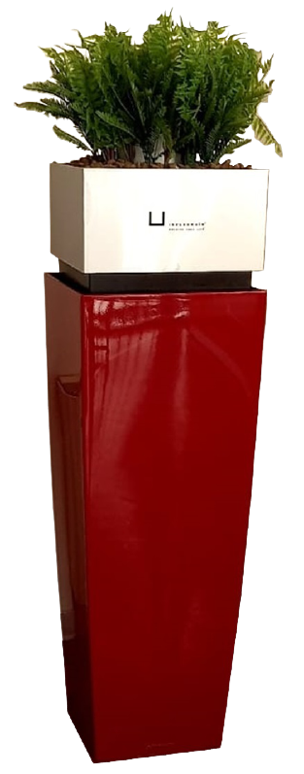
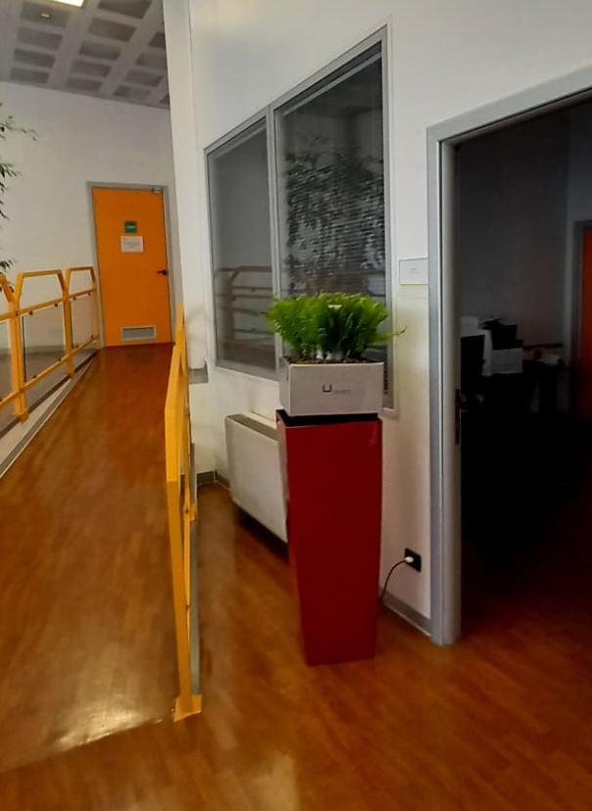
THE APA FLOWER POT - FOR INDOOR SPACES
For indoor spaces cleaning the air and reducing virus treats inside offices, shops and every kind of buildings
13

Slide 14
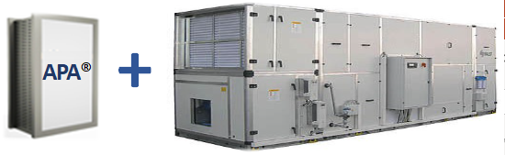
A SOLUTION FOR HVAC IN BUILDINGS – APA ADVANTAGES
NeZaPoB Project
“Near Zero Air Pollution Building”
Integrated system with HVAC
In our current Project NeZaPoB, we are integrating APA with HVAC system to optimise the benefit of Energy Savings and Reduced Equipment Management Costs, in addition to the air cleaning at the service of workers and the environment.
DEFINITELY SUPERIOR TO FILTER-BASED PRODUCTS
20% energy savings and related CO2
Up to additional 20% CO2 reduction
Re-use water produced by condensation
Up to 40% overall reduction of HVAC running costs
Pay back in only few year and benefits last for decades
14

Slide 15
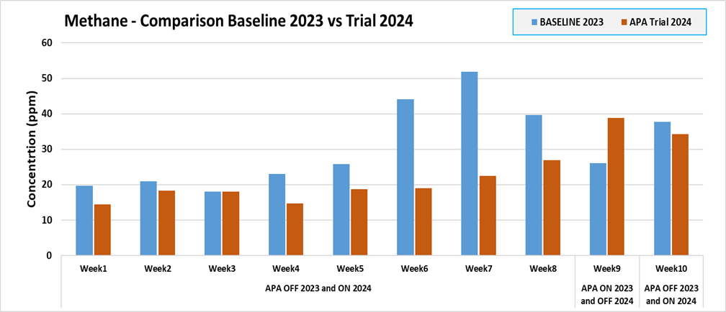
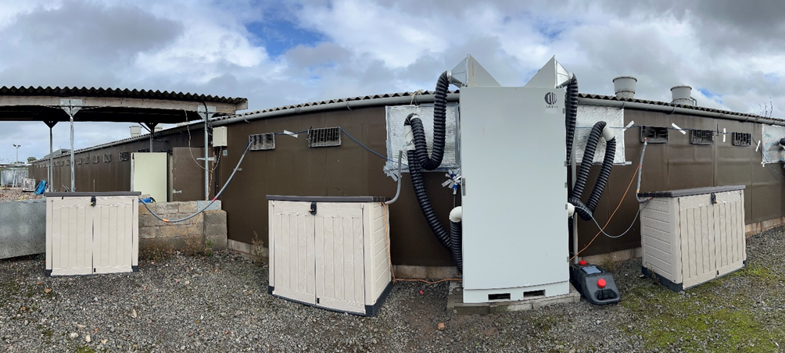
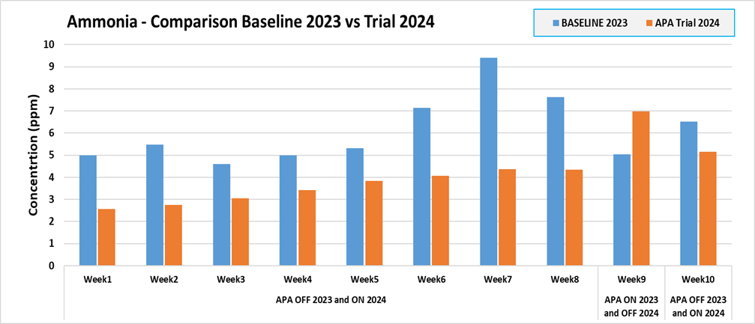
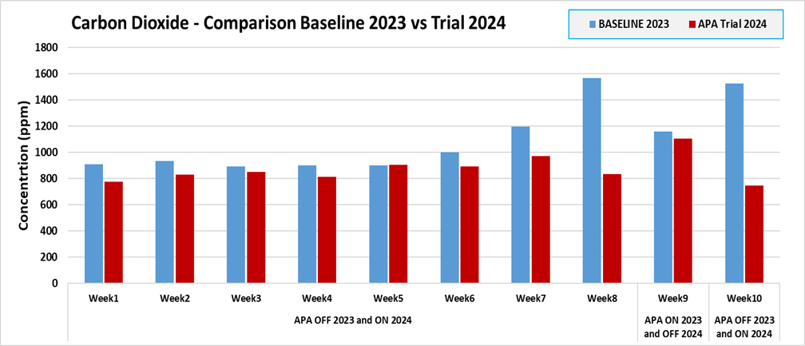
UK FARMING PILOT: FULL CYCLE RESULTS
2024 Demo Period: June – September
Full Pig Cycle (finisher unit) Abatement results
-40% Ammonia -34% Methane -22% CO2

Slide 16
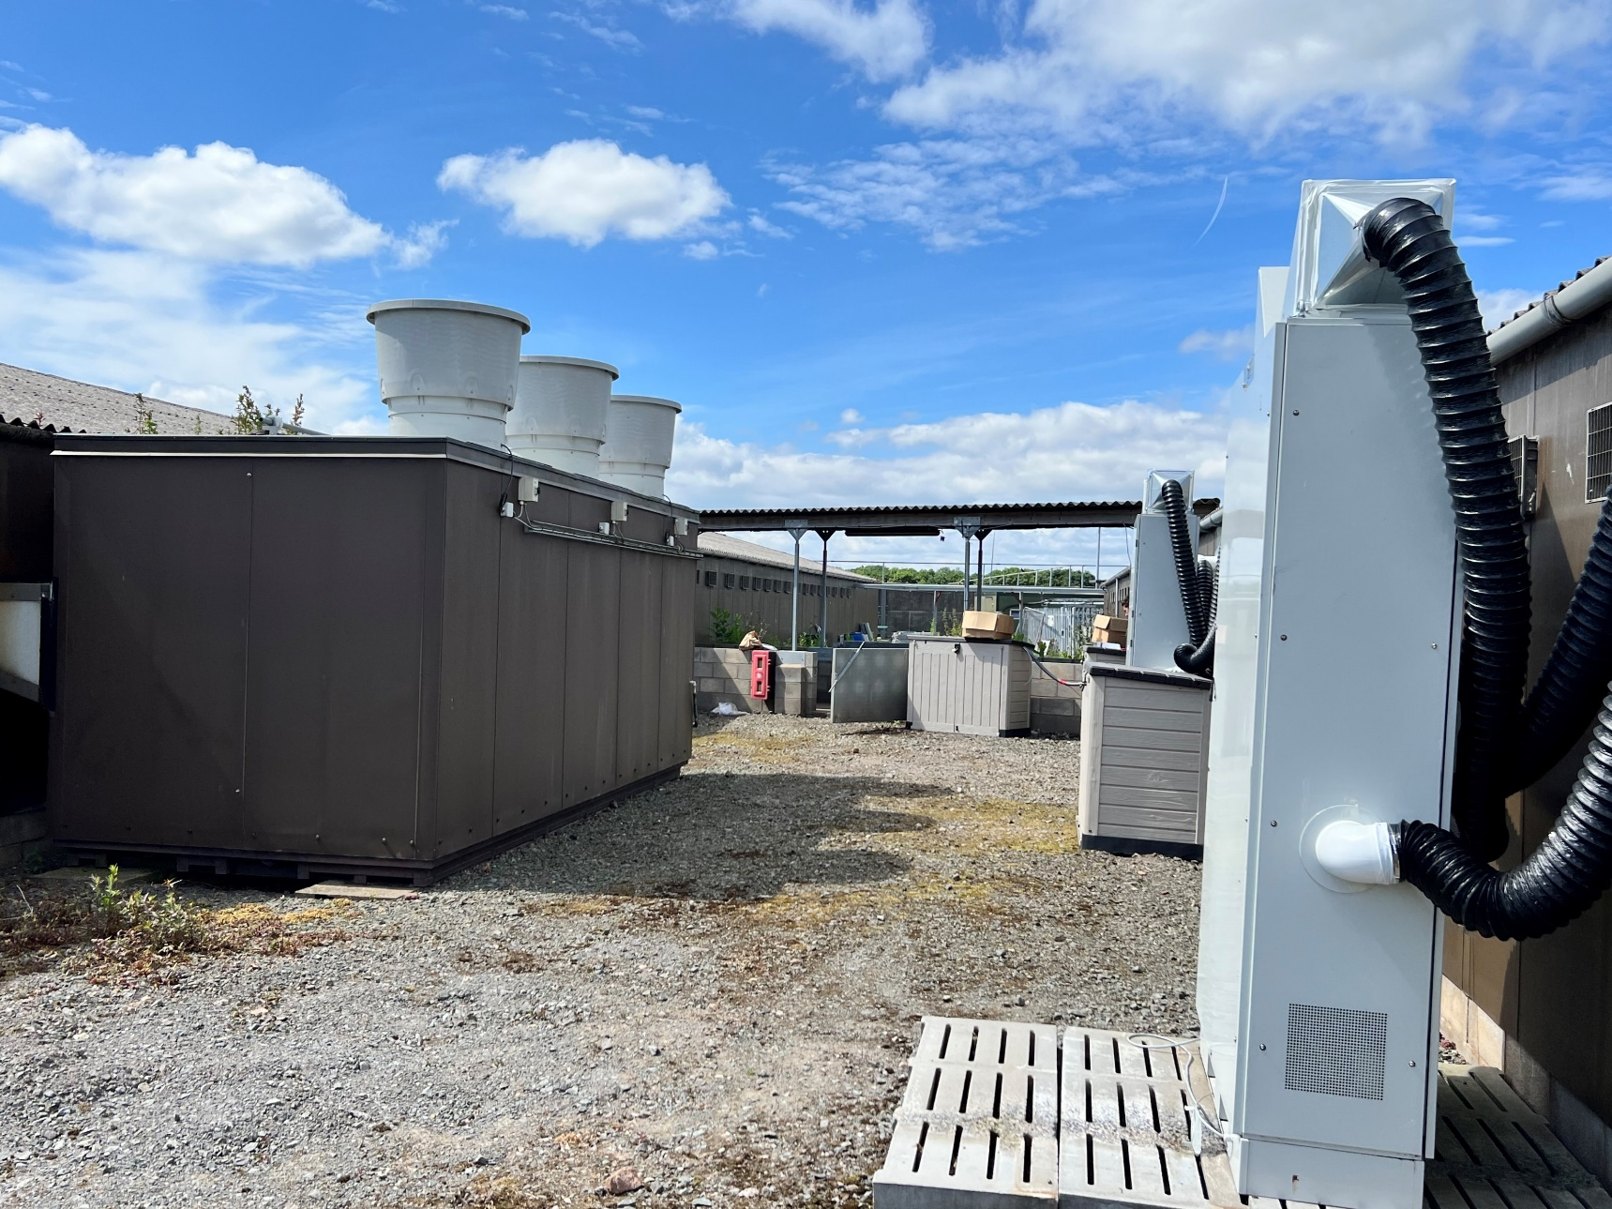
OLD vs NEW TECHNOLOGY FOR FARMING
Old scrubber system used only for few months
APA system

Slide 17
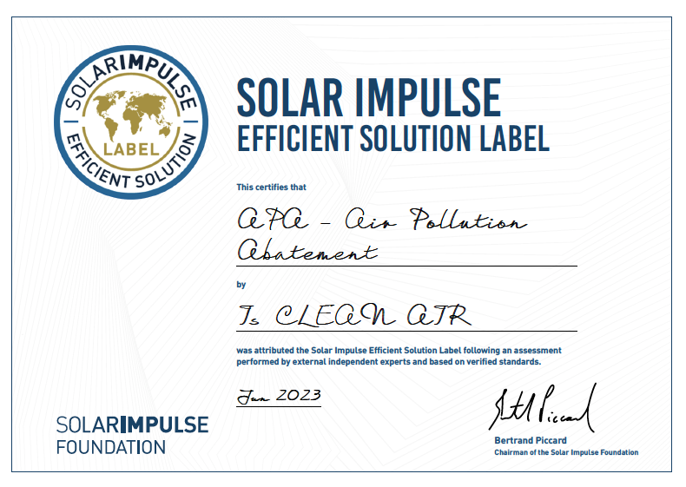



TWICE LABELED
- 4 STAR TECH -
17

Slide 18
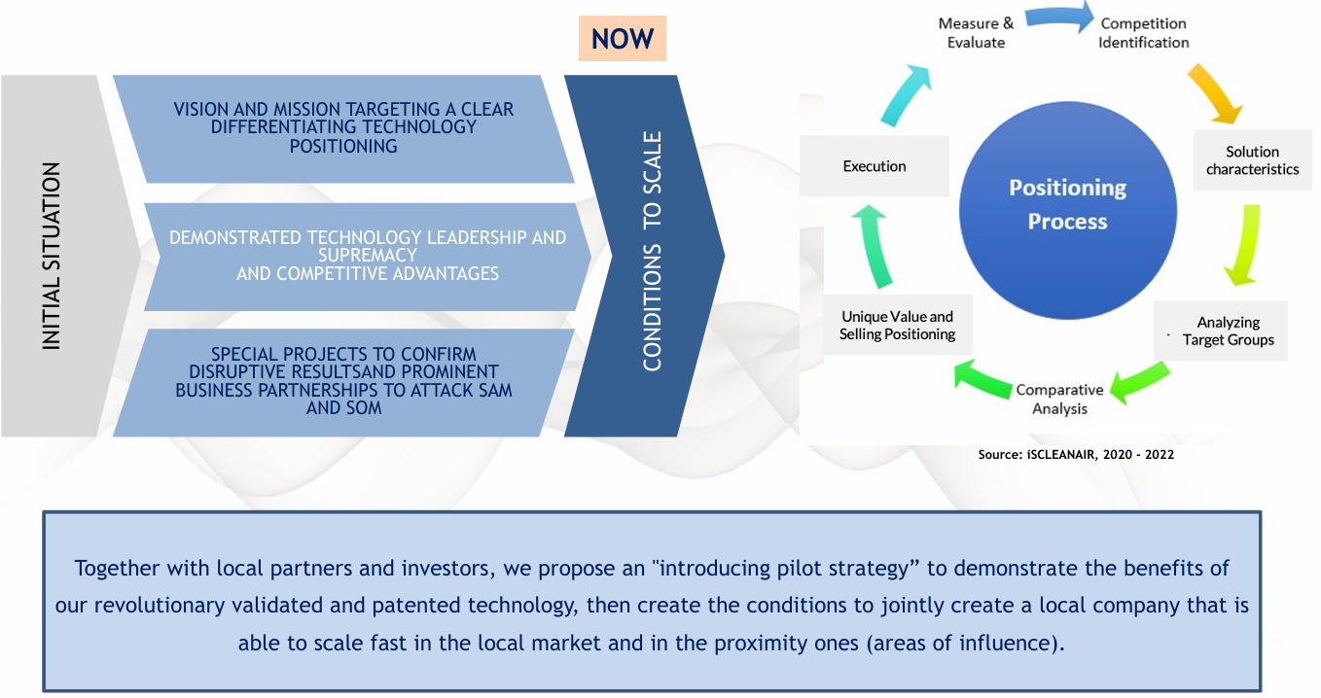
STRATEGIC POSITIONING AND BUSINESS MODEL

Slide 19
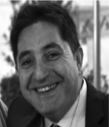
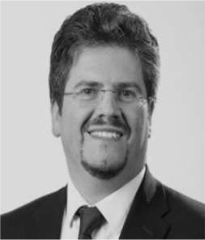
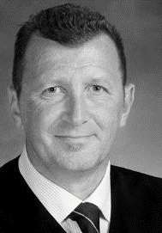



A SENIOR EXPERIENCED AND ENTHUSIASTIC TEAM OF KEY PEOPLE
MAIN
EXECUTIVES
GIUSEPPE SPANTO
Founder – Managing Director
FABIO GALATIOTO
CTO and Technology Management
Environment and Energy Expert
SANDRO DESIDERI
Commercial Partner and Business Developer
Environment and Energy Expert
An AGILE TEAM
of 21+ ENGINEERS
operating "at work" (as ~ 15 FTE),
passionate and committed to actions,
globally JOINTLY WITH
QUALIFIED SENIOR EXECUTIVES AND ADVISORS
CHIARA VERDERESE Head of Business Development
19

Slide 20




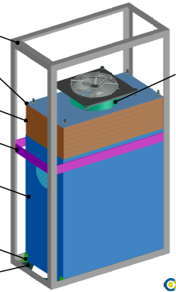
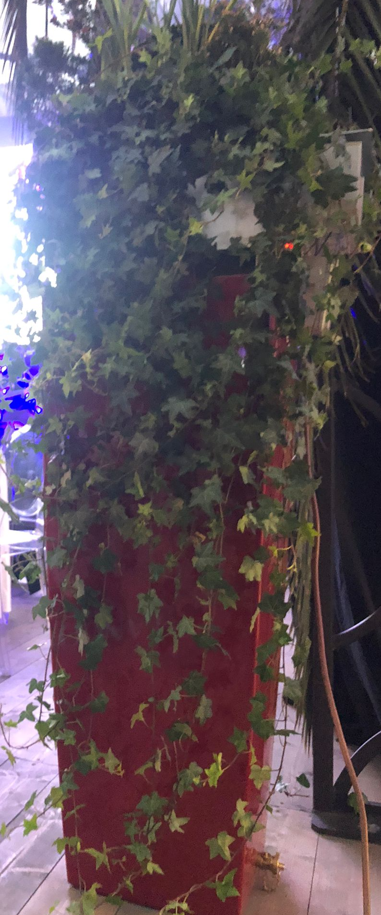
PLANNING TO SERVE AND ATTACK the enormous serviceable MARKETS
EXTRAORDINARY EXPANSION
OPPORTUNITIES
PLANNED INVESTMENTS
GO-TO-MARKET MAIN STRATEGIES
  Enhance and improve the organization, labs and productive module and start direct scale-up phases globally
JOINT
VENTURES
PUBLIC PRIVATE PARTNERSHIPS
AD HOC PROJECTS
APA SYSTEM
SALES
  Support commercial activities and working capital
LARGE TARGET GROUPS
WORKPLACES and INDUSTRIAL PLANTS
COMMERCIAL, REAL ESTATE and BUILDINGS
PUBLIC SPACES
(indoor and outdoor)
  New intellectual properties and further extension of the strong certifications' framework owned, globally
  New extensive growth opportunities on new solutions and products integrating energy solutions, new segments, verticals and territories, worldwide
  M&A to drastically increase the company growth opportunities in the mid-term
INTERIORS SPACES, as OFFICES, LOCALS and DOMESTIC AREAS
20

Slide 21
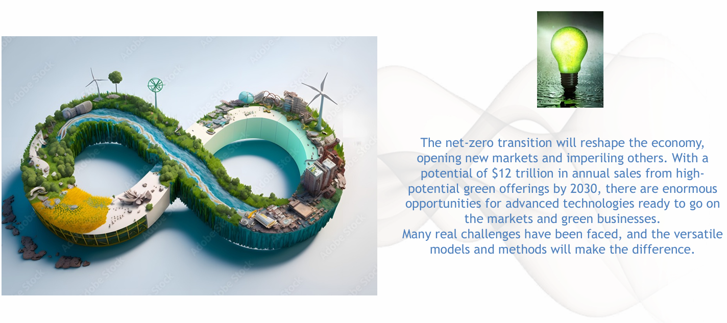
THE OPPORTUNITY OF THE NET-ZERO TRANSITION

Slide 22


SUSTAINABLE DEVELOPMENT GOALS: IMPACTS, IMPLICATIONS, COST OF INACTIONS ...
®
22

Slide 23



THANK YOU VERY MUCH
CONTACTS
info@iscleanair.com
gspanto@iscleanair.com
23

