Slide 1

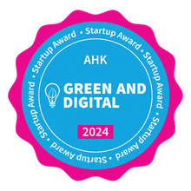
Synthetic Fuels
sustainably, locally, and profitably

Slide 2
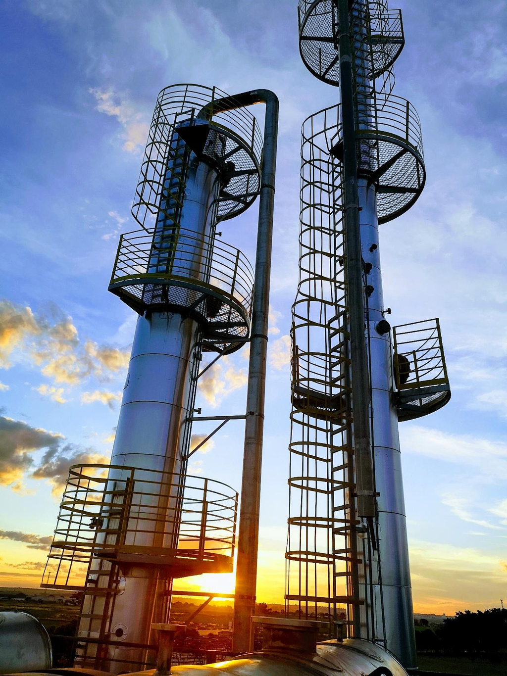
About us
We are an innovative start-up committed to synthesizing waste and biomass into sustainable energy sources.

Slide 3
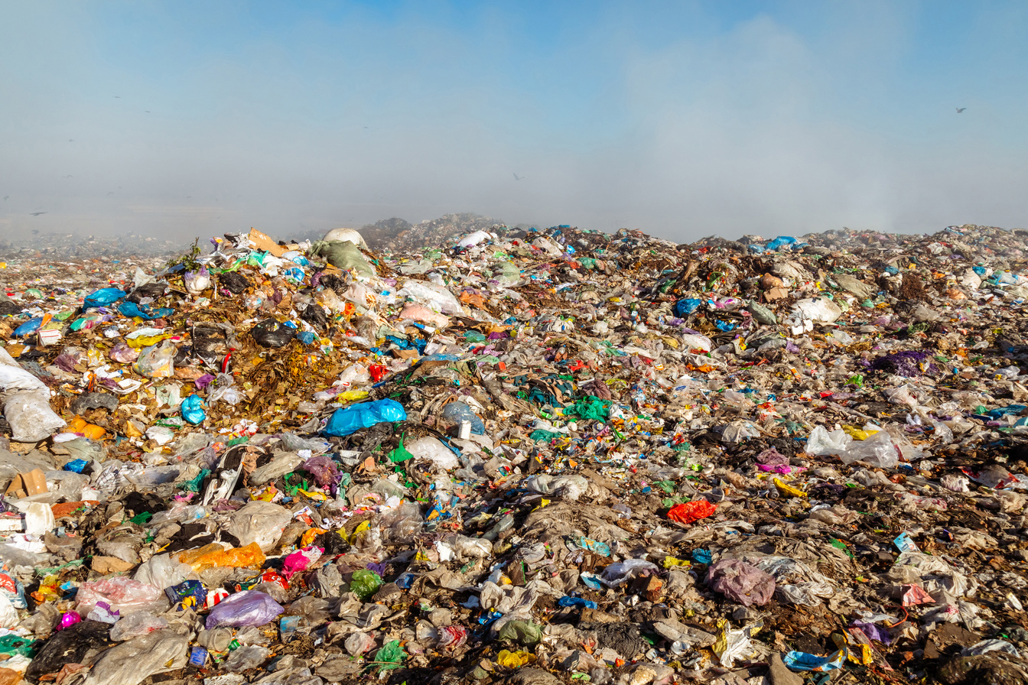
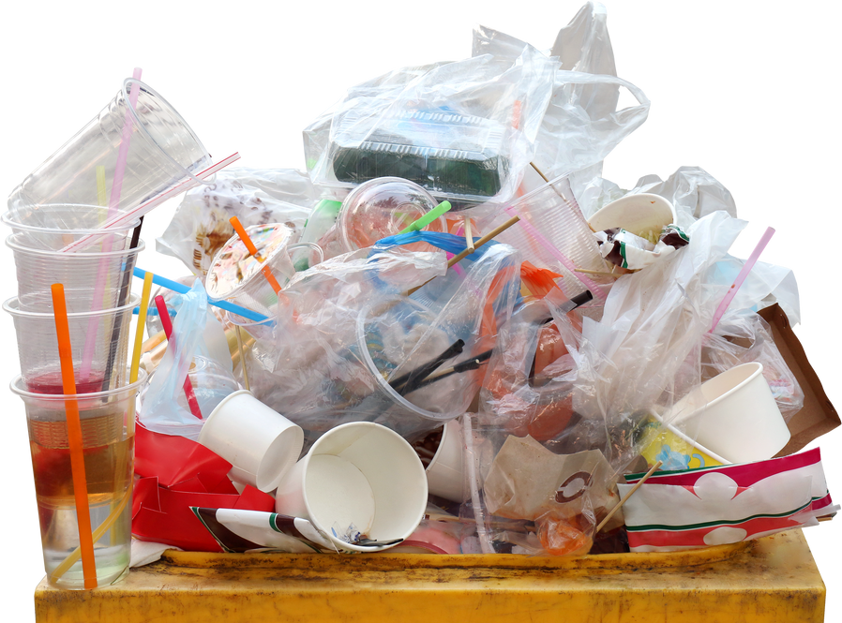
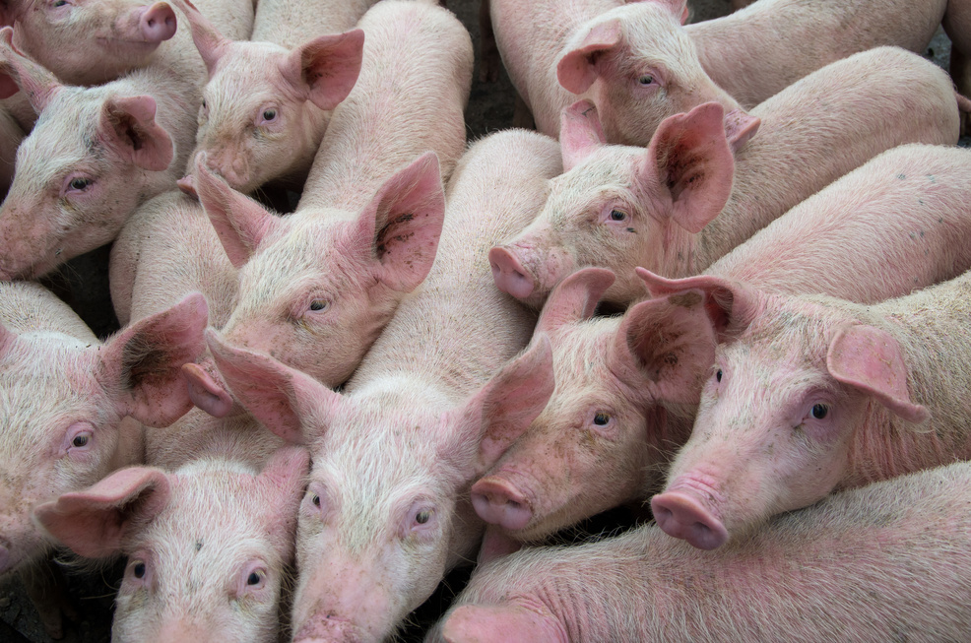
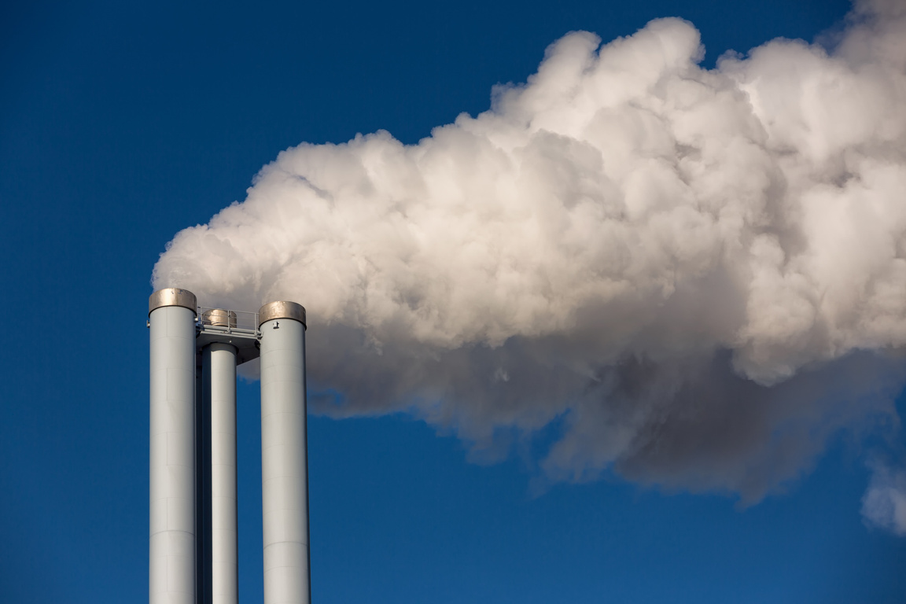
Global Problems
The WASTE and CARBON crisis…
MUNICIPAL SOLID WASTE
PLASTICS
PROTEIN
CARBON DIOXIDE
+ 4,5 billions of ton in landfills and dumps
+300 millions of ton discharged annually
Millions of ton of carcasses and fallen stocks discharged
Over 40 billion tons of carbon dioxide are emitted into the atmosphere.

Slide 4
Time line
2021
2022
2023
2024
2025
Animal waste
Tests and performance
Diesel HVO - Protein
Development with EMBRAPA/EMBRAPII
Funding of R$600k
Executive Project of Chemical recycling
Project of 200TPD of plastic waste
Angel investment R$600k
Scale-up
-Municipal Solid Wastes scale plant
-Development of the microalgae cultivation system
Funding and Acceleration
Grants: FINEP R$17 million

Slide 5
Technologies
We transform wastes and carbon into biocrude
  Chemical recycling of plastics and follen stocks
  Industrial carbon capture
  Green and synthetic hydrocarbon production
  Circular, scalable and modular models

Slide 6
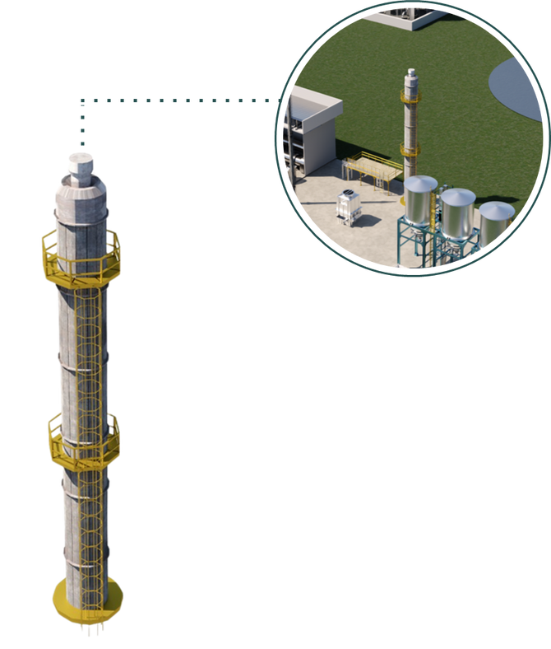
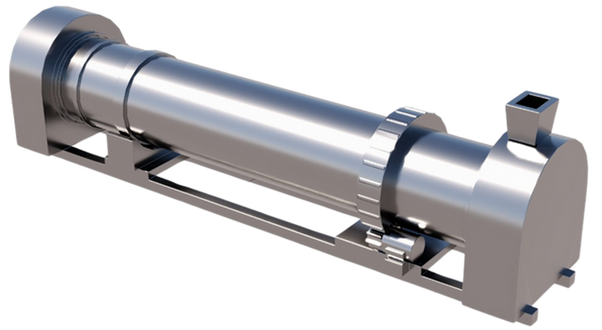
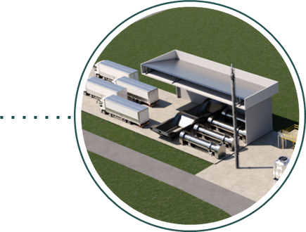
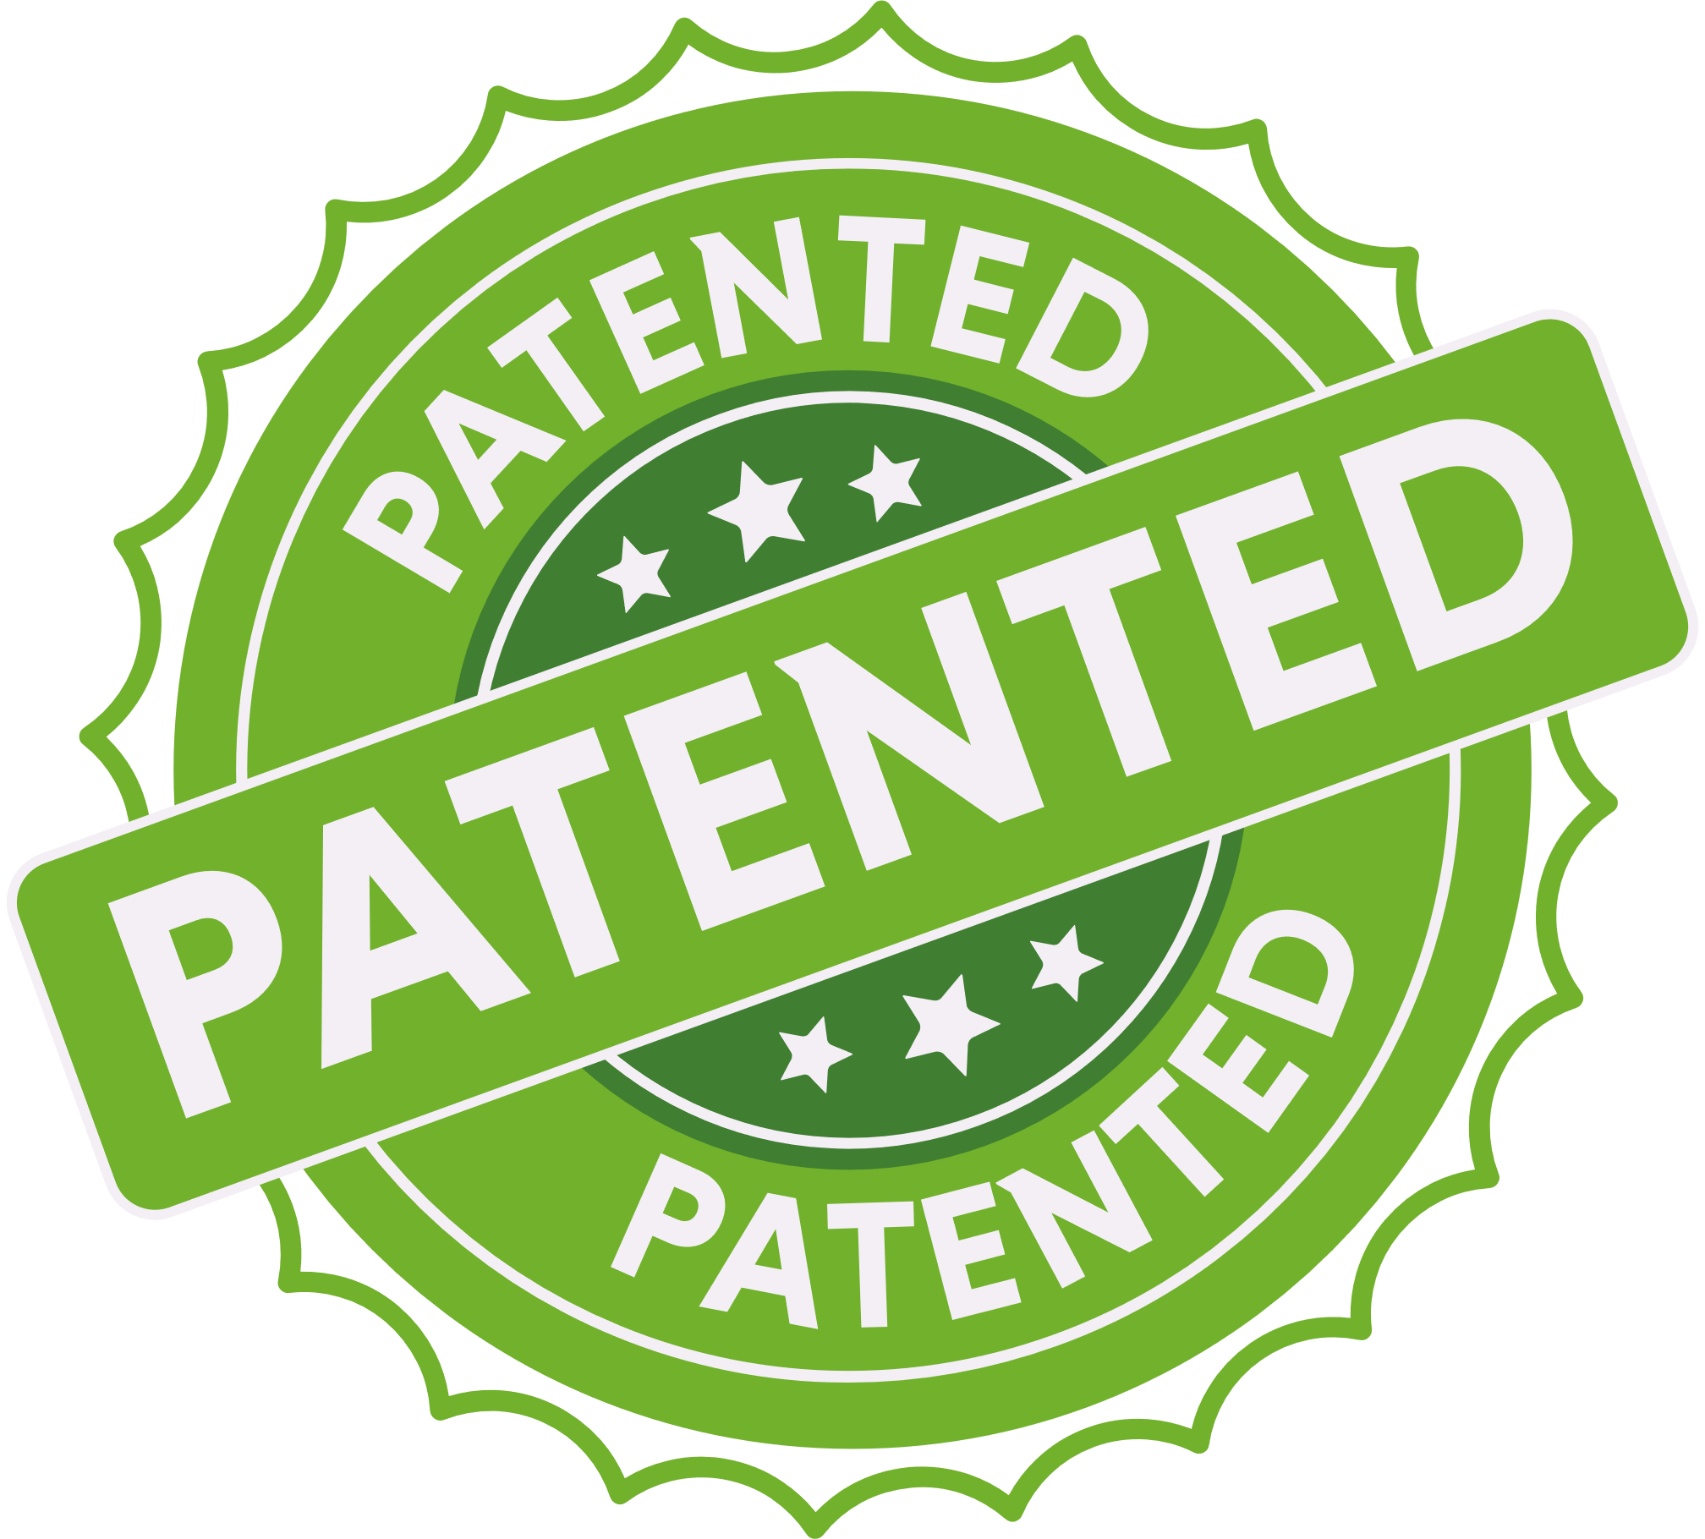
Biorefinery and chemical recycling
Drying system
Temperature: up to 200°C
Material: Stain steel and coating
Function: remove moisture, chlorine, and fluorine
Steam treatment: condensation and gas scrubber
Cracking system
Temperature: up to 550°C
Material: Stain steel and coating
Catalyst: metal oxides or calcium
Refining system
Process: Distillation
Products: Hydrocarbons
Combustion chamber: burn gases and dioxins > 800°C
Energy use: recovery in the drying and cracking system

Slide 7



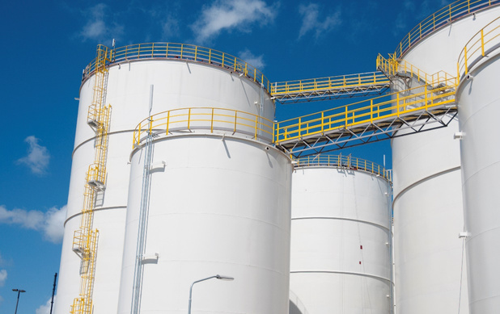
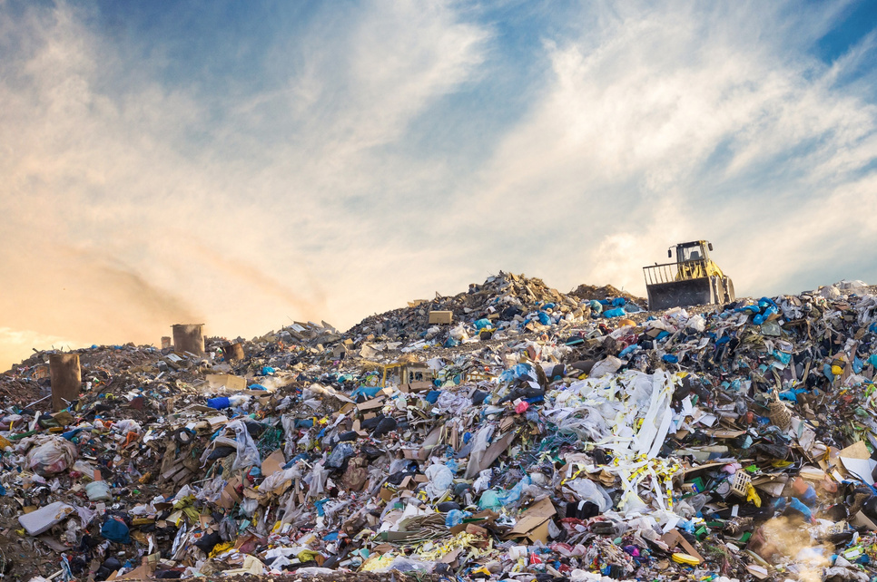




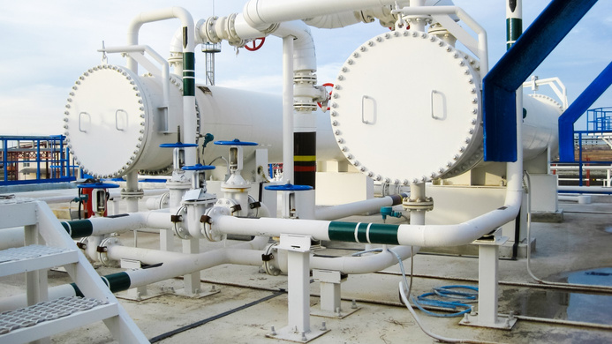
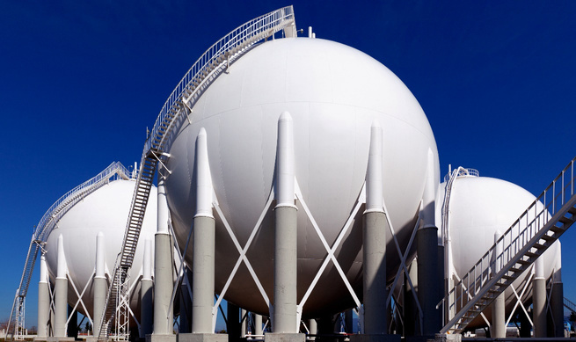


RQP
SYNTHETIC PRODUCTS
Base price
Brent
Naphtha
Kerozene
Biocrude
0,91 L
Ou
Plastics
1 Kg
Kerosene
Naphtha
0,26 L
0,65 L

Slide 8


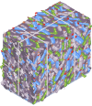
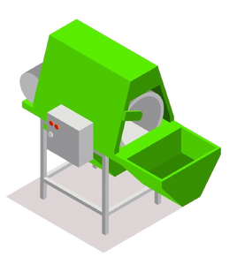
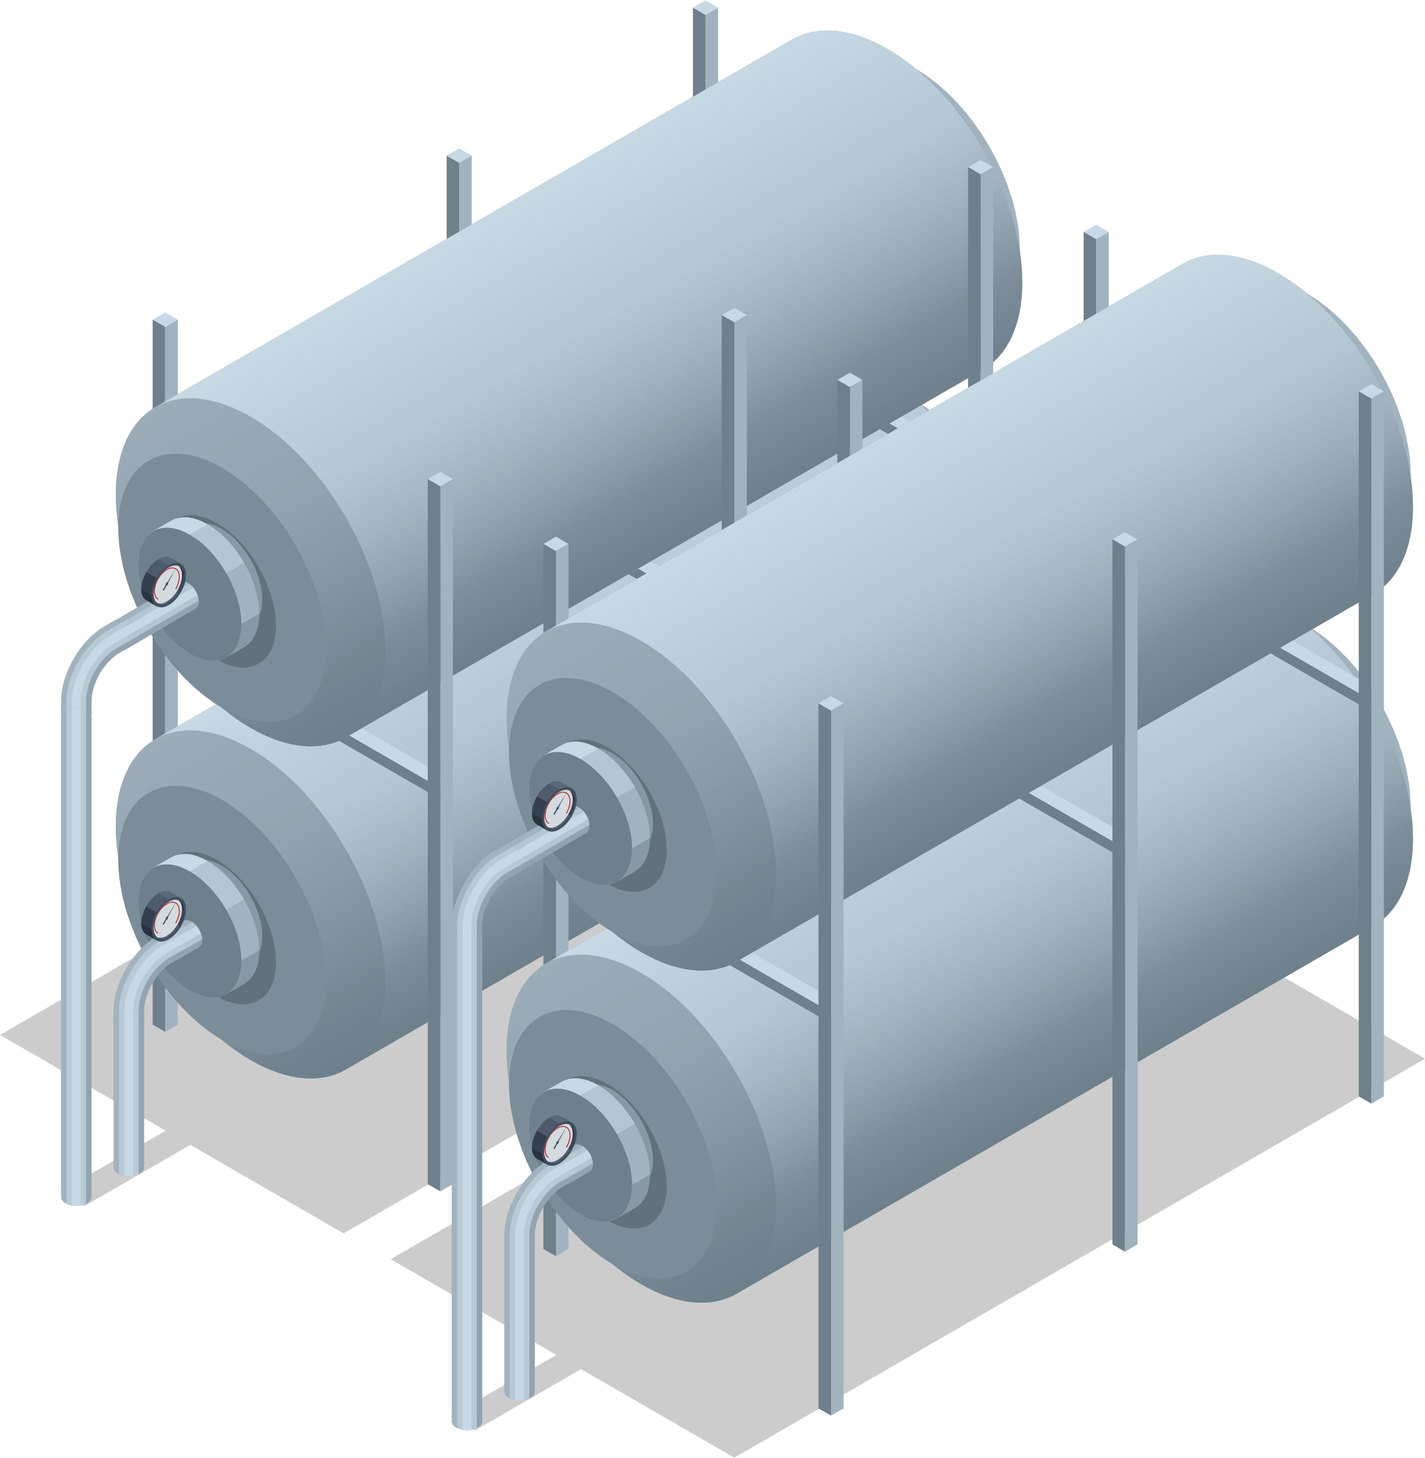
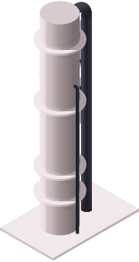
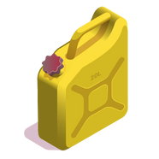


RQP PROCESS
CHEMICAL RECYCLING OF PLASTICS AND ORGANICS
Reuse
Gases
NAPHTHA
Pyrolysis
WASTE
Pre-treatment
KEROZENE
Destilation
BIOCRUDE
charcoal
WASTES
CHARCOAL
GASES
LÍQUIDS

Slide 9
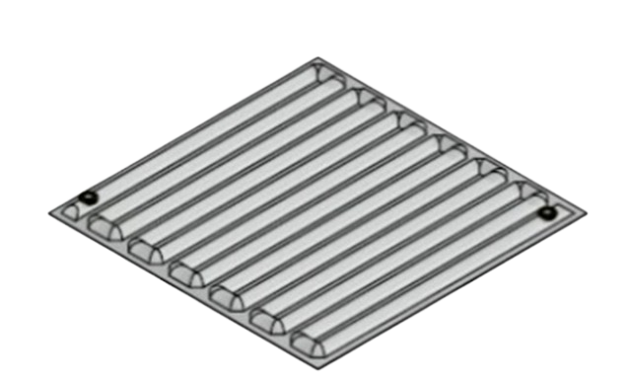
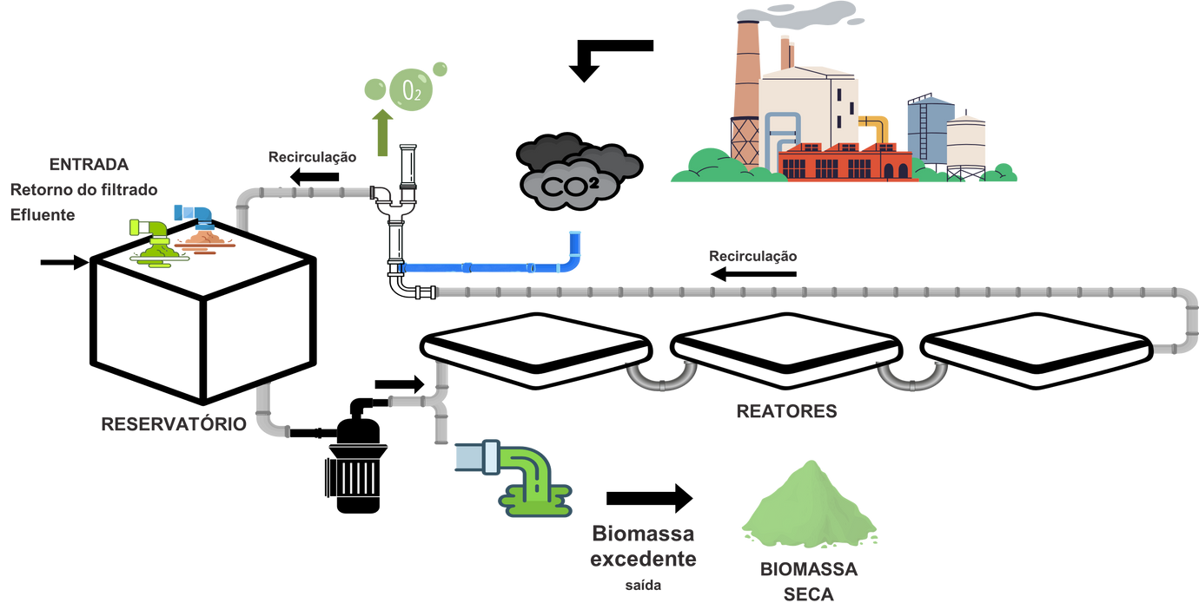

Carbon capture
Microalgae cultivating system
Cultivating system
Productivity: up to 1.000 ton/ha/yr
Sustainable: Industrial carbon capture
Low water consumption: 5 to 15 L/kg of biomass
Easy operation: Automatic system
Photobioreactor
Module: 4m² each
Low cost: plastic
Productivity: up to 300kg/m²
Versatile: any land or surface

Slide 10

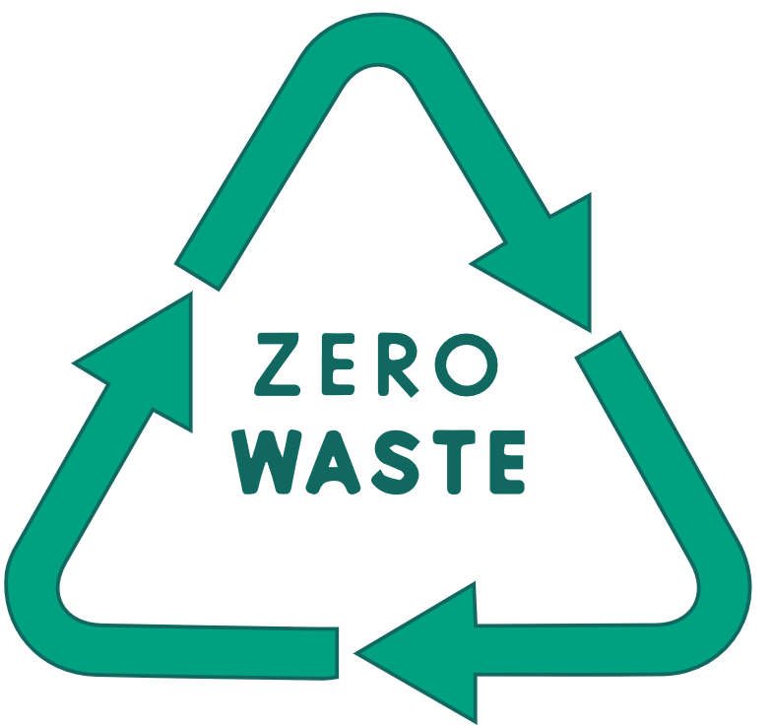



Technological edge
Chemical recycling
Our process removes toxic substances from plastic and municipal solid waste
Biorefinery
We transform waste and biomass into diverse high-value products.
Carbon Capture
Patents
Direct removal of industrial carbon, allowing its conversion into biomass for integrated valorization processes.
  Chemical recycling of plastics
  Chemical recycling of MSW (Municipal Solid Waste)
  Animal waste biorefinery
  Microalgae cultivation system

Slide 11
Environmental & Economic Impacts
PLASTICS
PROTEIN
MICROALGAE
Product Revenue Potential
€400–€600/ton
€500–€1,000/ton
€1,000–€2,000/ton
Additional Benefits
Avoids incineration and landfills
Avoid rendering and landfills
CO₂ avoided and captured
CO₂ Impacts
Up to 2.5 tons of CO₂ avoided
Up to 2.5 tons of CO₂ avoided
1 ton CO₂ captured =
0.72 tons CO₂ stocked +
0.77 tons CO₂ avoided
  All eligible for EU ETS or voluntary carbon offset markets

Slide 12
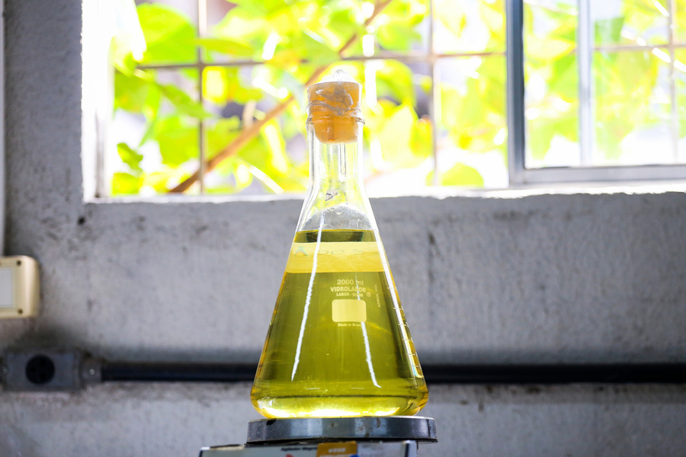
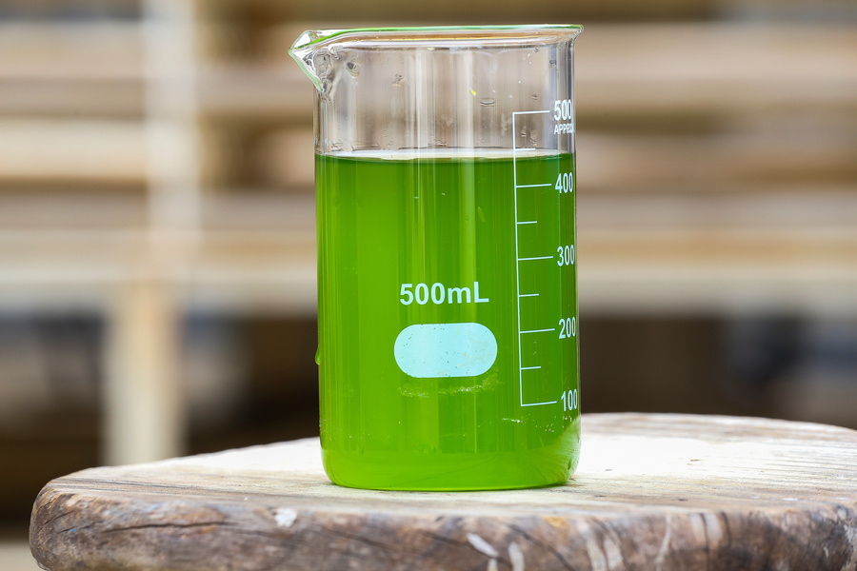
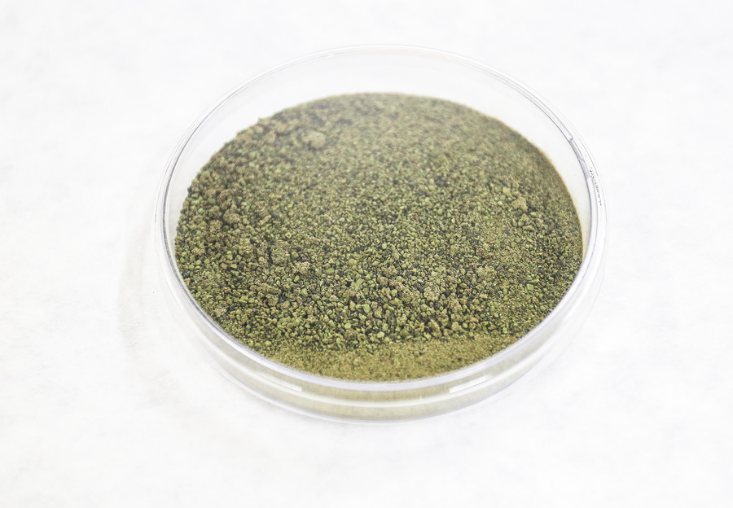
Products and by-products
Biofuel
Agriculture
Feed
Nafhtha
Kerosene
Biocrude
Biochar
Biostimulants
Biofertilizer
Protein
Fats
Peptides

Slide 13



Technology Licensing
To waste processors or energy companies
Business Model
Carbon Capture as a Service (CCaaS)
For cement, steel, refineries or ethanol industries
Engineering, Procurement and Construction (EPC) + O&M Contracts
Modular refineries for local governments or private parks

Slide 14
Why Haka is a game-changer for decarbonization
Modular, scalable, multi-input biorefineries
Converts CO₂ into value (biofuels, biochar, credits)
Aligned with Fit-for-55, Green Deal, EU ETS
Generates carbon credits + synthetic fuels from waste and emissions

Slide 15
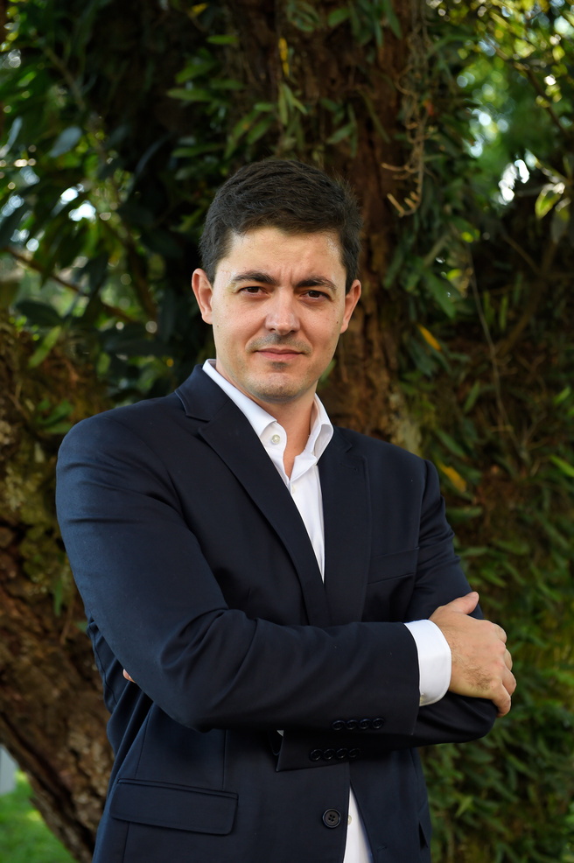
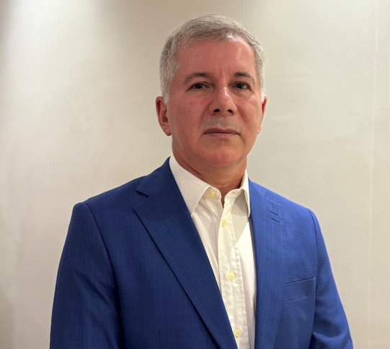
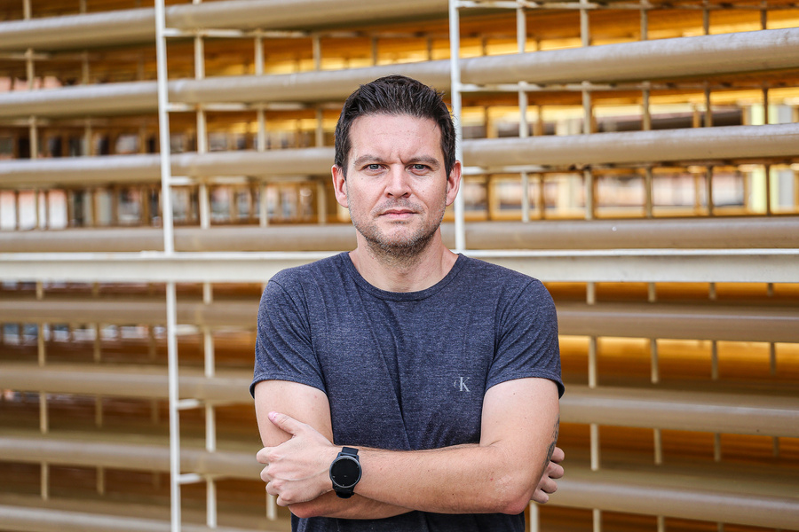
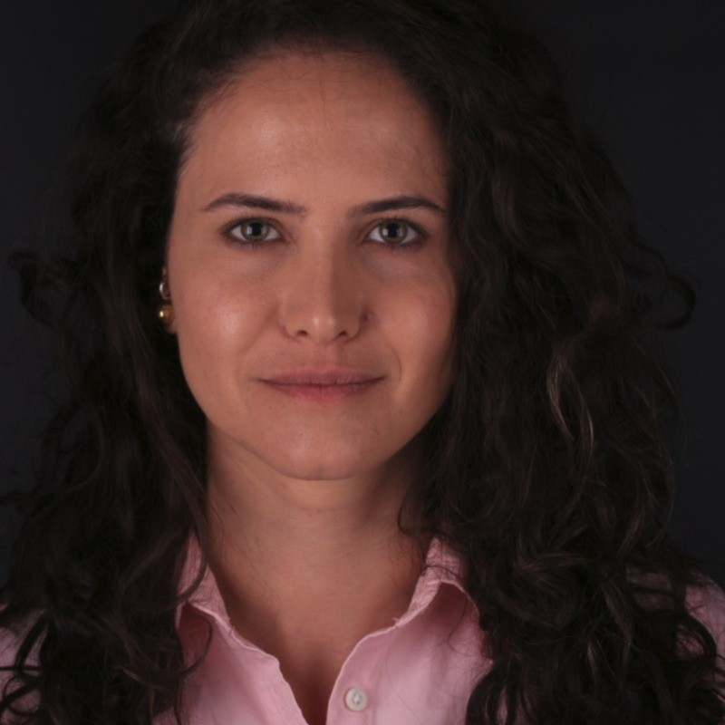
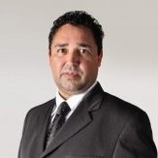
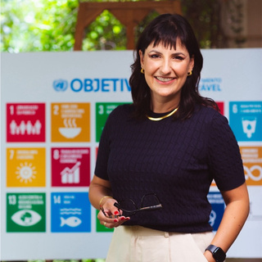
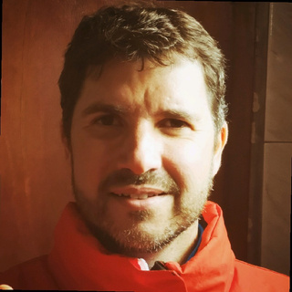
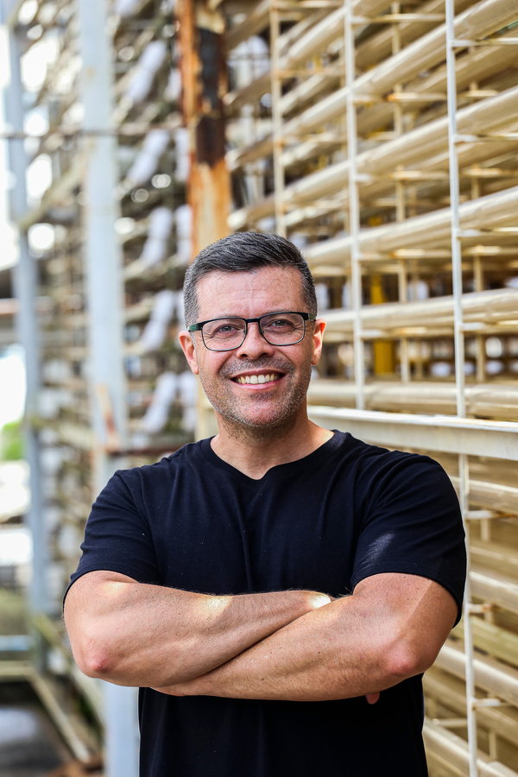






OUR TEAM
Consulting
Joel Neves
Clarissa Souza
Cyro Calixto
Carlos Kuligowski
Dhyogo Taher
Juliana Schultz
Engineering
Carbon
CEO
COO
CSO Microalgae
CSO Carbon Capture
Research center
Maurício Mascolo
André Mariano
Refinery
Microalgae

Slide 16
THANK YOU
http://www.hakabioprocessos.com
cyro@hakabio.com
+55 41 99286-1464

