Slide 1

SMART-INNO EXPERT LTD.
in cooperation with
HUN-REN CENTRE FOR ENERGY RESEARCH
GEOFFICIENT
SOLIDRONE
GIS-BASED PLATFORM OPTIMIZING BOTH EXISTING
AGRI-PV PERFORMANCE AND NEW SITE SUITABILITY FOR AGRICULTURE AND ENERGY EFFICIENCY
ADVANCED, AI-BASED SOLUTION FOR AUTONOMOUS DRONE CLEANING OF SOLAR SYSTEMS

Slide 2








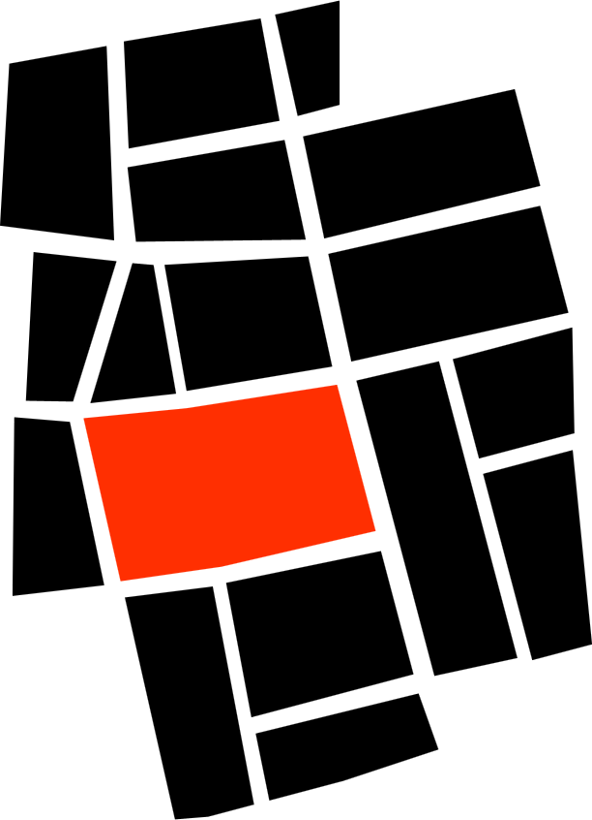

GEOFFICIENT
GIS-BASED PLATFORM OPTIMIZING BOTH EXISTING
AGRI-PV PERFORMANCE AND NEW SITE SUITABILITY FOR AGRICULTURE AND ENERGY EFFICIENCY
GEOFFICIENT
Two Service Outputs
Energy Efficiency
PR & soiling
Shading diagnostics
High‑yield configurations
AHP‑based planning
Financial modeling
WITH PV - Existing Asset Performance
Performance Optimization
& Monitoring
We boost output at current assets with diagnostics and data‑driven action plans; results are delivered as clear O&M recommendations and a performance uplift roadmap.
Agricultural Impact
NDVI/EVI monitoring
Soil moisture & microclimate
Crop health tracking
Yield forecast
Water‑saving scenarios
WITHOUT PV - New Site Selection
Site Selection & Feasibility
We plan high‑yield Agri‑PV layouts using GIS/AHP suitability and financial viability studies; results are delivered as siting maps and an investment‑grade feasibility brief.
GIS-Based Approach
Multi‑layer data (satellite, sensors, grid,
land)
AHP weighting
Spatial overlays
Suitability maps
3D scenarios

Slide 3

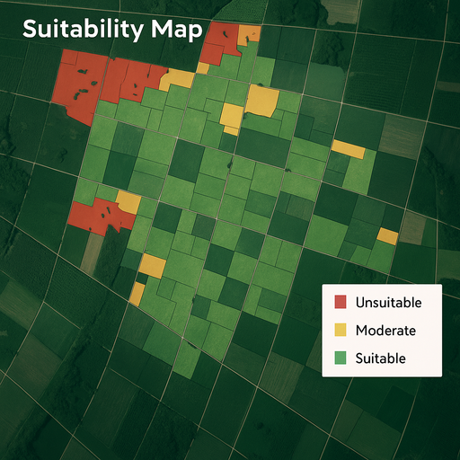
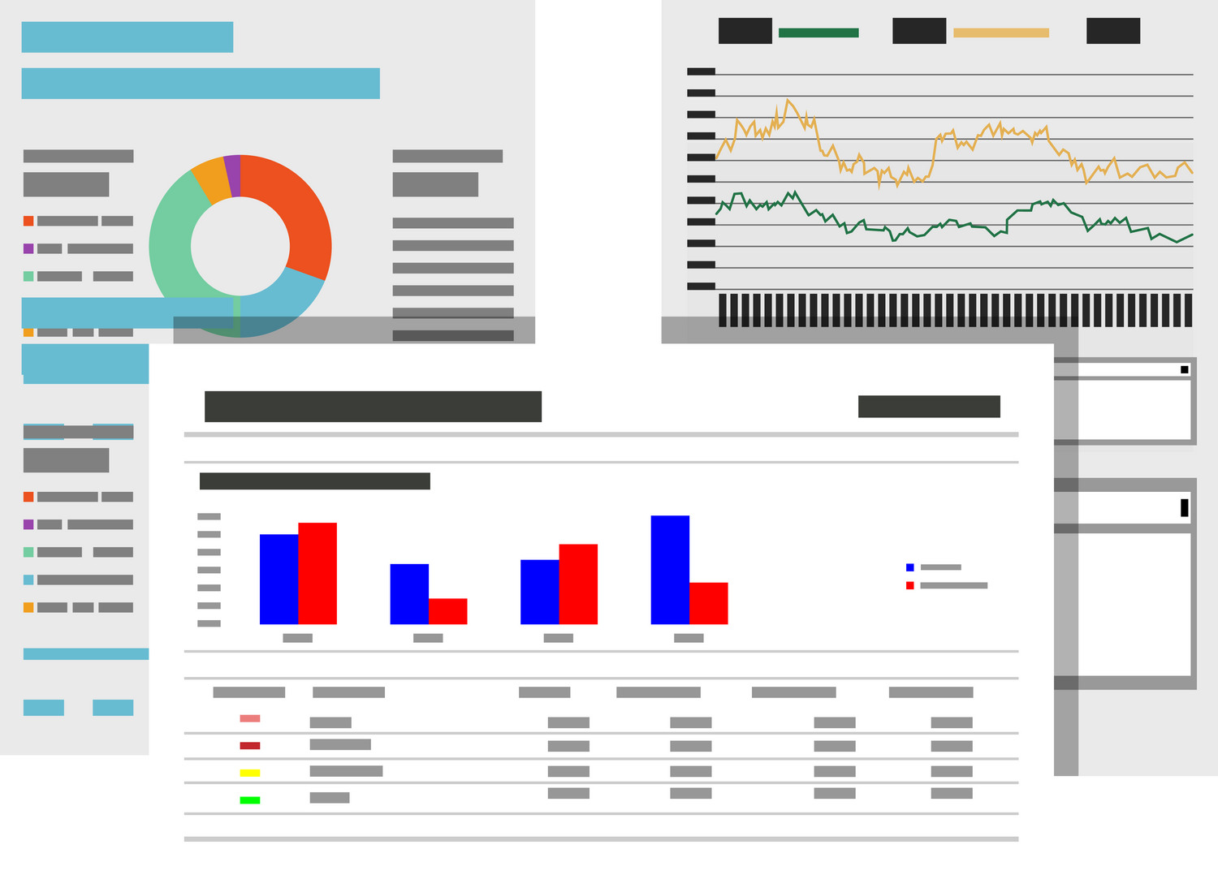
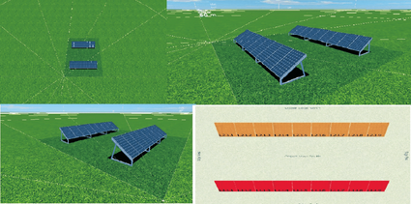

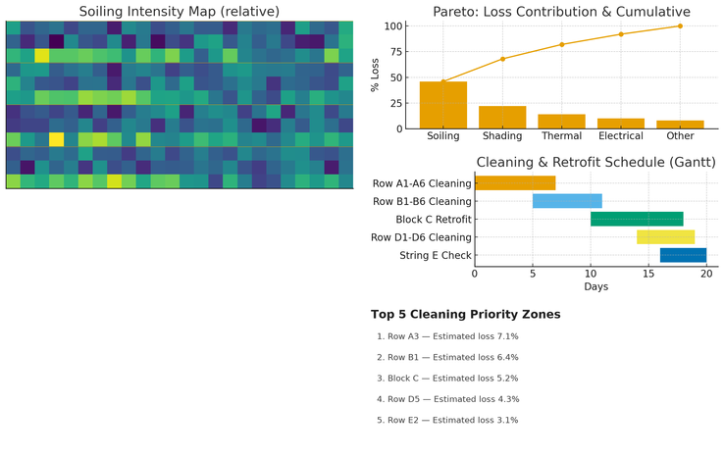
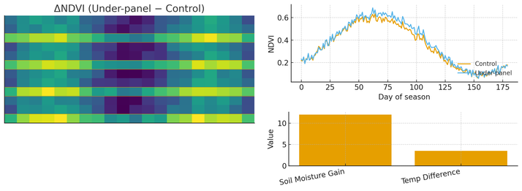
GEOFFICIENT
Impact with SOLEYE
Coverglass
Reduced heat load on crops
Enhanced panel efficiency & lifespan
Hydrophobic & antistatic (self-clean)
UV blocking (component protection)
Band-pass filter (passes useful light)
GIS-BASED PLATFORM OPTIMIZING BOTH EXISTING
AGRI-PV PERFORMANCE AND NEW SITE SUITABILITY FOR AGRICULTURE
AND ENERGY EFFICIENCY
INPUTS
METHODOLOGY
OUTPUTS & SERVICES
PHYSICAL AND NATURAL FACTORS
METHOD
OUTPUTS
SERVICES
  Solar radiation, slope, aspect
  Land use & constraints
  Grid, roads, parcel metric
WITHOUT PV
New Site Selection
AHP + GIS
Suitability Map
  Criteria weighting (AHP)
  Raster reclass & overlay
  Suitability scoring & zoning
INFRASTRUCTURE & ACCESSIBILITY
Financial Report
  Proximity to roads & water
  Distance from electrical grid
  Parcel size & shape
3D Agri‑PV Simulation
ENERGY PERFORMANCE
AGRIVOLTAIC EFFECT
DIAGNOSTICS
OUTPUTS
SERVICES
  NDVI/EVI trend;
  crop yield indicators
Efficiency & Maintenance Report
  PR, Specific Yield,Availability
EXISTING SITES
WITH PV
Existing Asset Performance
THERMAL EFFECTS
  Albedo /
  ground cover
  Soiling Loss
  Internal/external shade losses
  POA/GHI, diffuse-direct ratio
  Degradation rate (PLR)
  Regional benchmark; IEC 61724-1 class
  Module/array temperature‑coefficient loss
  PR & soiling decomposition
  Thermal hot‑spot mapping
  Shading & geometry analysis
Retrofit/Cleaning Plan
MICROCLIMATE
  Soil Moisture
  Air Temperature
Crop Impact Insights

Slide 4

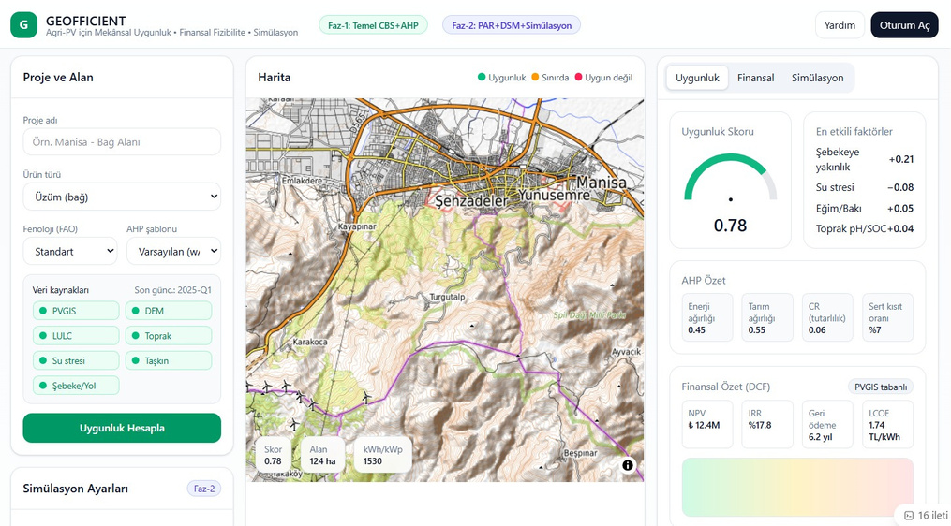
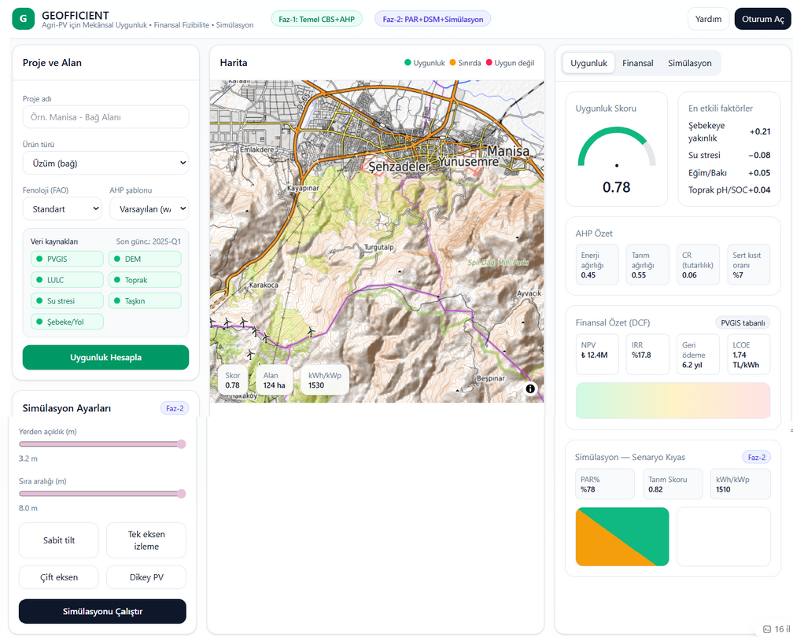

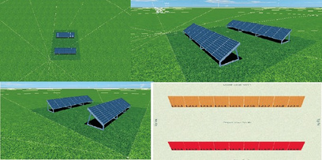
GEOFFICIENT
PARTNERS SOUGHT
Partner profiles we are seeking for the consortium
EPC / IPP / Utility
Pilot sites, production & PR data, field feedback.
Agricultural Cooperatives & Farms
Crop patterns, irrigation & yield observations, Agri‑PV alignment.
Data Providers
Satellite (PVGIS/DSM/LULC), climate and integration with existing sensors/stations.
Municipality / Regional Authority / DSO
Permitting/planning insights, grid proximity & access data.
Investor / Financial Institution
Feasibility feedback, investment criteria, scaling support.
Cloud & Software Partners
Secure hosting, enterprise integration (API/SSO).
GIS-BASED PLATFORM OPTIMIZING BOTH EXISTING
AGRI-PV PERFORMANCE AND NEW SITE SUITABILITY FOR AGRICULTURE
AND ENERGY EFFICIENCY
Spatial suitability · financial feasibility · simulation for Agri-PV
in one interface
Faz-3: Finansal İzleme
TR / ENG
+
Poligon Ekle
3B Simülasyon Panel arası mesafe: 5m
Kurulacak Panel Sayısı:35

Slide 5
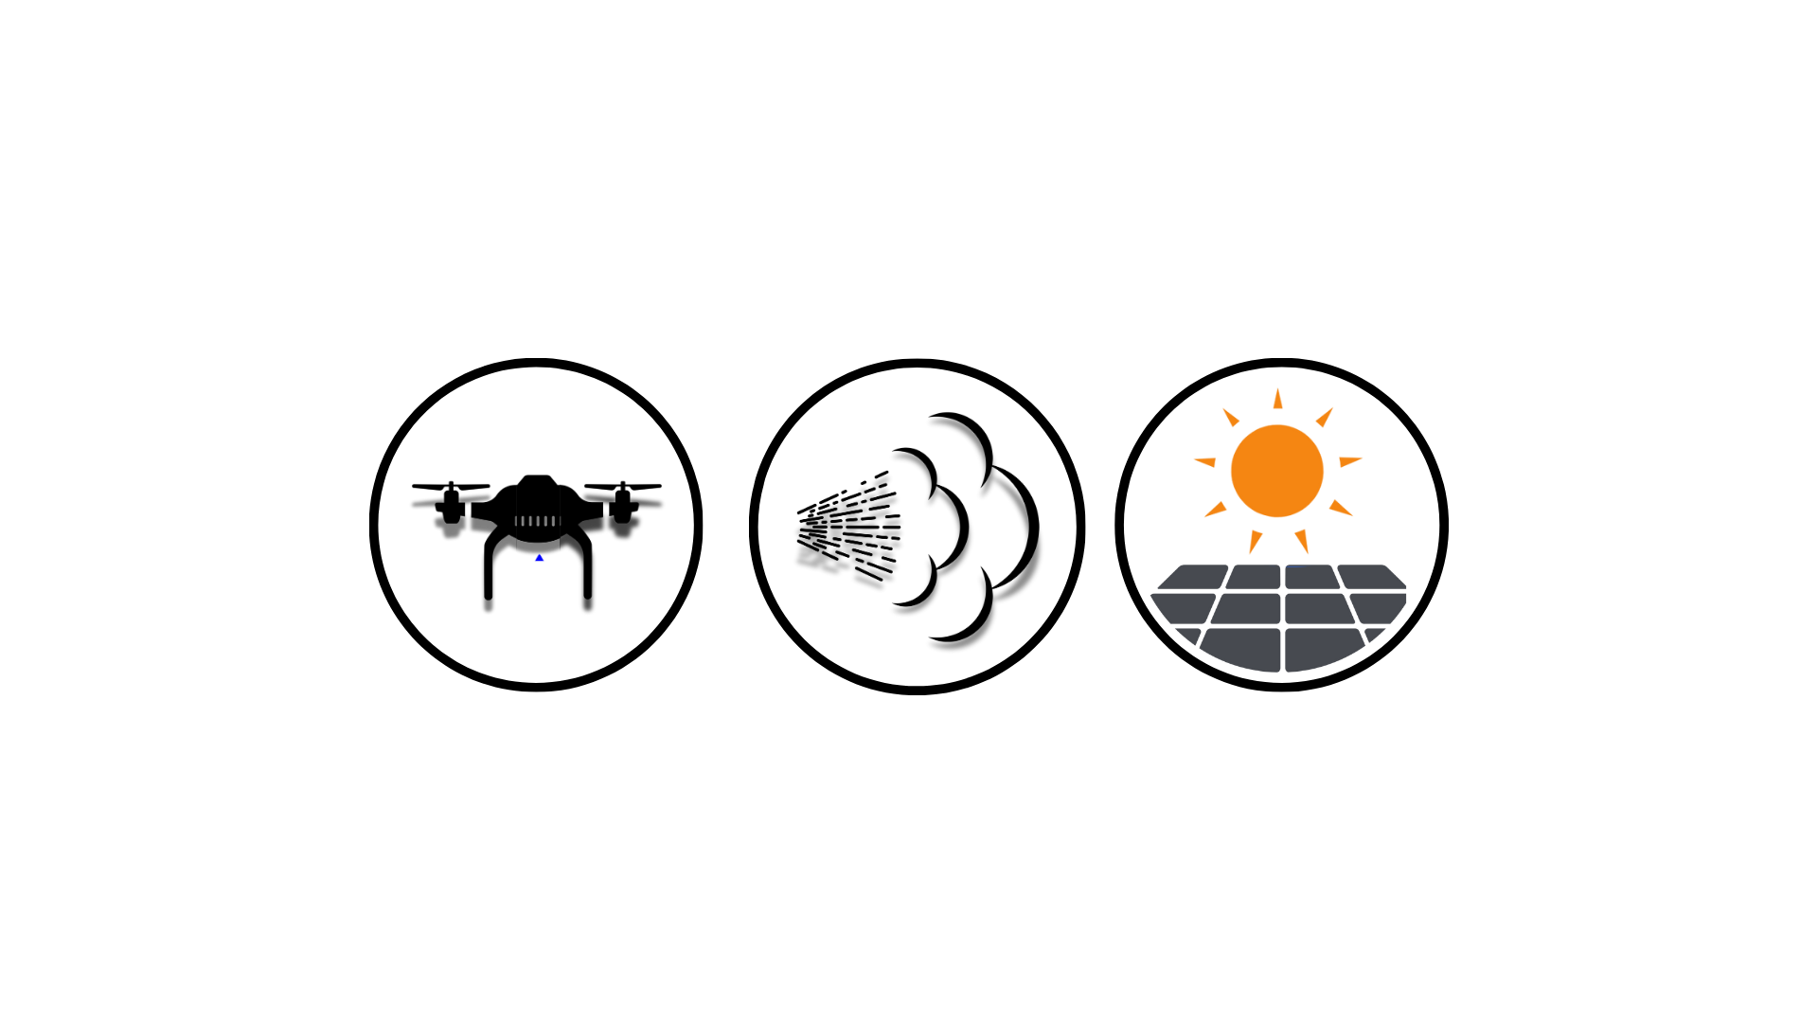
SOLIDRONE
ADVANCED AI-BASED SOLUTION FOR AUTONOMOUS DRONE CLEANING OF
SOLAR SYSTEMS
PARTNERS SOUGHT
We are looking for partners with
software development competencies to establish the precision AI cleaning feature;
hardware competencies for prototyping the high-pressure precision cleaning technology.
DRONE
PV
SPRAY
KEY FEATURES:
The AI-based control for cleaning outer surfaces with drones combines autonomous flight, perception (computer vision or LiDAR), and interaction with surfaces.
This requires precise control, robust obstacle avoidance, and potentially some form of manipulation or surface tracking.
PROJECT TASKS:
Analyses of system concept and existing solutions
Define data/control model/protocols
System Design
Modelling PoC
System design/SW, HW, NT communication - ready
HW prototyping: drone, cleaning equipment - ready
SW implementation, functional test
System Integration and system test

