Slide 1


Text in white – Cambria font 18
Synergistic sustainability-oriented recycling project in Istanbul-
Determination of The Optimum Amount of Recycled Asphalt Pavement (RAP) in Warm Stone Mastıc Asphalt
Contacts
Atilla Harun ÖZTOPRAK
Atakan AKSOY
Email
harun.oztoprak@ic-a.com.tr
aaksoy@ktu.edu.tr
Phone 05056550143/053232111 60
QR code
Website
https://ica-isletme.com/
Another image related to
company description
(optional)

Slide 2
The EUROGIA framework is described as a holistic, industry- and market-driven programme that addresses all areas of the energy mix, from renewable energy to efficiency and reducing the carbon footprint of fossil fuels.
EUROGIA is known as a cluster of the EUREKA network, a decentralised intergovernmental initiative launched in 1985 to increase Europe's competitiveness by supporting businesses, research centres and universities involved in transnational projects.
The EUROGIA2030 program supports and encourages international partnerships developing innovative projects in low-carbon energy technologies. It addresses all innovative energy technologies aimed at reducing the carbon footprint of energy production and use, and developing new energy technologies such as solar, wind, biomass, geothermal, energy efficiency, hydrogen, and more.

Slide 3
Why a EUROGIA label?
The label itself does not automatically guarantee public funding. Individual EUREKA member countries have the final say on public funding within their own countries, based on their national policies, priorities, and constraints. However, the EUROGIA label facilitates access to such public funding, particularly within countries supporting EUROGIA2030 that have committed to positively accepting applications for national funding from projects with the label.
International project proposals submitted by EUROGIA member countries are evaluated comprehensively based on relevant criteria, and the PO and FPP stages are evaluated by selected arbitration committees.

Slide 4
Eurogia 2030 Project Preparation
Eurogia2030 is at the forefront of the energy sector in achieving carbon neutrality goals. Eurogia aims to contribute to a sustainable environment, climate change mitigation, and sustainable growth through Low Carbon Technology R&D solutions. Some of the challenges targeted in the project proposal requests (carbon-free energy supply, green mobility and smart cities, smarter homes and buildings, and bioresources and the environment) are necessary to achieve these goals, but are not limited to these.

Slide 5
Objectives in the Context of the Project Proposal to be Prepared
We may propose a Eurogia 2030 project within the scope of the project: "Increasing the asphalt pavement recycling rate, examining the usability of RAP material scraped from SMA pavement in SMA production, evaluating the synergistic gain mechanisms that can be created by combining slaked lime, waste oil, and rejuvenating additives, the importance of fatigue test results and their comparative analysis across different test points, strengthening recycling strategies and sustainability approaches through the application of warm mix technology, ASECAP approaches, the necessity of an advanced R&D environment in Türkiye due to the rapid experimental demand that will arise with the recent KGM regulations, and, in general, the establishment of the ICA İÇTAŞ R&D Center project and expansion of its application studies, and quiet asphalt applications and analysis."

Slide 6
We intend to continue our efforts to find partners within the context of the countries listed at https://eurogia.eu/funding/. ASECAP's recycling and sustainability goals are our focus. We will be working to find potential partners in line with our goal of establishing our advanced R&D center. This effort will continue.

Slide 7
Research Topic: DETERMINATION OF THE OPTIMAL AMOUNT OF RECYCLED ASPHALT PAVEMENT (RAP) IN WARM STONE MASTIC ASPHALT
Main Objectives and Scope:
-SMA mix production
-3 different warm mix additives
-15%, 25%, 35%, and 45% RAP SMA
-Use of RAPSMA material in warm SMA production
-Creation of an experimental infrastructure to examine noise reduction asphalt applications
-Basic bituminous binder tests and performance tests - softening, penetration, duclility, flash point, viscosity, specific gravity, penetration index, DSR, PAV

Slide 8
Research Topic: DETERMINATION OF THE OPTIMAL AMOUNT OF RECYCLED ASPHALT PAVEMENT (RAP) IN WARM STONE MASTIC ASPHALT
Main Objectives and Scope:
-Determination of Cellulose Fiber Properties (from the manufacturer)
-SMA Recycled Asphalt Pavement (RAPSMA) from a heavily trafficked highway. Residual asphalt binder content in RAP was determined using a centrifugal extractor apparatus according to the ASTM D 2172 standard test method. Extracted bitumen penetration (25°C; 0.1 mm) was determined using ASTM-D5, softening point (°C) was determined using ASTM-D36, and asphalt content was determined using ASTM-D2172.
-Dynamic creep test methods for stone mastic asphalt mixtures (SMA) were determined using EN12697-25 to approximate the yield point.
-Dynamic creep testing was performed using the UTM-25 apparatus, the most widely used method for verifying the permanent deformation of asphalt mixtures. A three-stage model will be applied to determine the three-stage deformation curve (i.e., Primary, Secondary, and Tertiary) based on the mechanical properties of the asphalt mixture at the rutting depth in the field, according to the number of cycles.
The yield number test and dynamic creep test will be performed using the UTM apparatus.

Slide 9
Research Topic: DETERMINATION OF THE OPTIMAL AMOUNT OF RECYCLED ASPHALT PAVEMENT (RAP) IN WARM STONE MASTIC ASPHALT
Main Objectives and Scope:
Deciding on appropriate stress levels to capture the tertiary creep zone in the dynamic creep test
-Warm SMA designs
-Regression coefficient parameters and correlation analysis of dynamic creep test results
-Semicircular bending (SCB) test - Asphalt mixtures for the manufacture of SCB specimens were compacted to the target air void using a kneading compactor under the same conditions, according to ASTM D8044-16. (Semicircular bending test - Recording the load and deformation during the loading process until the specimen fractures, and computational analysis - Parameters such as fracture toughness, fracture energy, and morphological changes such as crack expansion will be used to evaluate the performance of asphalt mixtures against cracking.)

Slide 10
Research Topic: DETERMINATION OF THE OPTIMAL AMOUNT OF RECYCLED ASPHALT PAVEMENT (RAP) IN WARM STONE MASTIC ASPHALT
Main Objectives and Scope:
-In addition to the SCB test, comparative studies were conducted to characterize the fatigue and cracking performance of the asphalt mixture using the four-point bending (FPB) test, indirect tensile (IDT) test, disc-shaped compact tensile (DCT) test, and overlay tests (OT).
-Hamburg rutting tests

Slide 11
The project's partners and general objectives are listed below.
-Purchase, installation, calibration of laboratory equipment capable of conducting all design tests, trial tests, training activities, acquisition of test systems for performance tests, training of laboratory personnel, and preparation of the laboratory environment.
-Performance analyses and comparisons of cracking and fatigue for different warm mix types and different RAPSMA ratios in warm asphalt SMA mixtures within the specified framework.
-Consistency analysis of test results, performance assessment for increased recycling rates, production of plants for warm mix field application, and practical evaluation of recycling within warm asphalt production.
-Conducting a trial cut and long-term performance analyses, implementing warm asphalt application in Turkey, the use of RAPSMA in SMA production, and the advantages that can be achieved with warm asphalt application.
-Finding a test center abroad, contacting a company producing warm asphalt abroad, and ensuring that a test center capable of conducting the tests described in this study contributes to the project.
-Studies within the context of Turkey's harmonization strategy towards EU objectives, the Eurogia framework and approaches, the sustainability framework, and experimental research on rapidly developing topics in Turkey. Creating an effective R&D environment according to demands

Slide 12
In line with the above objectives and explanations, we would like to receive offers for project proposal preparation in order to contribute to our recycling strategies, establish an R&D center and create infrastructures on the subjects, in line with our goal of proposing the Eurogia 2030 project.

Slide 13
In terms of Eurogia 2030 project preparations;
Eurogia2030 is at the forefront of the Energy field to achieve carbon neutrality goals. Eurogia aims to contribute to a sustainable environment, climate change reduction and sustainable growth through Low Carbon Technologies R&D solutions. In order to achieve these goals, some of the challenges targeted in the project proposal requests (carbon-free energy supply, Green mobility and Smart cities, Smarter homes and structures, Biological resources and environment) are necessary, but the topics are not limited to these.
Increasing the asphalt recycling rate, examining the usability of RAP material recycled from SMA pavement in SMA production, evaluating the synergistic gain mechanisms that can be created together with hydrated lime-waste oil-rejuvenating additives, the importance of fatigue test results and their comparative examination at different test points, strengthening recycling strategies and sustainability approaches with the application of warm mix technology, ASECAP approaches, the necessity of an advanced R&D environment in terms of a rapid experimental demand that will occur with the latest KGM regulations in Türkiye, and in general, within the scope of the project to establish the ICA İÇTAŞ R&D center and the expansion of implementation studies, we may have a Eurogia 2030 project proposal.
At this point; we need to find a partner at https://eurogia.eu/funding/ in terms of Eurogia 2030 Member States (in the context of the Countries in the address). At this point, we will make an effort to find potential partners in matters such as ASECAP interaction and experimental center selection.

Slide 14
WARM MIX ASPHALT IN TURKEY
Overall, warm-mix asphalt provides substantial sustainability benefits similar to or, in some cases, better than conventional hot-mix asphalt. Sustainability benefits include lower energy use, reduced emissions, and potential for increased reclaimed asphalt pavement usage.

Slide 15
Warm mix asphalt (WMA) primarily differs from its hot mix asphalt (HMA) counterpart on the basis of providing for lower asphalt production and compaction temperatures, which can be between 30 to 120°F less than HMA applications. However, WMA offers a number of key advantages over traditional HMAs beyond temperature reduction.
While WMAs are no longer uncommon across the paving industry, some departments of transportation and producers are hesitant to use WMAs. Primary among concerns is whether warm mix asphalt has the capability to remain durable over the long term in comparison to traditional hot mix asphalt (HMA) applications.
Here, we’ll take a closer look at the potential benefits and considerations of using WMA technology in roadway paving applications.
Warm Mix Asphalt: Pros and Cons of WMA Technology in Paving - Sripath Technologies, LLC

Slide 16
Improved Compaction and Workability
Warm mix asphalt use has demonstrated an ability to achieve compaction, density, and air void requirements set by departments of transportation. Dosed with a warm mix additive for asphalt, such as PHALANX®, WMAs can achieve equal, if not superior, compaction compared to HMA mixes, even at lower temperatures. For example, PMB mixes dosed with just 0.25% of PHALANX demonstrated fewer air voids compared to a traditional PMB mix at 115°C. Mix workability is also improved as warm mix additives are believed to improve wettability and reduce friction in a mix.
Reduced Energy Requirements
WMAs can allow for significantly lower production and compaction temperatures compared to HMA. These lower temperatures mean that producers can reduce the amount of energy and fuel needed to heat the product throughout manufacture and application. Studies have shown that WMA mixes can reduce energy consumption by 5-13% with some examples reaching 20%. In turn, these reductions can help lower overall production costs.
Warm Mix Asphalt: Pros and Cons of WMA Technology in Paving - Sripath Technologies, LLC

Slide 17
Lower Carbon Emissions
Correlated directly with lower fuel consumption is a reduction in carbon emissions. Warm mix asphalt consistently demonstrates decreases in CO2 emissions between 17-23%. Another study found that WMA can lower greenhouse gas (GHG) emissions by 20-35% compared to HMA applications. The majority (92-96%) of total CO2 emissions generated during asphalt production result from the drying and heating of aggregates at the plant. WMA technology’s lower temperatures allow for a decrease 2.9kg CO2 per ton of asphalt compared to HMA.
Broadened Paving Seasons
Being able to pave roadway surfaces with lower compaction temperatures also means contractors can operate during an extended paving season that can also include night paving. Typically, larger differences between ambient temperatures and HMA temperatures cause the mix to cool too quickly, often resulting in poorer compaction characteristics and degraded long-term performance. Because WMAs are produced and compacted at lower temperatures, they cool more slowly in comparison to the air temperature. This allows for a longer compaction window, preserves the integrity of the roadway surface, and allows for contractors to pave during months or late hours traditionally prohibitive to quality compaction.
Warm Mix Asphalt: Pros and Cons of WMA Technology in Paving - Sripath Technologies, LLC

Slide 18
Safer Working Conditions
Working with WMA is likely to be a healthier experience for the production and construction crews working with the materials. Because of their higher temperatures, traditional HMAs produce more smoke, fumes, and dust than when working with WMA mixes. According to the EAPA, reducing compaction temperatures by just 25°C can reduce fume emissions by 75%. The reduction in compaction temperature also results in less hostile and sweltering conditions at the job site. Reduced emissions from WMA implementation also leads to an improvement in air quality for both workers and the surrounding area.
Warm Mix Asphalt: Pros and Cons of WMA Technology in Paving - Sripath Technologies, LLC

Slide 19
Environmental Impact of Warm Mix Additives in Asphalt
Warm mix additives may enable production of WMA mixes, resulting in the benefits outlined above, but not all warm mix additives are environmentally friendly. Chemical additives are typically surface-active agents, but their formulation and production processes can vary greatly. Those derived from fossil fuels can have a negative environmental impact.
Choosing an environmentally friendly WMA like PHALANX can help departments of transportation and producers reach their carbon emissions goals throughout the production lifecycle. PHALANX has a global warming potential (GWP) of just 2.99 after cradle to gate assessment and is highly dosage efficient, requiring half or even less compared to other WMAs to achieve superior compaction results.
For more information about PHALANX and how warm mix asphalt in paving can help support sustainability efforts, contact info@sripath.com.
Warm Mix Asphalt: Pros and Cons of WMA Technology in Paving - Sripath Technologies, LLC

Slide 20
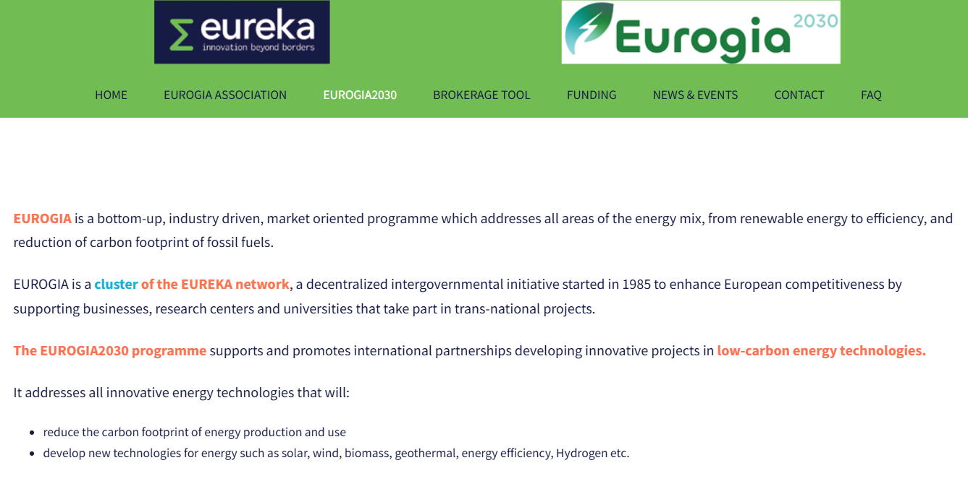

Slide 21
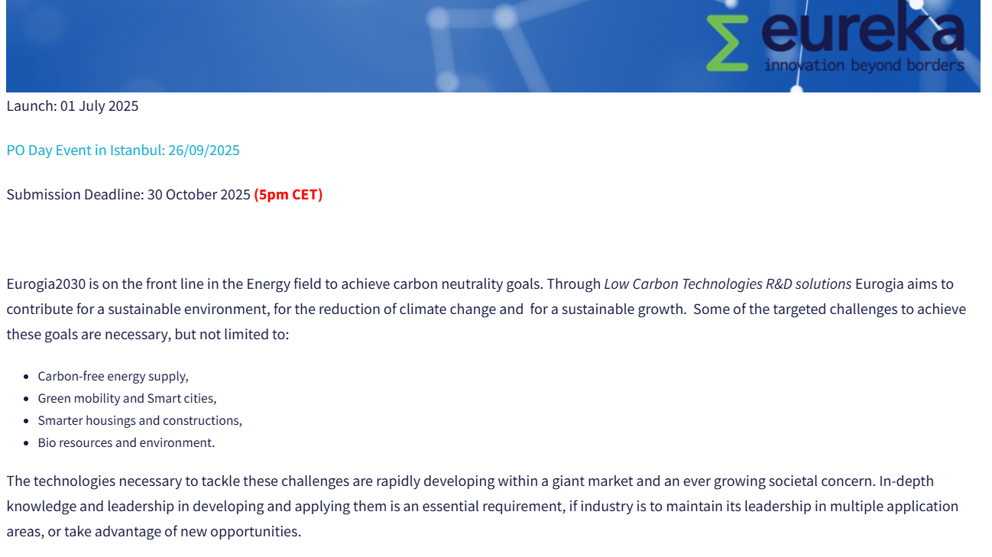

Slide 22
BEST REGARDS

