Slide 1

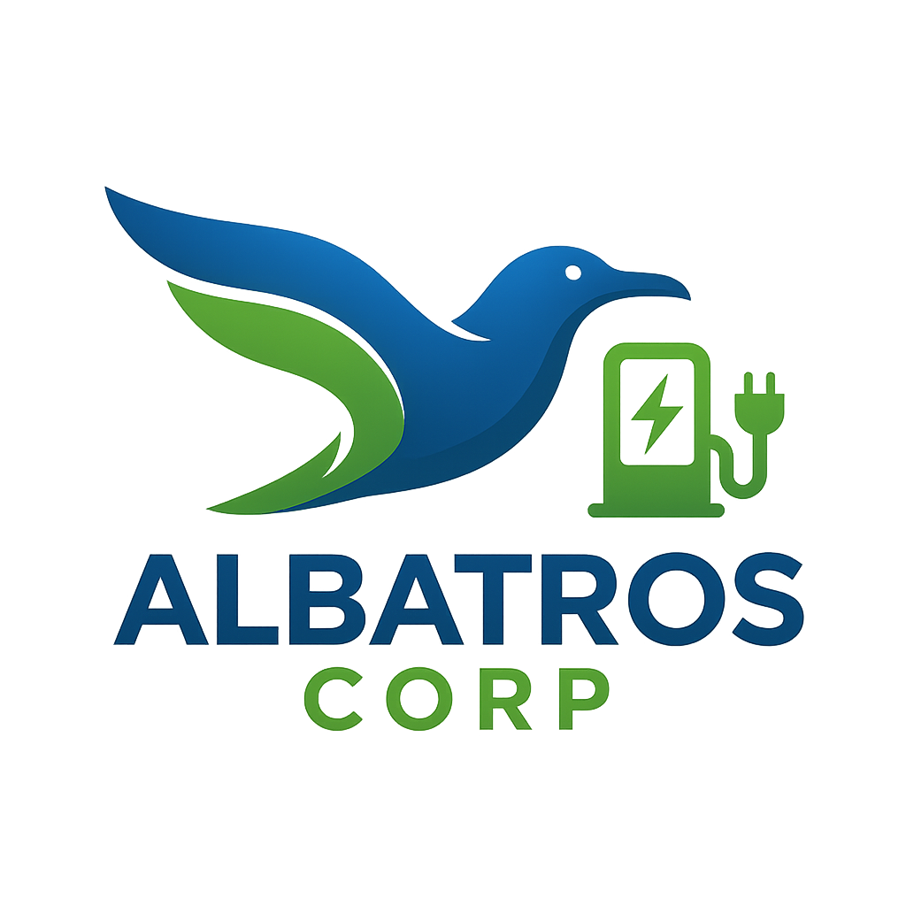



Project Green Taxi
Green Taxi is a sustainable mobility project that produces zero emissions. Our Albatros Green Taxi stands have solar panels on their roofs, generating their own clean energy. Supported by solar-powered charging stations across the city, the system powers both taxis and minibuses in public transportation. With dedicated software, we also improve customer satisfaction. By combining renewable energy with efficient transportation, Green Taxi offers eco-friendly and cost-effective solutions for cities worldwide. Join us in building a healthier, greener, and more sustainable future.
Contacts
trtanadolu@gmail.com
+90 532 120 68 92

