Slide 1


PO DAY ISTANBUL
26/09/2026
Feyza Pakelgil
Email: feyza.pakelgil@zorlu.com
Phone: 0(531) 784 59 27
QR code

Slide 2
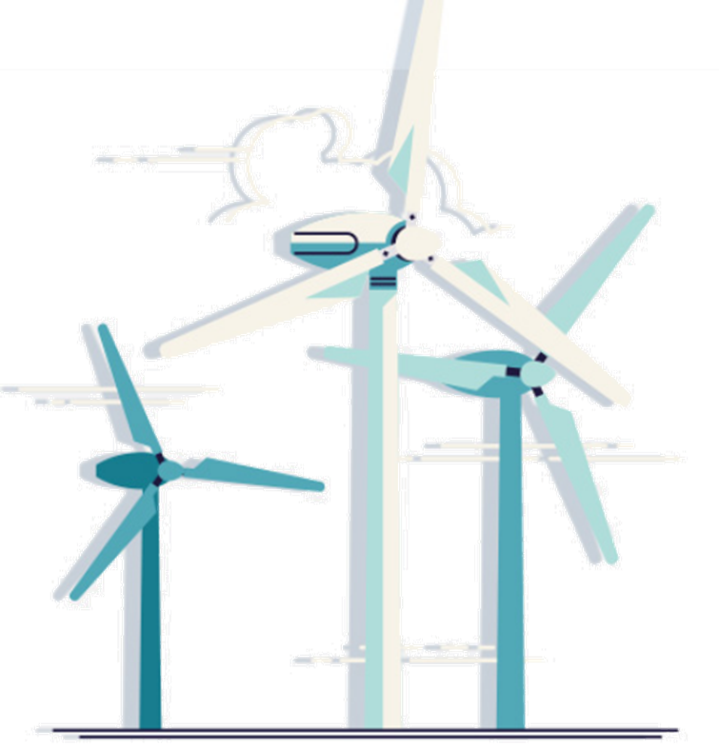







ZORLU ENERJI
4
2
7
GEOTHERMAL
POWER PLANTS
WIND FARMS
HYDROELECTRIC
POWER PLANT
305 MW
191.4 MW
118.9 MW
INSTALLED POWER
TOTAL CAPACITY
TOTAL CAPACITY
1
ELECTRICITY DISTRIBUTION
SOLAR
POWER PLANT
EV CHARGING STATIONS
+3 M
CUSTOMERS
4762
3.8 MW
6.7 TWh
1650
CAPACITY
DISTRIBUTED ENERGY
EV SOCKET CAPACITY

Slide 3
R&D PROJECTS
QUICK LOOK
ONGOING
COMPLETED
ZORLU ENERJI
9
1 Era-NET - Geothermica
8
4 Horizon2020
5 Horizon Europe
1 Era-NET ACT
1 Eurogia2030
1 Eurogia2020
1 TENMAK
1 ITEA3
1 SMART
1 Horizon Europe
OEDAŞ
20
1 ERA-NET
31
27 EMRA
19 EMRA
4 Horizon2020

Slide 4






















R&D PROJECTS
TIMELINE
2018
2019
2020
2021
2022
2023
2024
2025

Slide 5
R&D PROJECTS
RESEARCH AREAS
PLANT OPTIMISATION & DIGITALIZATION
PREDICTIVE MAINTENANCE
HYBRID SYSTEMS
RENOVATION & GREEN CONVERSION
BATTERY & ALTERNATIVE STORAGE TECHNOLOGIES
e - MSP
SMART GRID
RECYCLING
CCUS
CPO
GRID PLANNING
DATA TRANSMITTION
LITHIUM EXTRACTION
UX
DERs - EVs
HEATING&COOLING
EXPLORATION
EV CHARGING
DSO
WIND
SOLAR
HYDROPOWER
GEOTHERMAL

Slide 6





































































































































PARTNERSHIPS
20+
Countries
130+
PARTNERS
Universities
Research Institutions
Companies
SMEs

Slide 7
PUBLICATIONS
Four Decades of Service – Kızıldere Reservoir, Units and Management
Reflecting Supportive Mechanisms and Experience of Turkey - Zorlu Case Study
How Did Turkey Succeed in Raising Public Awareness and Environmental Protection Along with Geothermal Developments?
Design of a Scaling Reduction System for Geothermal Applications
Optimal Sizing and Siting of Different Types of EV Charging Stations in a Real Distribution System Environment
A Smart Dynamic Pricing Approach for Electric Vehicle Charging in a Distribution System
Enhancing the Flexibility of Electricity Generation and Heating for Kızıldere II Geothermal Power Plant by Demonstrating Heat Storage Systems
Analysis of the Potential for Increased Power Production in an Onshore Test Wind Farm Using Active Wake Control Methods
Trading process and flexibility energy service exchange
Coatings to Regulate Scaling in Geothermal Applications
Distribution Network Planning Considering Ev Integration: Case Study In The Northwest of Turkey
Environmental benefits for a geothermal power plant with CO2 reinjection: case study of the Kizildere 3 U1 geothermal power plant
Techno-Economical Assessment of Hydrogen Production from the Integrated System Including Geothermal Energy and Proton Exchange Membrane Electrolyser
Hybridization of Concentrated Solar Power with Geo-thermal and Biomass Power
Hybrid Geothermal and Concentrating Solar Power Plant: A Case Study for Kizildere 2, an 80 MW Plant in Turkey.
Demonstrating technologies for geothermal to enhance competitiveness in smart and flexible operationin Turkey.
Artificial Intelligence Approaches for Sustainable Geothermal Energy Systems: With A Case Study
Carnot battery integration in a geothermal power plant: study case of Zorlu Enerji.

Slide 8
THANK YOU
Feyza Pakelgil
Email: feyza.pakelgil@zorlu.com
Phone: 0(531) 784 59 27

