Slide 1




ReMinergy-TES: Recycled Minerals & Clay-Based Materials for Thermal Energy Storage Systems
Helin Hazar¹, Assoc.Prof.Dr. Birgül Benli^{1,2*}
Istanbul Technical University, Mining Faculty, Mineral Processing Engineering Department, Maslak, Istanbul, Turkiye
Istanbul Technical University, Graduate School, Nanoscience and Nanoengineering Program, Maslak, Istanbul, Turkiye
Contact
benli@itu.edu.tr
26/09/2025
Eurogia2030 Spring Call
Sabancı Center, Istanbul

Slide 2

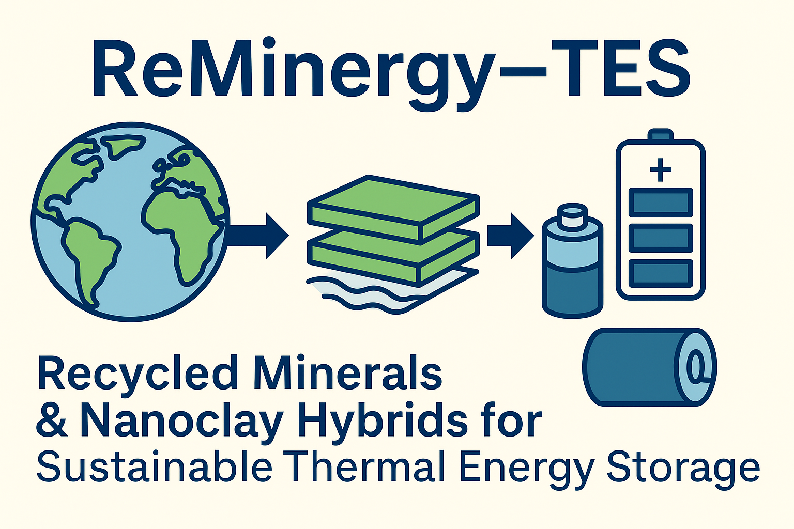
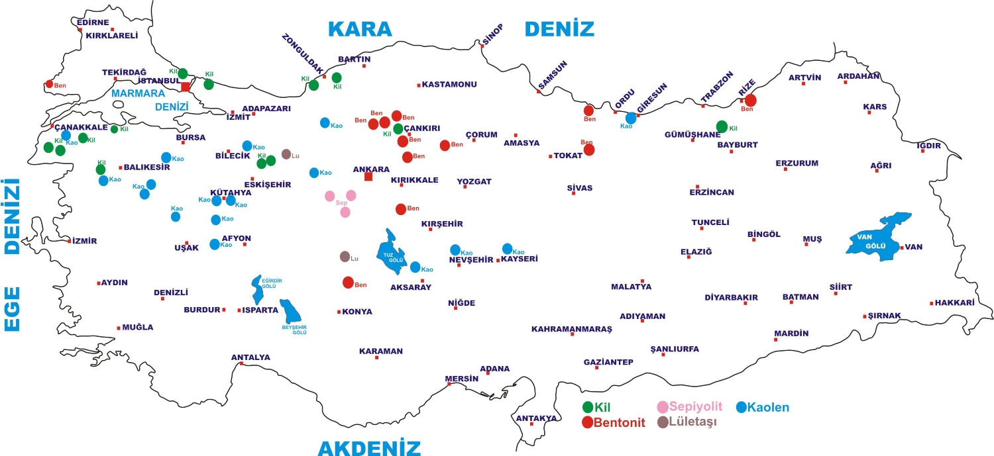
Why This Project?
Fossil-free energy systems require reliable thermal energy storage (TES) solutions
Conventional TES materials (salts, paraffins) are expensive or environmentally harmful
End-of-life EV batteries are growing globally — containing valuable critical metals
Natural nanoclays in Türkiye are underutilized despite their energy storage potential

Slide 3
🧱 Why Are Nanoclays Needed in TES?
Nanoclays, like montmorillonite, halloysite, and bentonite, are layered silicate minerals with nanoscale structures that offer unique advantages for TES materials:
✅ 1. Improved Thermal Conductivity
TES materials (like PCMs) often suffer from low heat transfer rates. Nanoclays improve thermal conductivity, helping heat move faster and more evenly.
✅ 2. Stabilization of PCMs
PCMs like paraffin melt and solidify, but they may leak or degrade. Nanoclays encapsulate or support these materials, making them more stable, reusable, and leak-proof.
✅ 3. Mechanical Strength
TES composites often face mechanical stress. Nanoclays add mechanical durability and resistance to thermal cycling.
✅ 4. Eco-friendly and Abundant
Nanoclays are natural, non-toxic, and widely available — especially in countries like Türkiye. This makes TES solutions more sustainable and affordable.
🔥 What is Thermal Energy Storage (TES)?
Thermal Energy Storage (TES) is a method of storing thermal (heat) energy for later use.
Instead of storing electricity, TES systems store heat that can be used later for:
Heating buildings
Industrial processes
Solar energy storage (e.g., CSP – Concentrated Solar Power)
Reducing peak energy demand
Main TES methods:
Sensible heat storage – storing heat by raising temperature (e.g., water, rock, concrete)
Latent heat storage – using phase change materials (PCMs) like paraffin, salts
Thermochemical storage – storing energy in chemical bonds (reversible reactions)

Slide 4
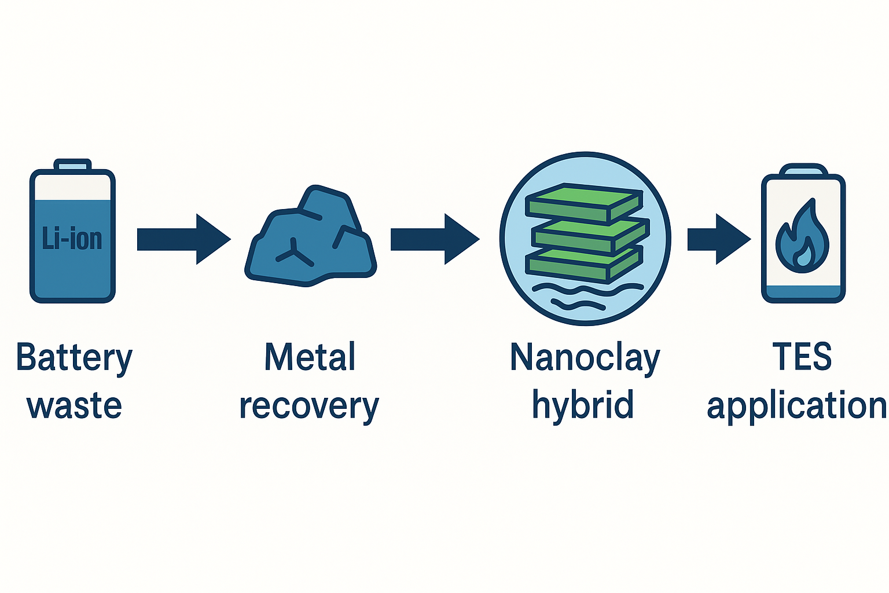
ReMinergy-TES Concept
Our Solution
Recovery of Li, Co, Ni from spent EV batteries
Combination with montmorillonite, halloysite and bentonite clays via intercalation & composite casting
Development of nanoclay-metal hybrid materials
Integration into sensible or latent thermal energy storage systems
→ Thermal energy storage: Buildings, industry, low-carbon systems
Inspired by ancient clay heating uses, modern nanoclay hybrids enable efficient and sustainable heat storage from recycled materials.

Slide 5
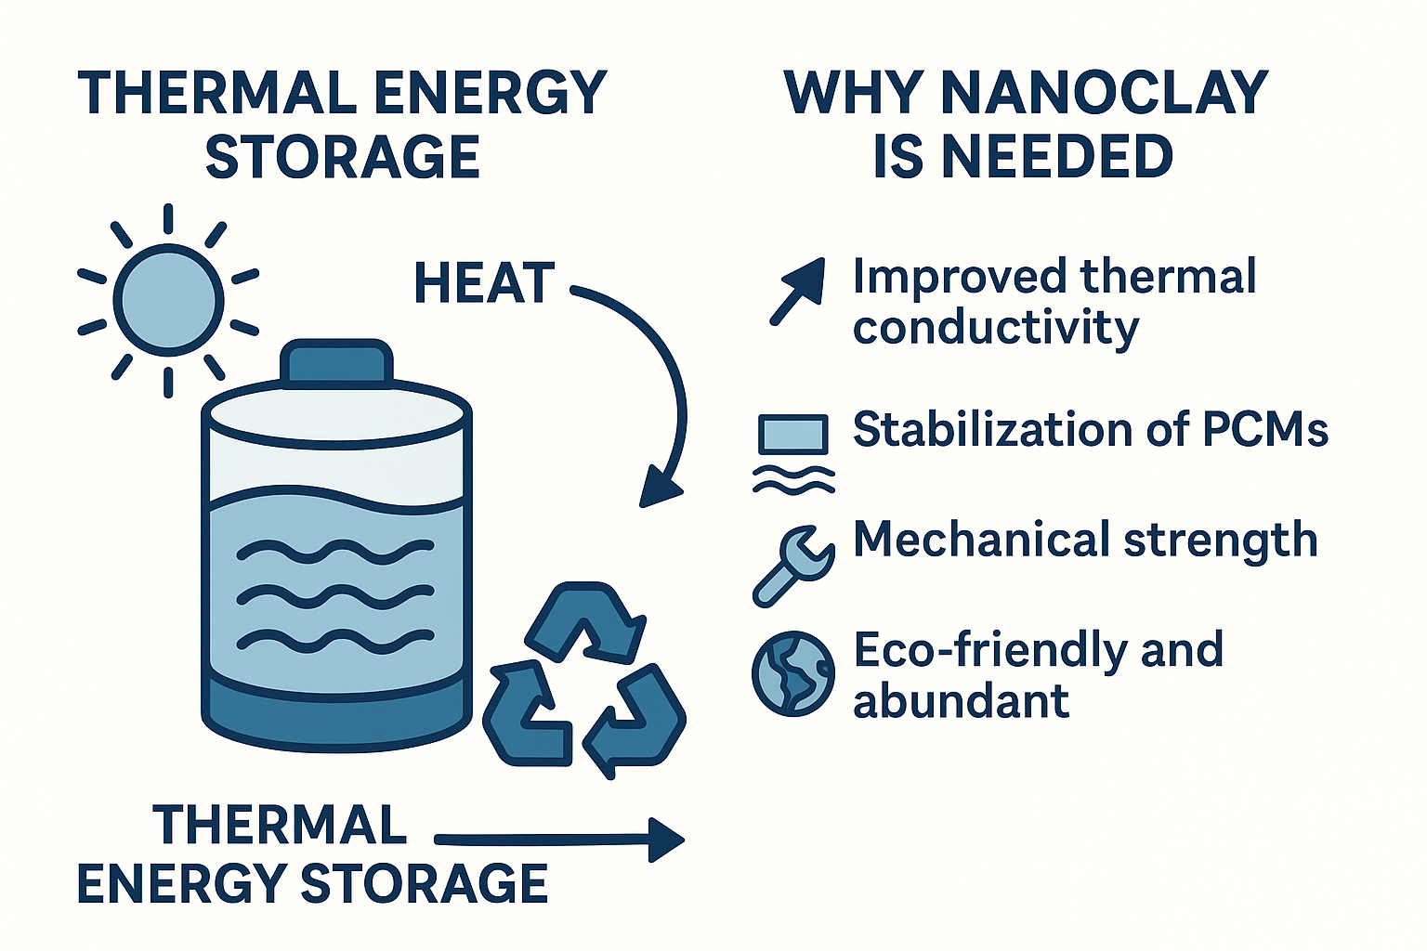
Why It Matters ✔️
Impact and Added Value
Enhances safety, thermal conductivity, and durability in TES systems
Reduces environmental impact and material costs
Utilizes Türkiye’s rich natural clay reserves
Supports circular economy and local mineral valorization
Contributes to sustainable mining via our mineral processing expertise
Revalorizes abandoned mineral stockpiles through upcycling

Slide 6
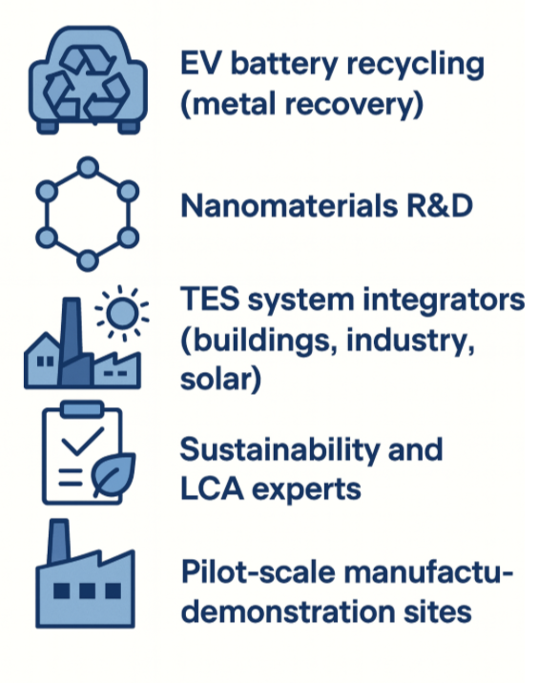
Who We Are Looking For
Call for Collaboration
Closing the Loop: Nanoclay-Based Thermal Energy Storage from EV Waste

Slide 7
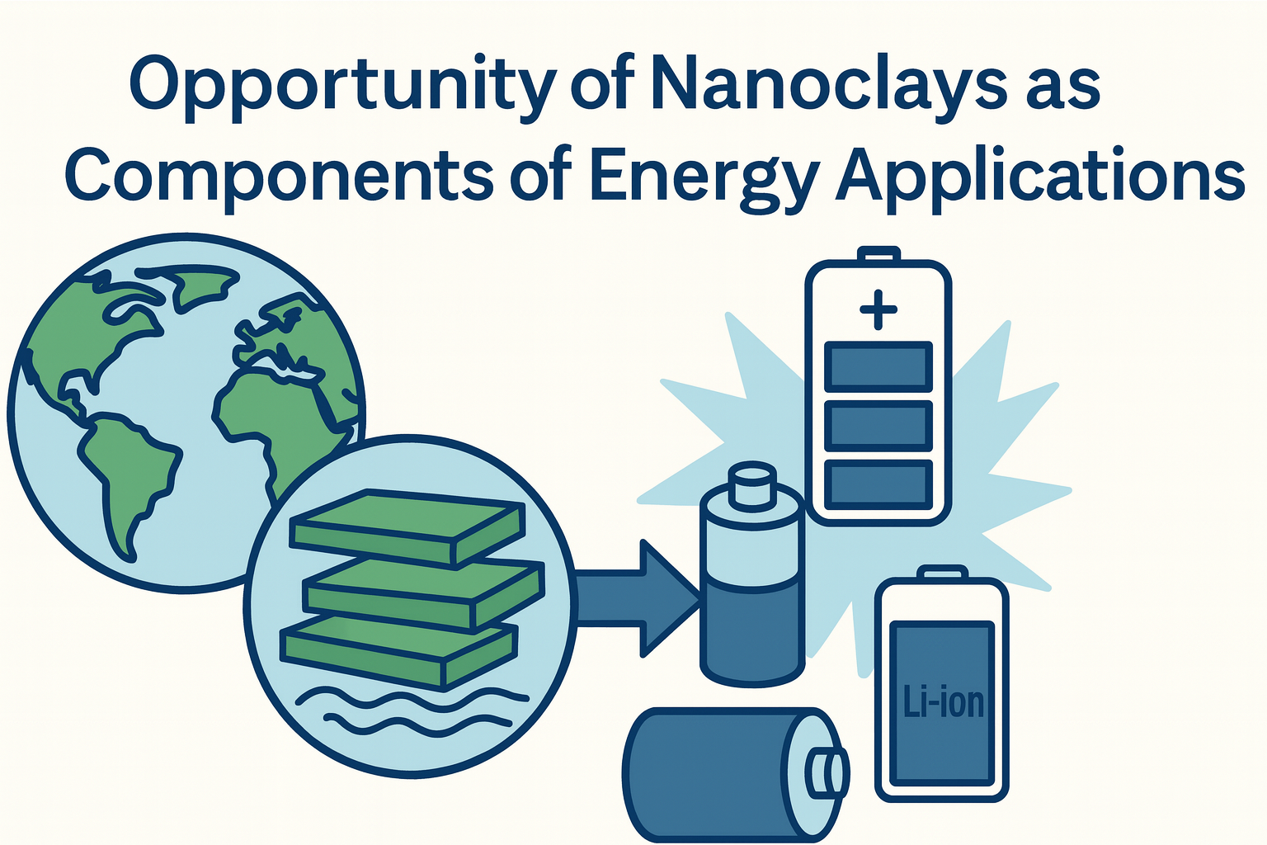
We welcome collaboration — thank you for your attention.
??.??.2024
Thermal energy is everywhere — let’s store it sustainably.

