Slide 1

EUROGIA PO DAY PRESENTATION
Dr. Anıl Erdoğan
26.09.2025

Slide 2
Outline
About Vestel
Topics Interested in Vestel

Slide 3

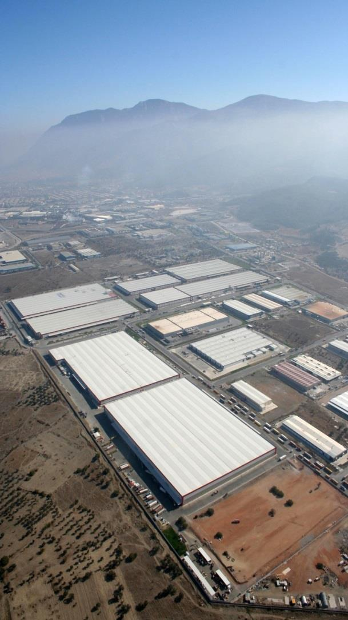
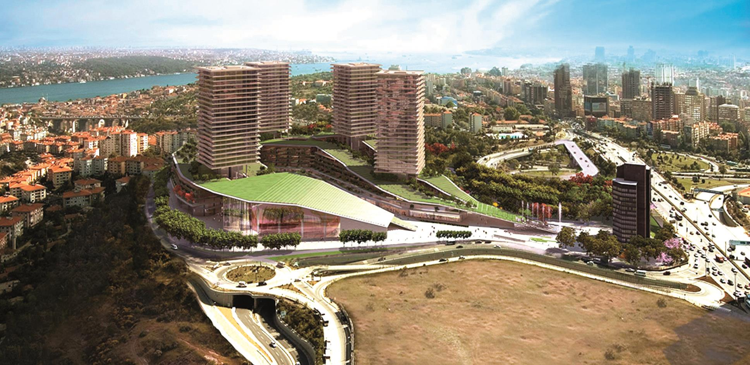
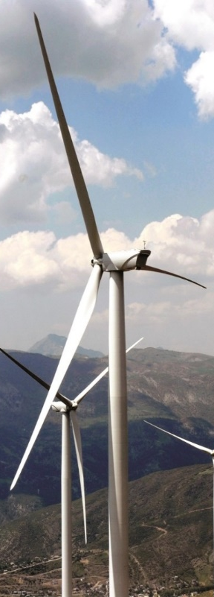
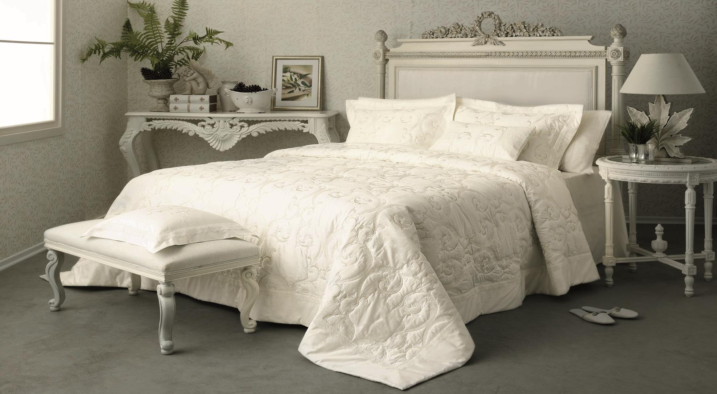


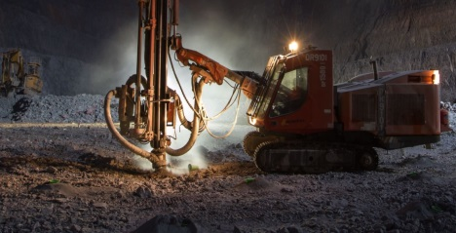
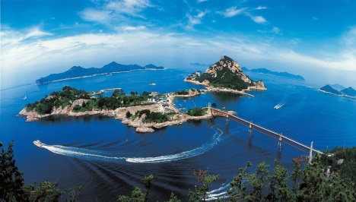
SOCIAL FOUNDATION
FACTORING
REAL ESTATE
TEXTILE
VESTEL
ENERGY
NICKEL MINING
TOURISM
Notes:
Vestel is a part of Zorlu Holding Company. Zorlu has different companies in different sectors. These are…

Slide 4
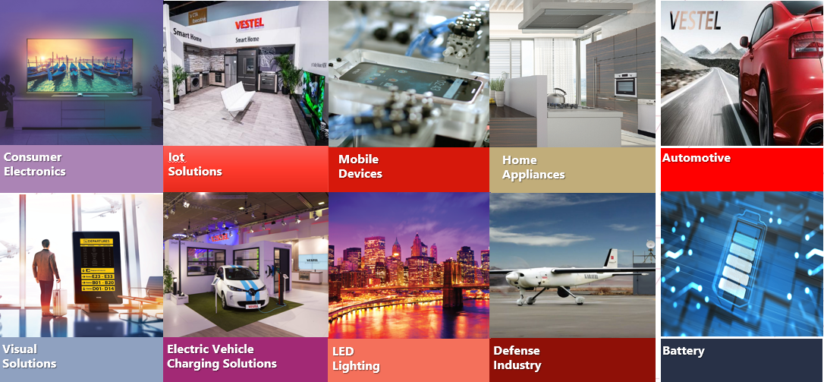
About Vestel

Slide 5
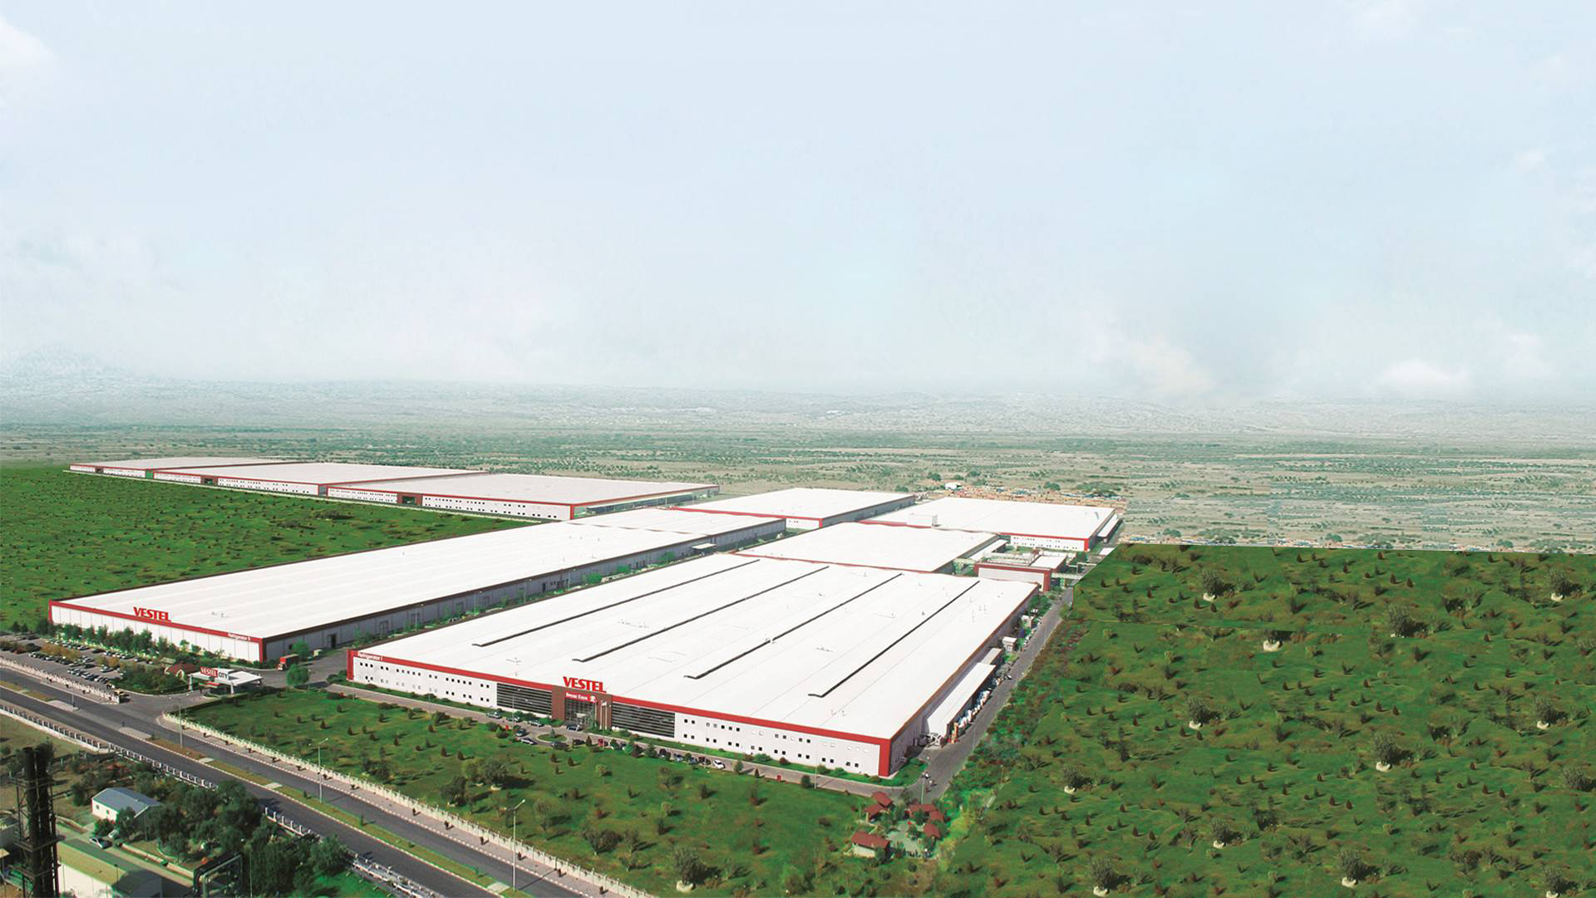





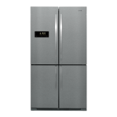
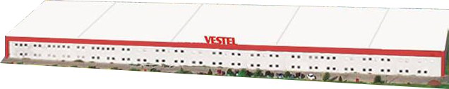
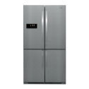
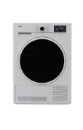

Total: 44.500 m²
Production: 34.500 m²
Warehouse: 10.000 m²
Total: 43.500 m²
Production: 31.000 m²
Warehouse: 12.500 m²
Cooking Appliances
Washing Machine
Total: 19.200m²
Production: 14.200 m²
Warehouse: 5.000 m²
Total: 97.700 m²
Production: 51.000 m²
Warehouse: 46.700 m²
Total: 46.000 m²
Production: 30.000 m²
Warehouse: 16.000 m²
Air Conditioner
Dishwasher
TV
Total: 90.100 m²
Production: 54.500 m²
Warehouse: 35.600 m²
Refrigerator 2
Total: 66.900 m²
Production: 58.400 m²
Warehouse: 8.500 m²
Total:62.000 m²
Production: 33.000 m²
Warehouse: 30.000 m²
Refrigerator 1
Tumble Dryer
Vestel City Total:
1.3 million m²
Notes:
This Picture shows the genaral layout of our plant. Now we are here in Refrigerator-1, Just beside on the left refrigerator-2, at the rear washing machine, on the left air conditioner, water heater, cooking appliances and dishwasher, on the right tumble dryer. And on the right, new building for dishwasher is under construction. You will have a chance to see the buildings during Vestel city tour.
Avrupa’nın sektöründe en büyük teknoloji üssüdür. Şu anda buradayız. Bulaşık makinesi yeni fabrikamız da kurutmanın arkasındadır. City Tourd sırasında

Slide 6
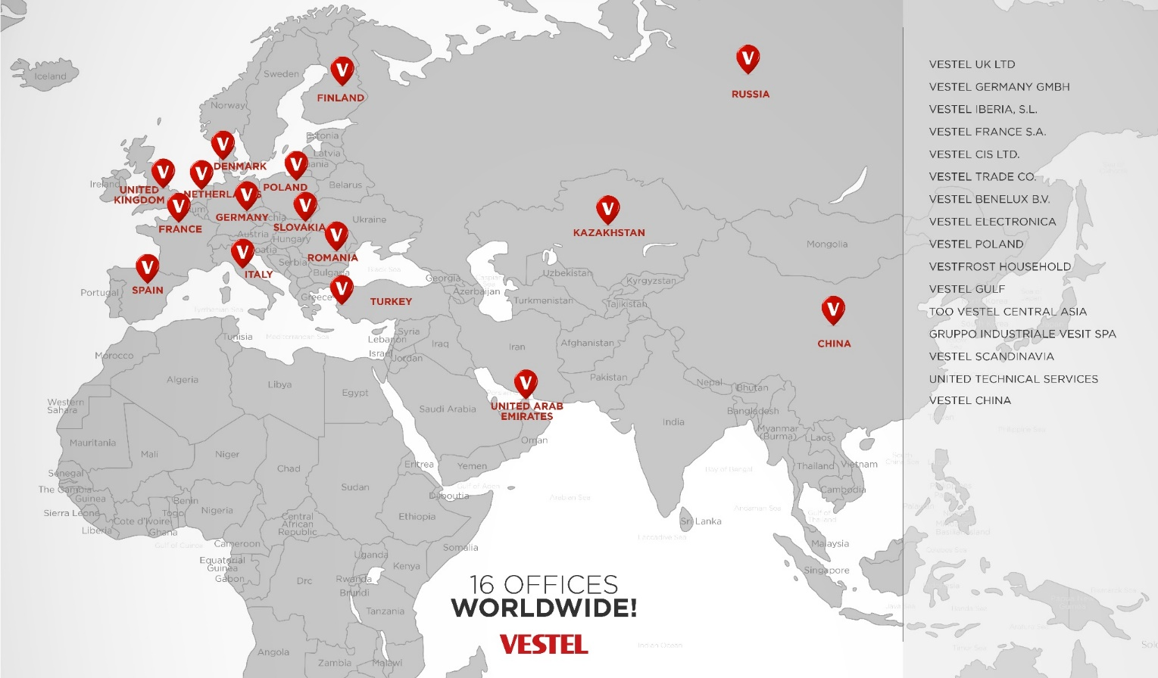
About Vestel

Slide 7


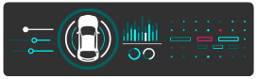







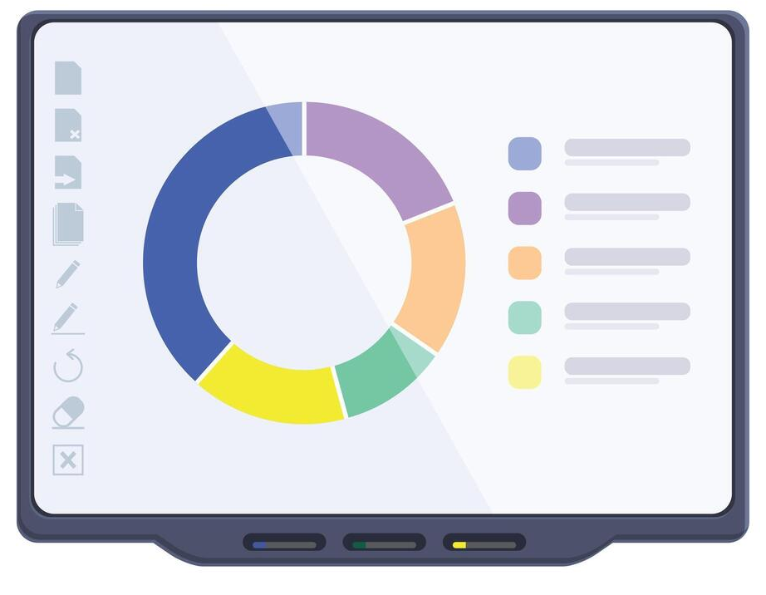
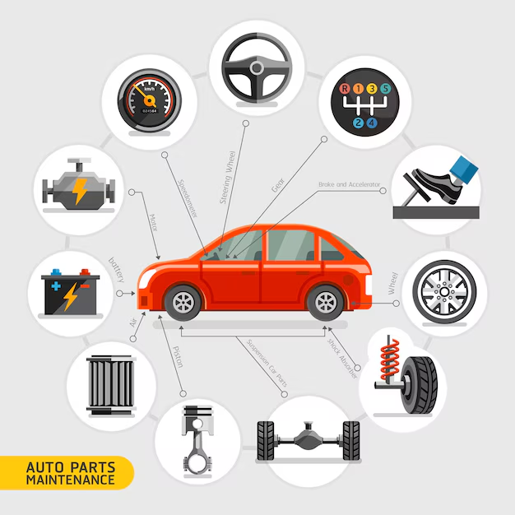
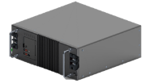
Plasma
TV Production
Automotive
Display
Vestel
Establishment
New
Diswasher
Plant
Air Conditioner
Cooking Appliances
Heater
Android TV
1984
1999
2000
2003
2005
2007
2010
2012
2016
2018
2019
2022
2023
Refrigerator
Washing Machine
DishWasher
Visual Solutions
Smart Boards
Tumble
Dryer
Automotive
PCDBA
OLED
OCM
ESS
Notes:
Vestel Home Appliances has 7 main product groups. Starting in 1999 with refrigerator, then air conditioner, washing machine, cooking appliances, dishwasher, water heater and lastly in 2018 tumble dryer production has been started.

Slide 8



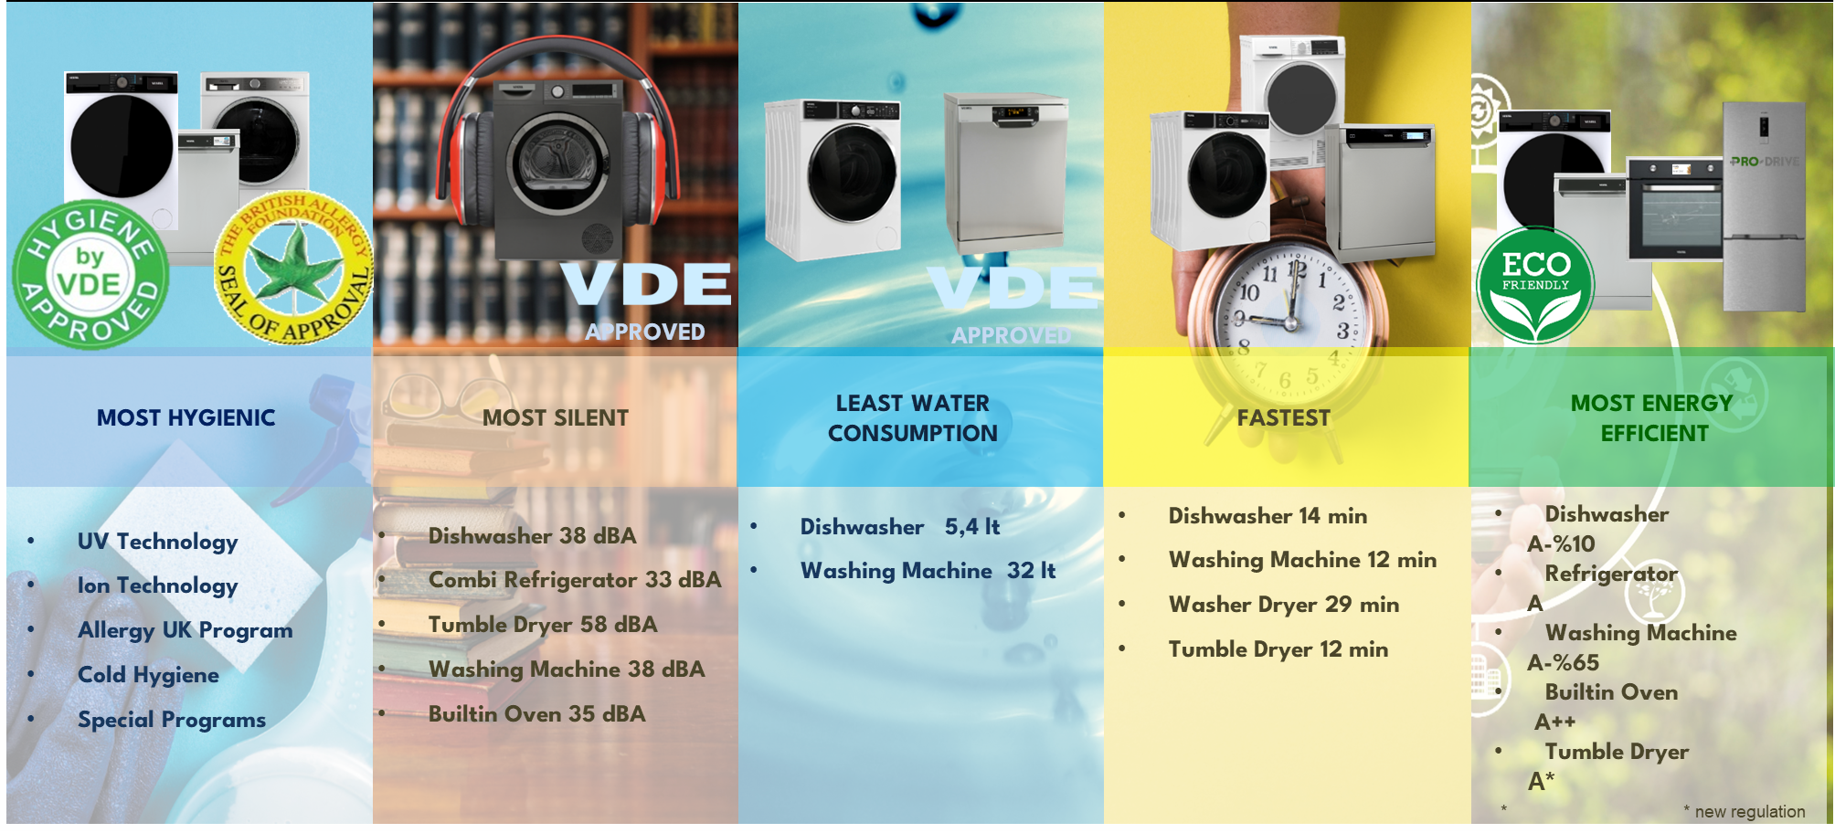
About Vestel
Key attributes
Most hygienic
Most silent
Least water consumption
Fastest
Most energy efficient

Slide 9
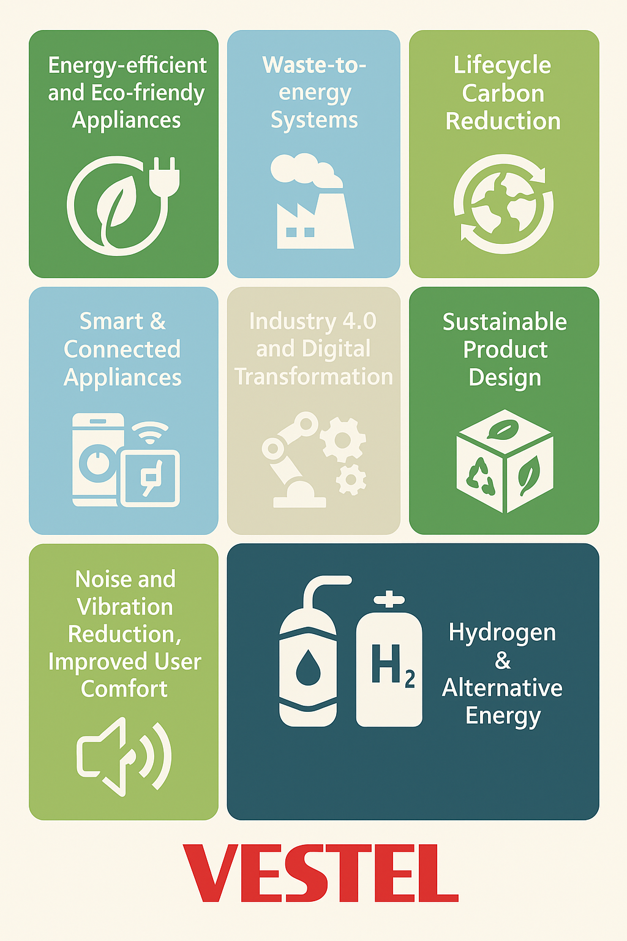
Topics Interested in Vestel
• Energy-efficient and eco-friendly appliances (high-efficiency products, low GWP refrigerants, lifecycle carbon reduction)
• Waste-to-energy systems
• Smart and connected appliances (IoT integration, AI-based control, cloud-enabled features)
• Industry 4.0 and Digital Transformation (robotics, predictive maintenance, digital twins, smart factories)
• Sustainable product design (recycled/recyclable materials, circular economy approach)
• Noise and vibration reduction, improved user comfort
• Next-generation cooling, food preservation, and water/energy saving systems
• As part of our long-term innovation roadmap, we are exploring the potential of hydrogen energy as a clean and efficient solution for the next generation of home appliances. Alternative energy solutions, such as hydrogen-based heating systems for future appliances

Slide 10


THANK YOU FOR LISTENING

Slide 11


