Slide 1
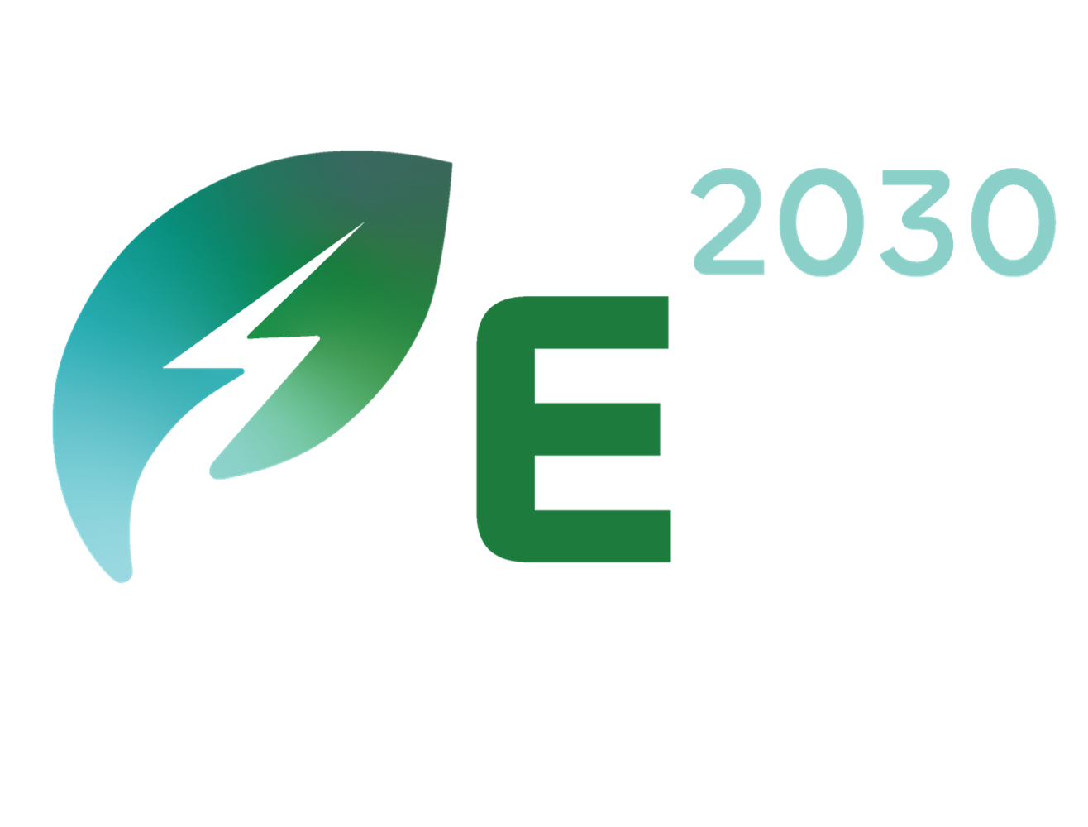


Sustainable Biofuel Production for the Maritime Industry
This project develops an AI-enabled model for sustainable biofuel production from biomass and plant waste, aligning with zero-waste principles. The platform will digitally classify biomass, match feedstocks with optimal technologies, and apply digital twin models for forecasting and optimization. By enhancing energy efficiency, minimizing environmental impact, and valorizing byproducts like biogas and biochar, the project provides a national roadmap to maximize biofuel production and support circular economy practices.
Company Logo
Contacts: Hüseyin BIYIKCI (Project Coordinator)
Email: hbiyikci@pirireis.edu.tr
Phone: (0216) 581 00 50 - 1648
QR code:
Website: https://pirireis.edu.tr/

Slide 2
Zero Waste and Circular Production Model with AI-Supported Biomass Ecosystem (BioLoop)
BioLoop develops an AI-driven circular biomass ecosystem based on zero-waste principles. Regional biomass resources are digitally classified, while digital twin models enable real-time monitoring and optimization of conversion processes. AI algorithms identify optimal conditions for each biomass type, increasing efficiency and minimizing emissions. By-products such as biogas and biochar are reused through industrial symbiosis, fostering circular economy models and sustainable, traceable biomass valorization.
Company Logo
Contacts: Hüseyin BIYIKCI (Project Coordinator)
Email: hbiyikci@pirireis.edu.tr Phone: (0216) 581 00 50 - 1648
QR code:
Website: https://pirireis.edu.tr/

