Slide 1

VESSEL-TWIN
Virtual Environmental Simulation for Sustainable Energy Lifecycle - Twin
Saeed Nourizadeh Azar

Slide 2
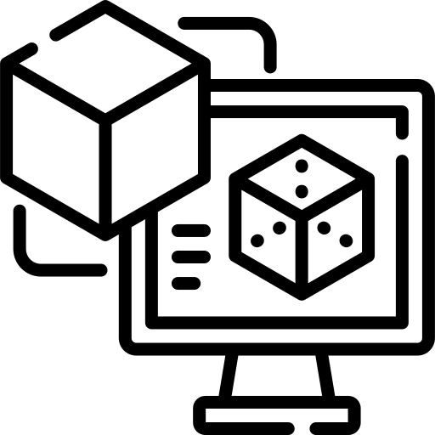




Project Idea
Challenge:
Decarbonization pressures and stricter environmental regulations
High costs and risks of testing new solutions at sea
Lack of real-time data collection and analysis infrastructure
Solution:
Digital twin platform for real-time simulation of vessel operations
Enables virtual testing of strategies to reduce costs and risks
Supports data-driven decision-making and sustainable operations
Result:
Smarter, greener, and safer maritime operations with optimized performance
Digital Twin
AI
Simulation

Slide 3
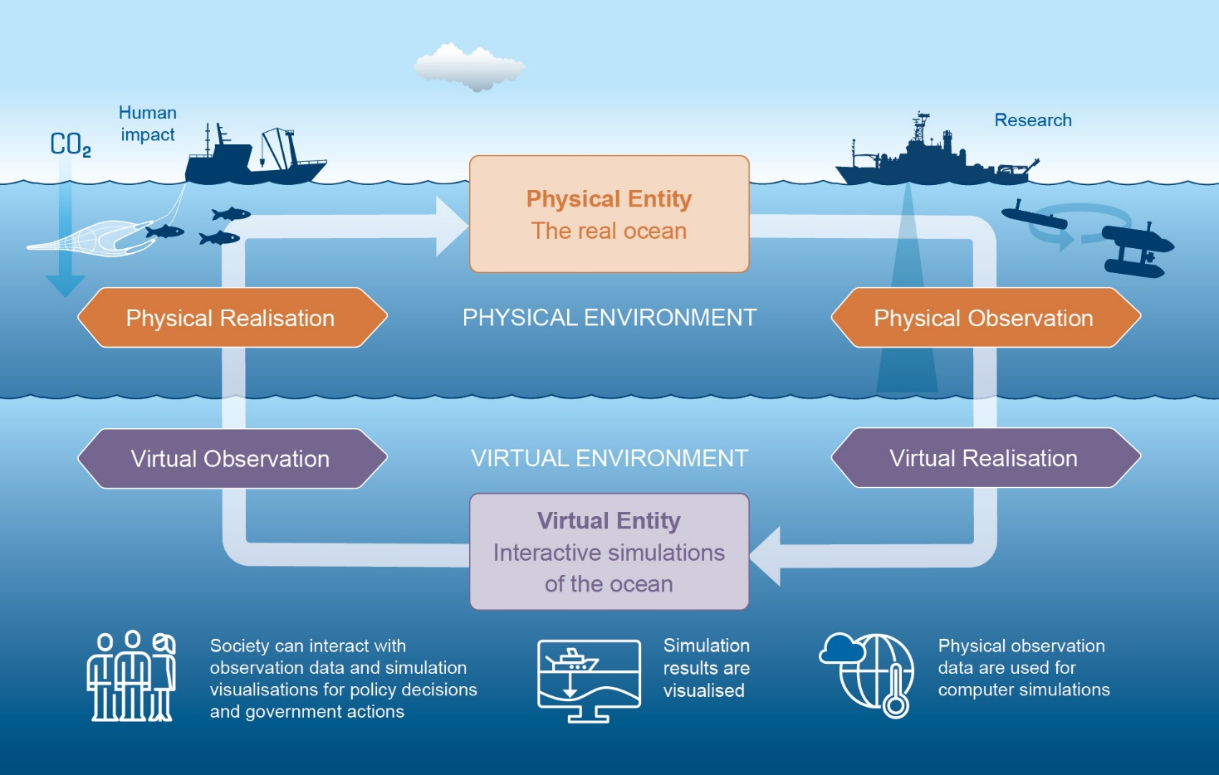
Scope of the Project
Scenario Definition
Data Collection & Analysis
Digital Twin Development
Performance Optimization & Decision Support
Saeed Nourizadeh Azar
https://www.geomar.de/en/research/irf/digital-twin-ocean

Slide 4
Key Points
Innovative Digital Twin Platform
  Virtual testing of different scenarios
  Optimization of operations to reduce fuel use, emissions, and costs
  Data-driven decision-making
Flexible and Scalable Solution
  Various vessel types and operational conditions
  Multiple data sources, including sensors, IoT devices, and existing systems
  Autonomous vessel operations and smart ports

Slide 5
Partners & expertise
Partners involved:
OBSS
Glasgow University
Missing partners / Expertise:
Marine Vehicle Provider
Hydrogen & Decarbonization Partner
Sensor Provider
Saeed Nourizadeh Azar

Slide 6
Contact
Saeed Nourizadeh Azar (OBSS Technology)
Email: saeed.nourizadehazar@obss.tech
Phone: +90 551 049 36 49
Saeed Nourizadeh Azar

