Slide 1


About us

Slide 2

Technical Background
Geospatial Intelligence
Remote Sensing
Disaster Risk Assessment

Slide 3

GIS
DATA IMPUTATION
SYNTHETIC URBAN MODELLING (DIGITAL TWIN)
HAZARD SIMULATION
DATA MANAGEMENT
WEB GIS DEVELOPMENT
GIS DASHBOARD DESIGN

Slide 4
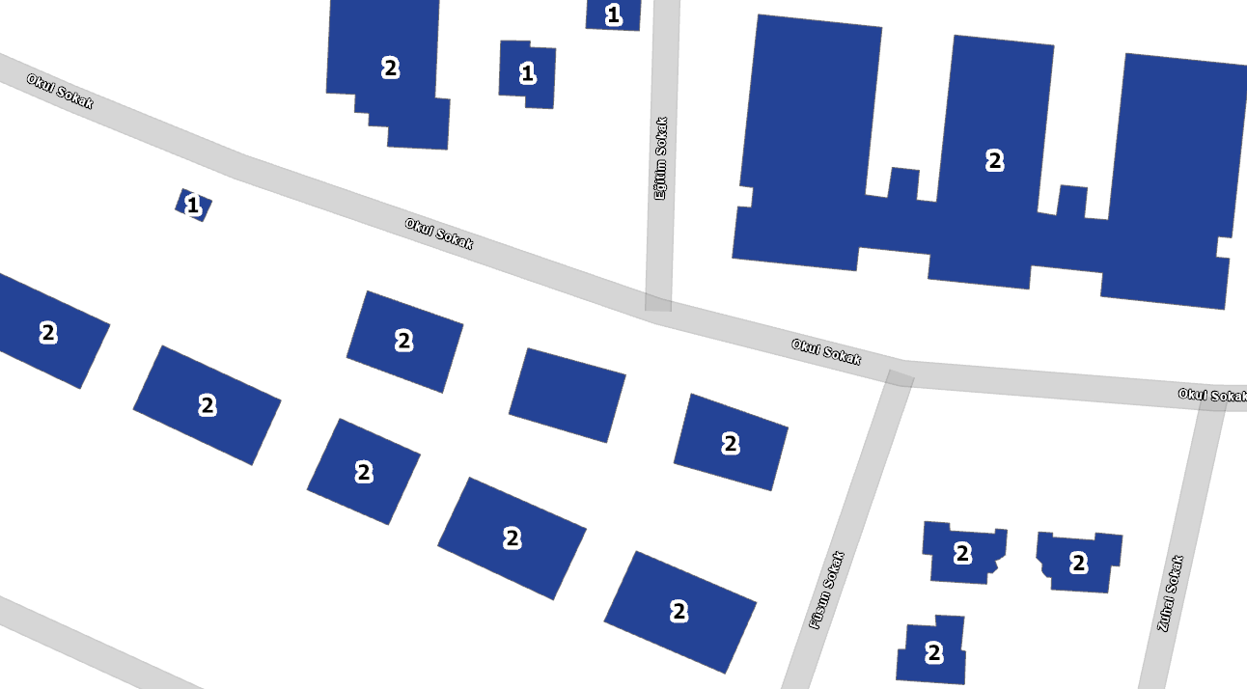
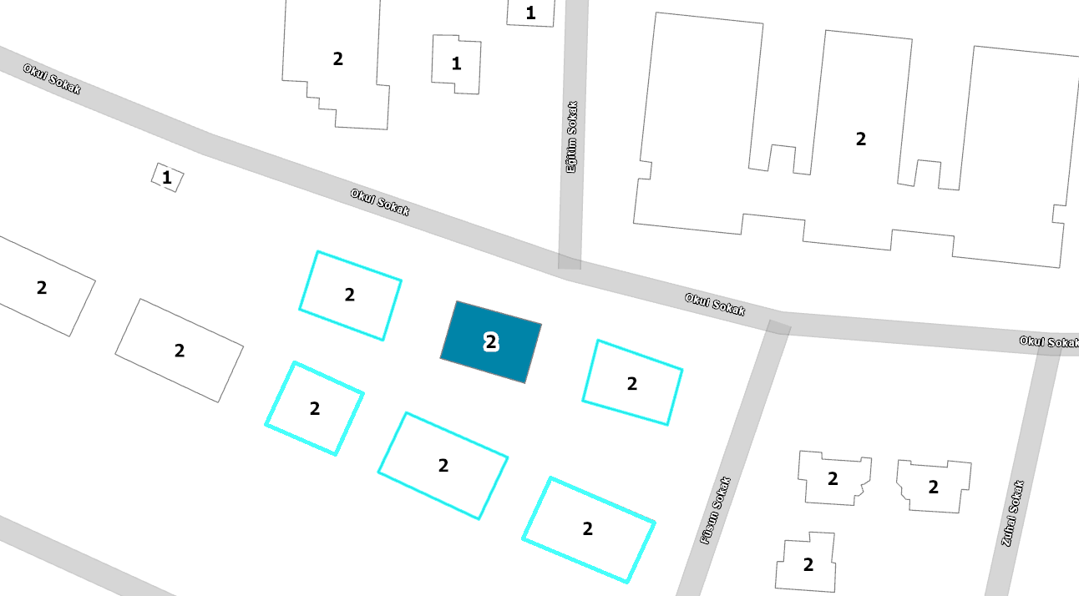
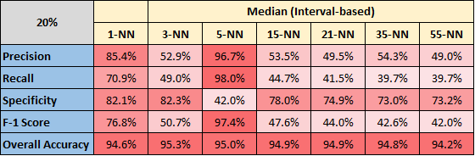
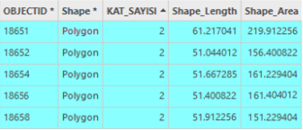
DATA IMPUTATION
Missing data is not a problem anymore

Slide 5
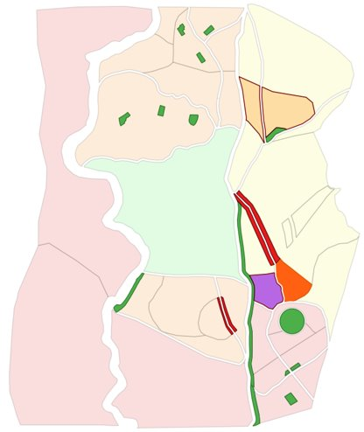
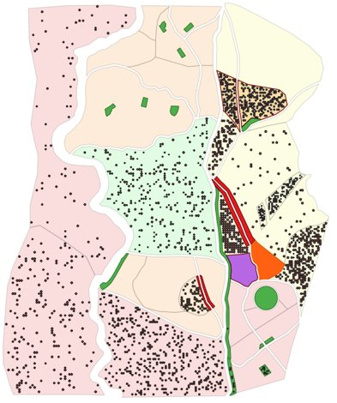
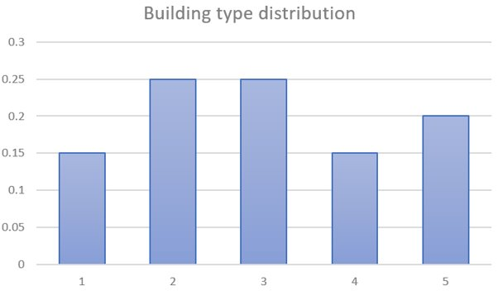
SYNTHETIC/FUTURE URBAN MODELLING
Understanding how and where future cities will emerge gives you an understanding of future energy demands

Slide 6
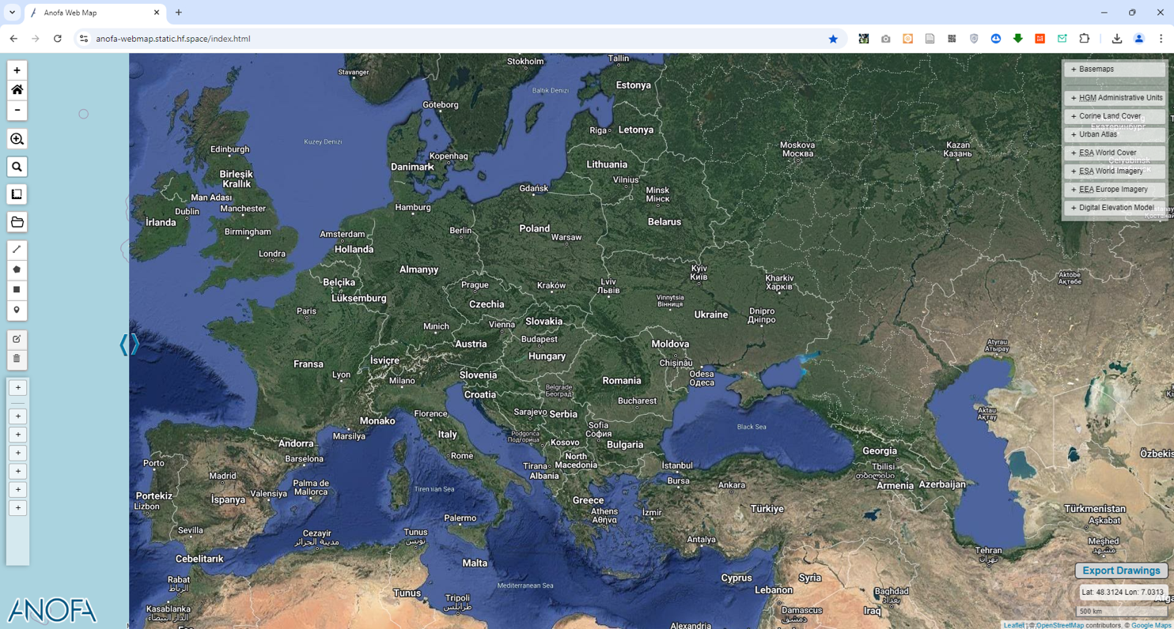
Web GIS applications
Easy access to datasets
Efficient communication of complex spatial information
https://webmap.anofa.co

Slide 7
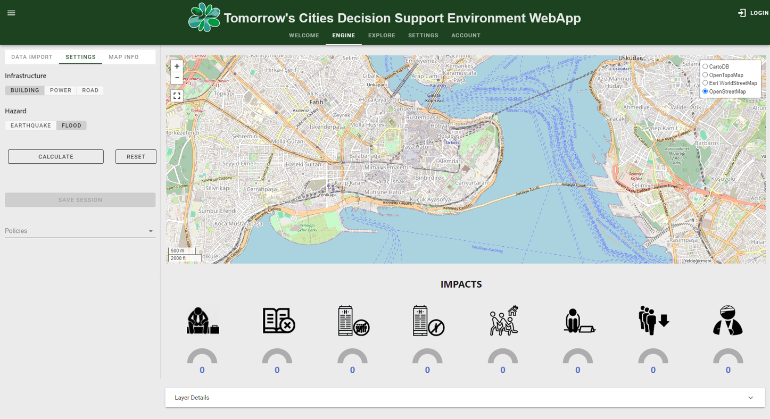
Web GIS for Disaster Risk Assessment
Model how your assets may behave under different hazard effects
An intelligent approach to prevent potential losses to your energy infrastructure
https://webapp.tomorrowscities.org/

Slide 8
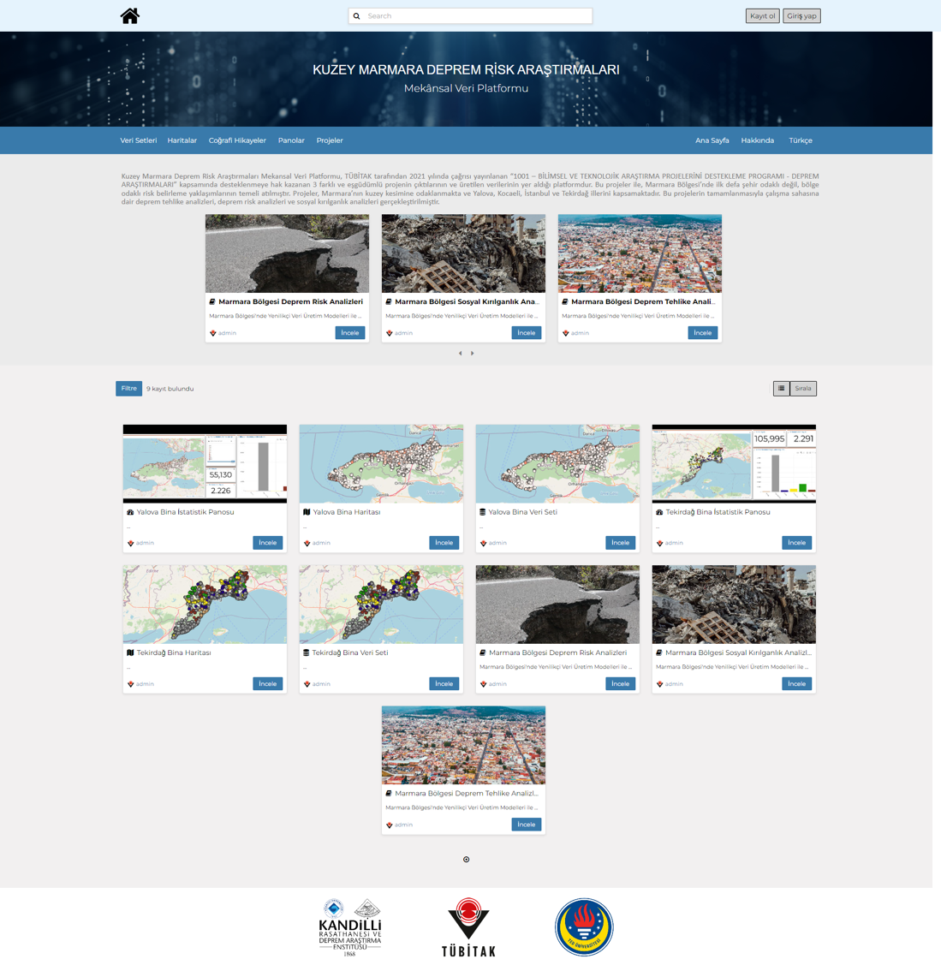
DATA MANAGEMENT
Organize your data with open source frameworks such as:
CKAN
GeoNode (Provides spatial backend too)

Slide 9
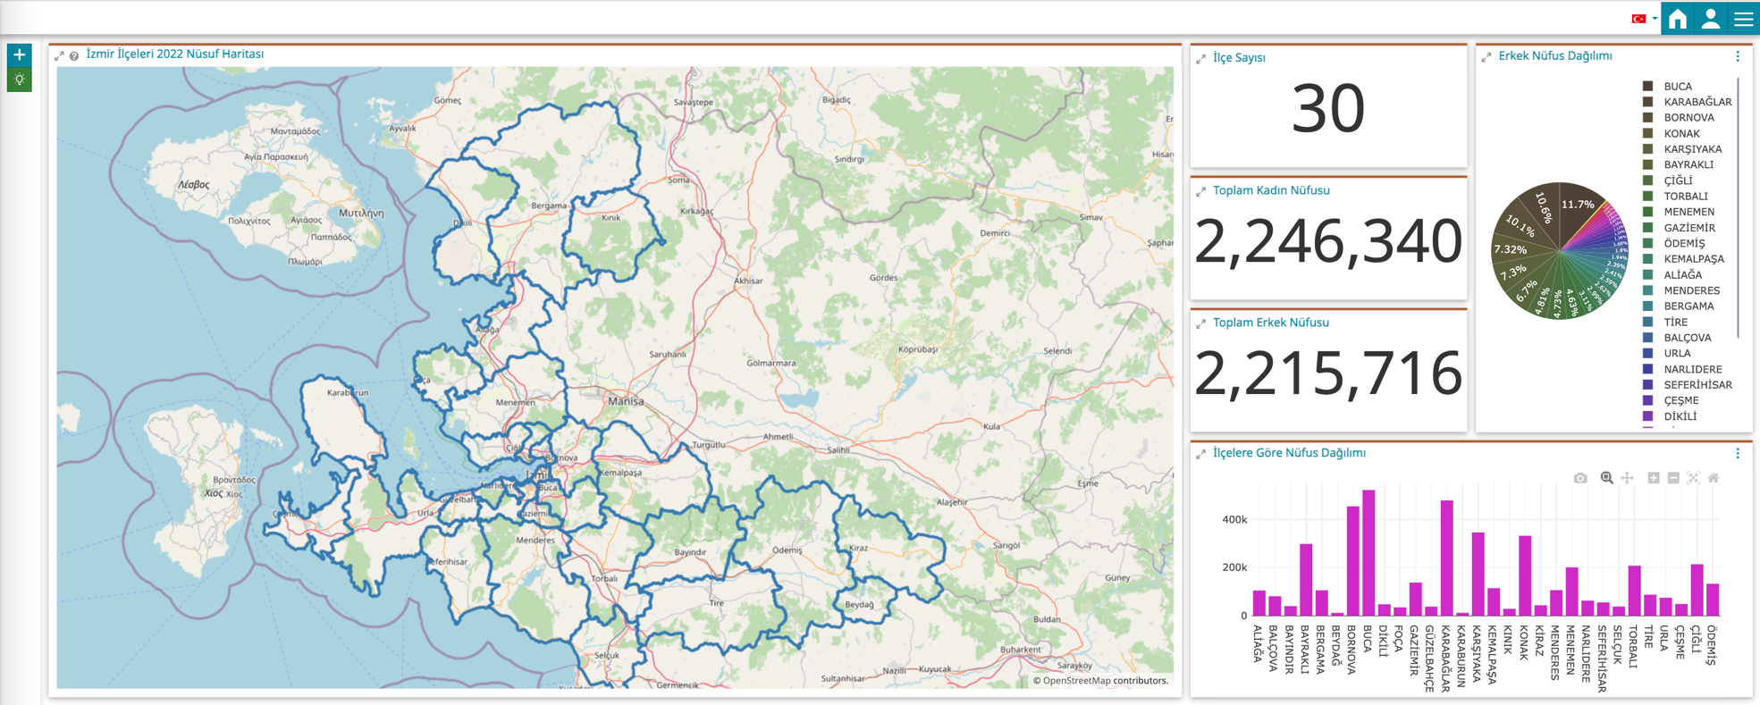
Dashboard – Present statistics with maps

Slide 10

EARTH OBSERVATION
Object/Pixel based classification
  Land use and land cover
  Water resources and pollution
  Forests and vegetation
  Urbanization and infrastructure
Urban growth forecast

Slide 11
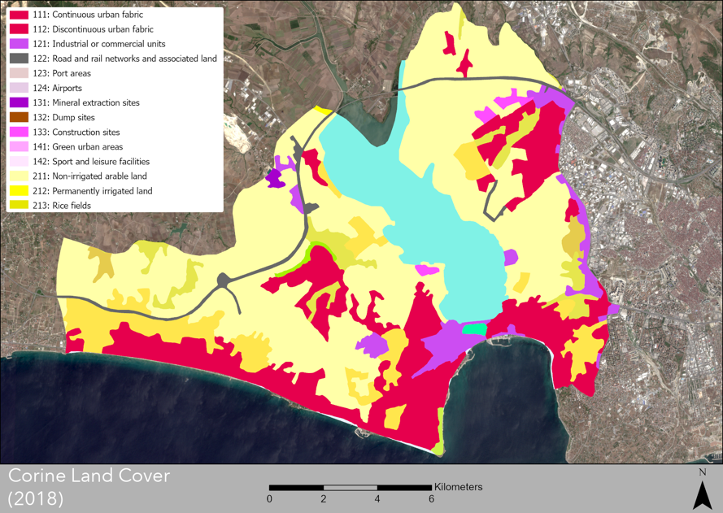
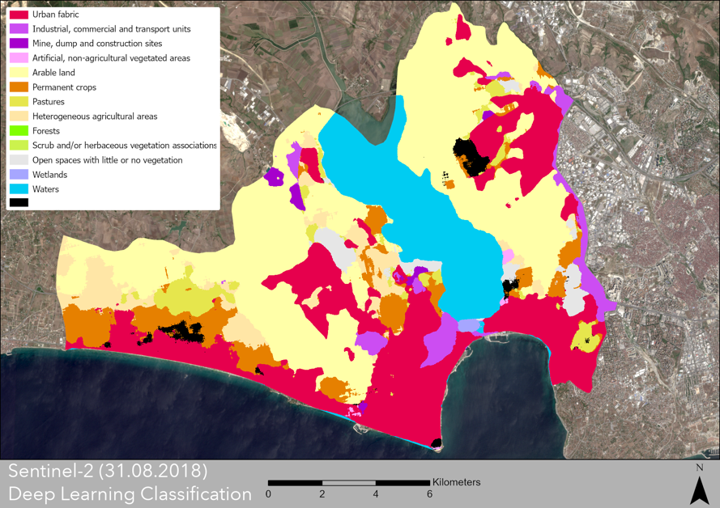
Land Cover Classification
Corine Land Cover
Deep Learning Classification

Slide 12
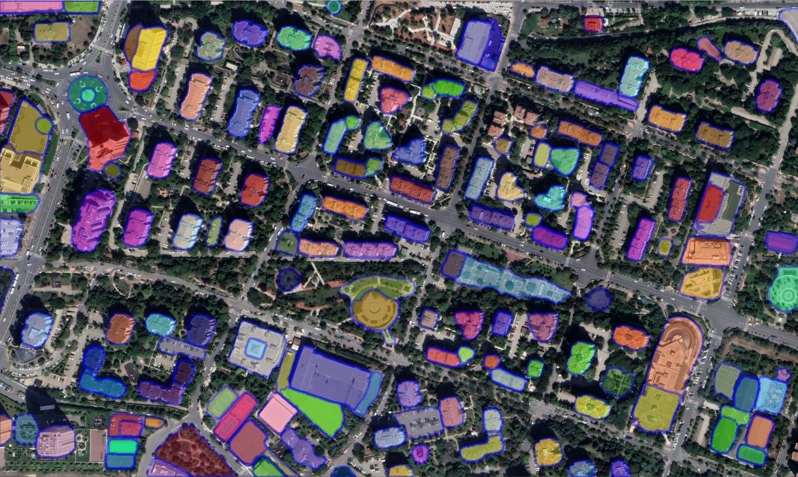
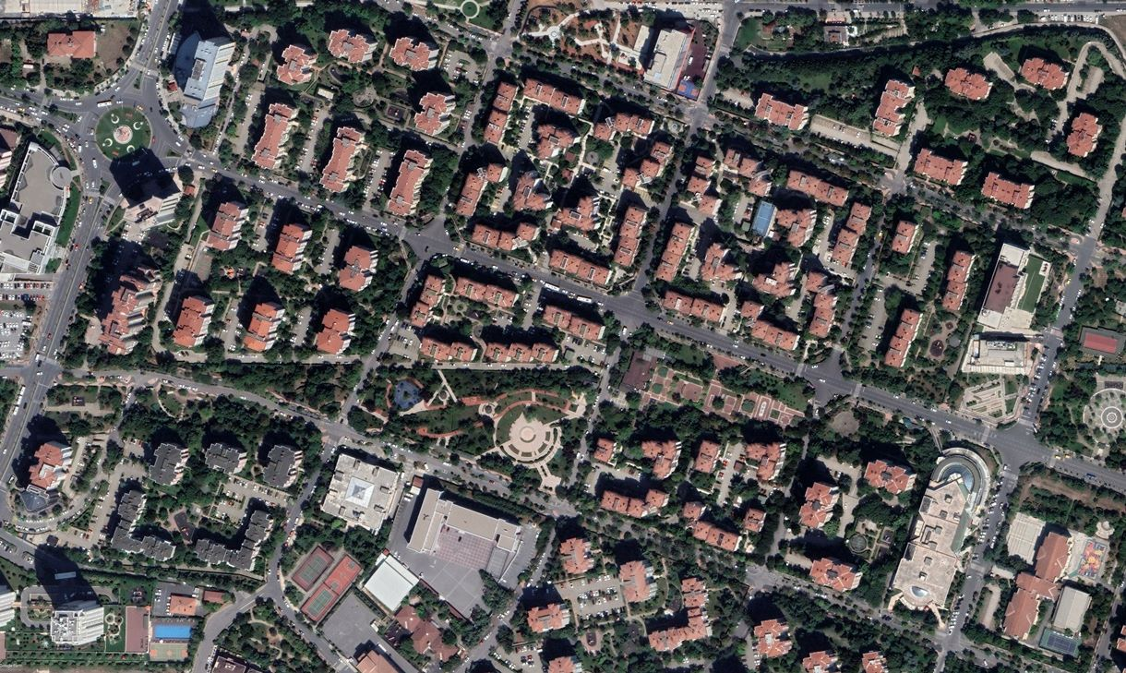
Rule based vectorization
(Segment Anything Model)

Slide 13
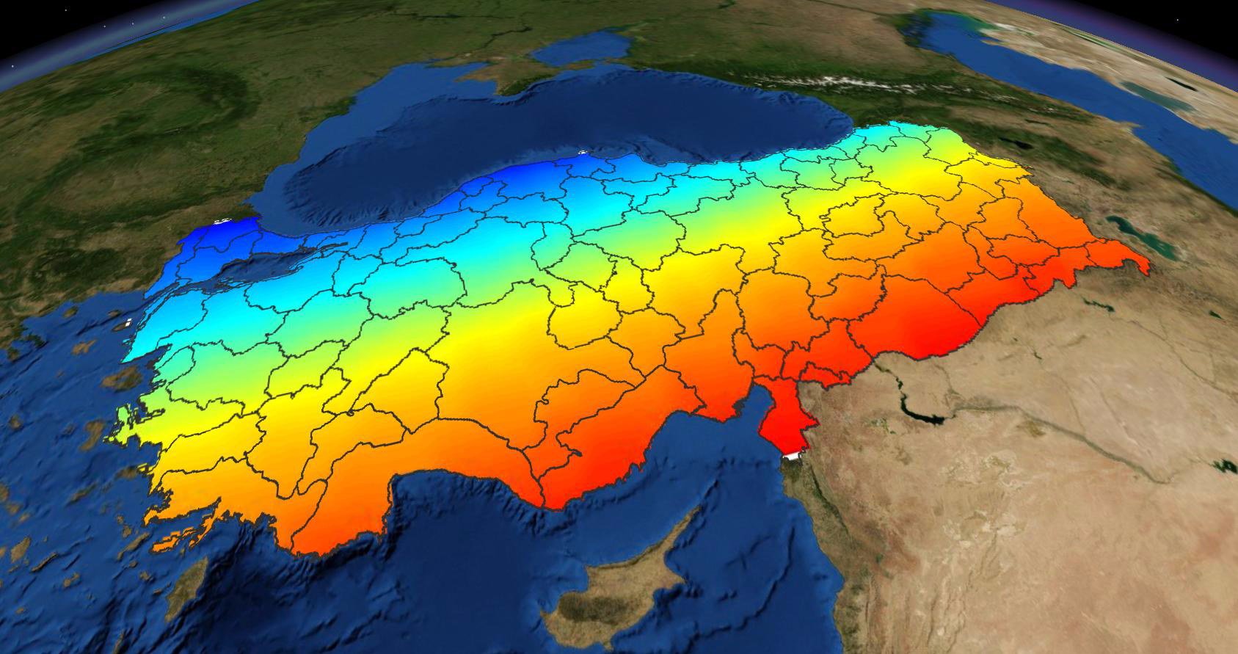
Atmospheric Analysis & Simulations
(Daily Ionosphere Effect)

Slide 14
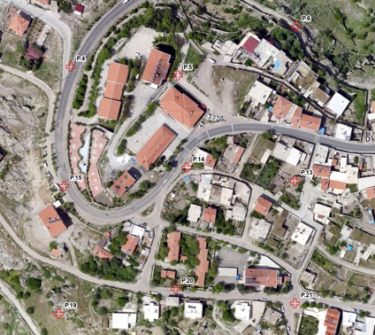
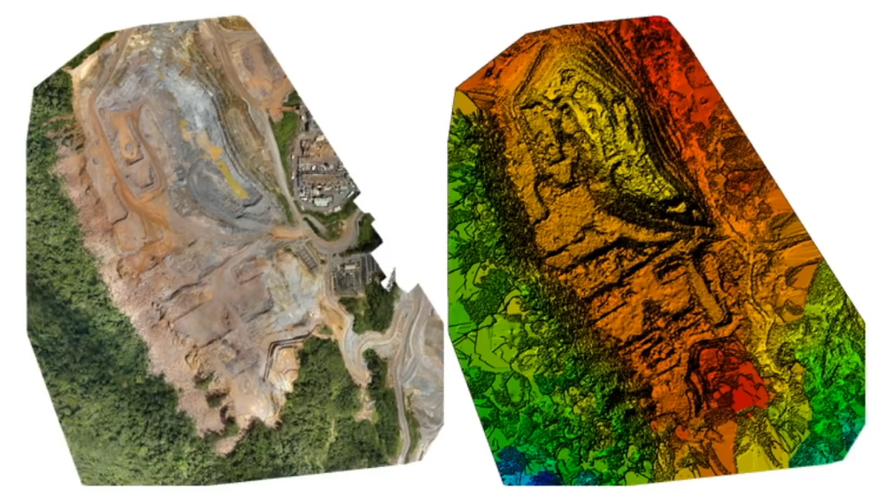
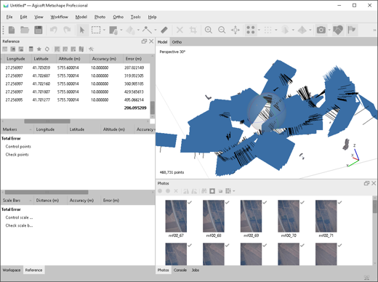
Photogrammetric Applications (DSM/DTM/Orthophoto)

Slide 15
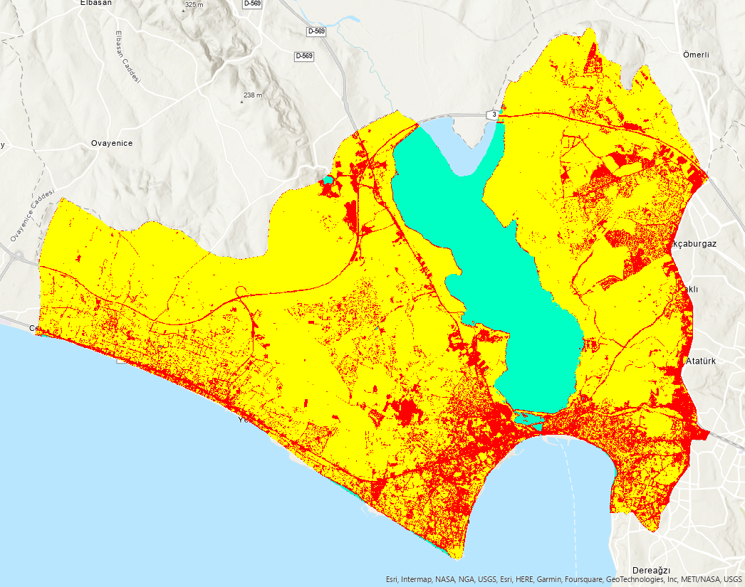
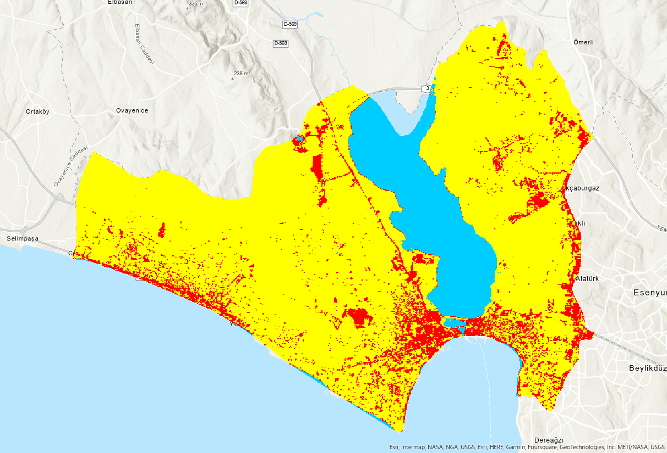
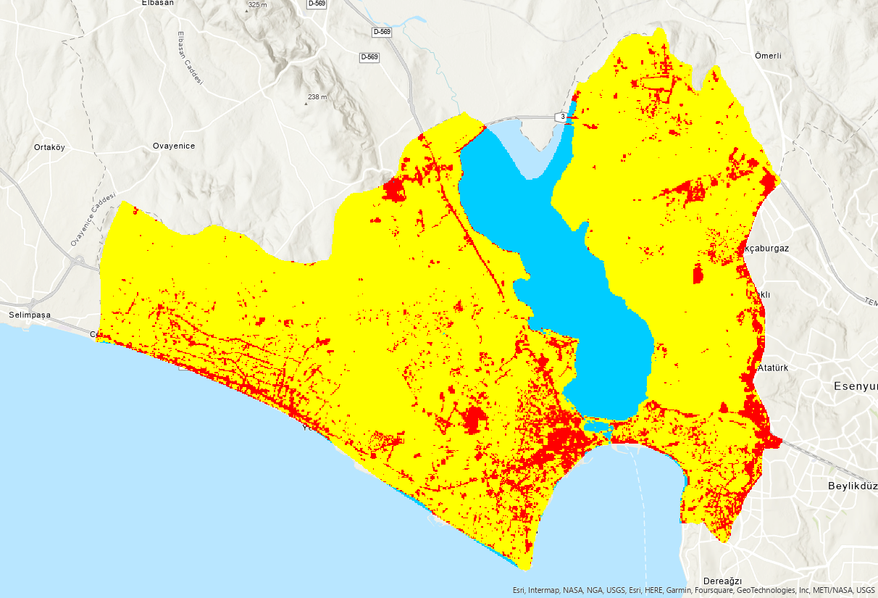
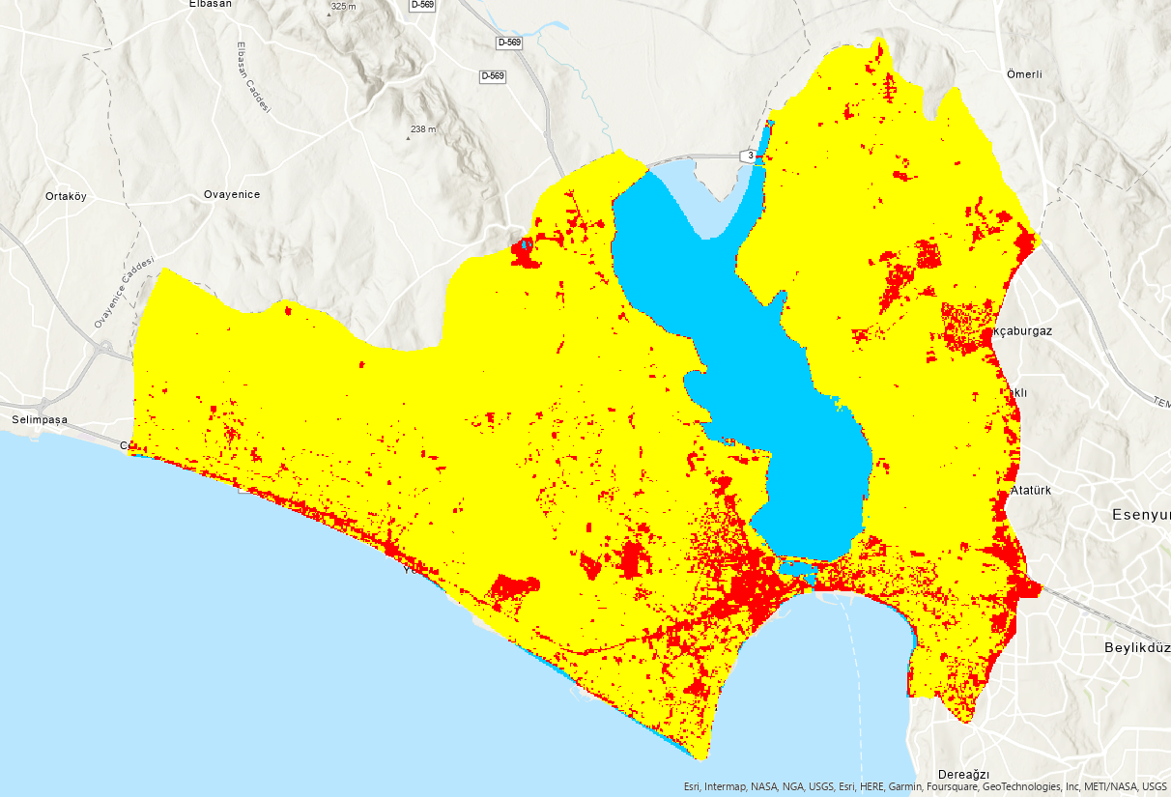
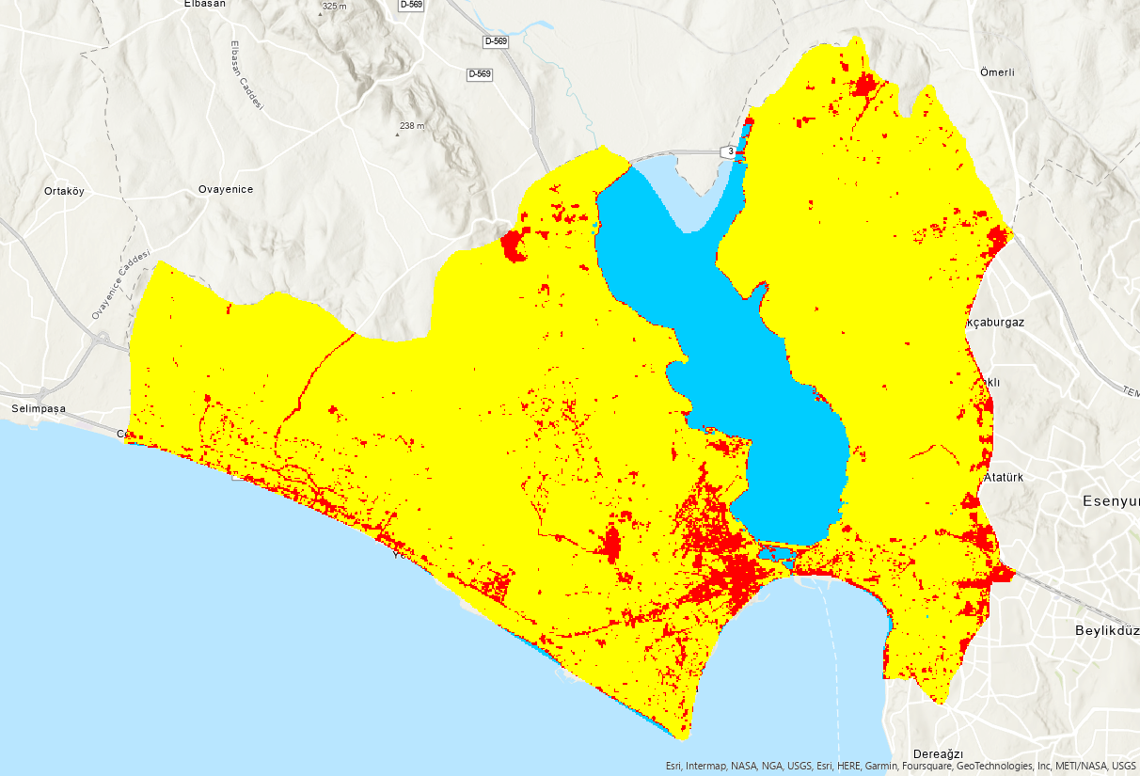
Urban Growth Forecast

Slide 16
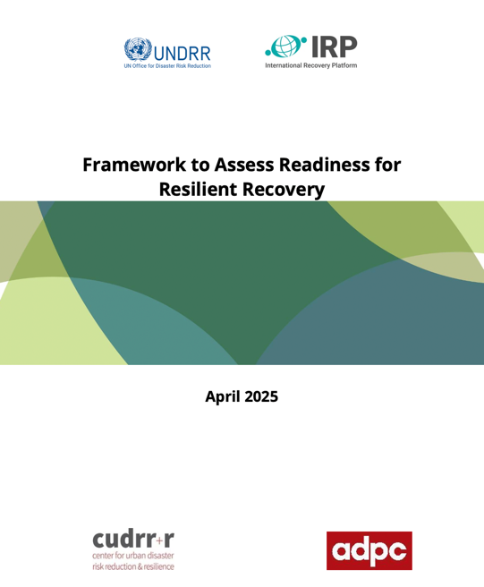

Disaster Consultancies

Slide 17
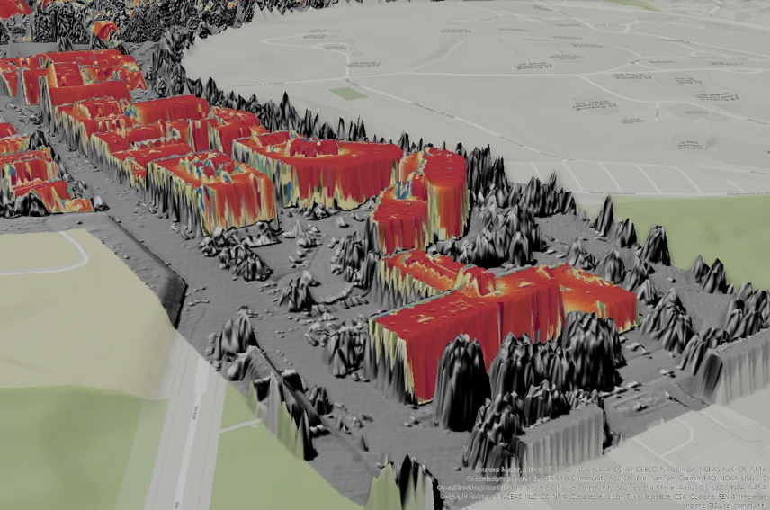
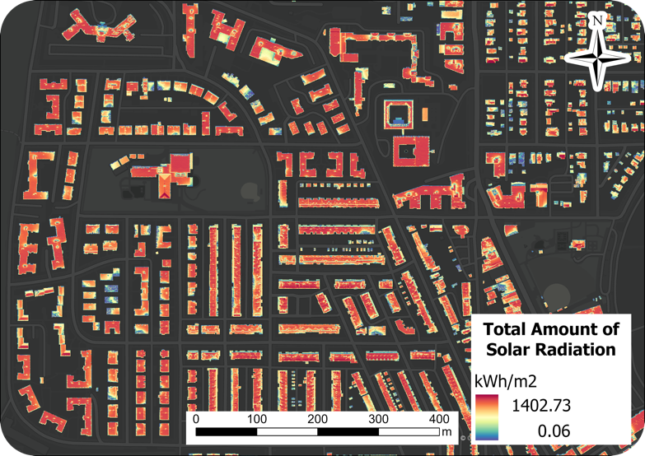
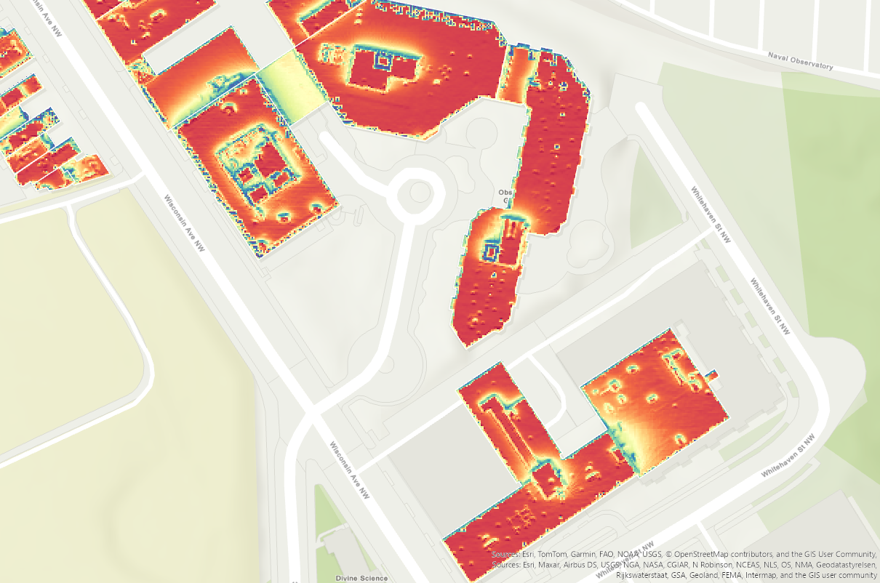
A simple example on Solar Energy Potential

Slide 18



Our partners

Slide 19
If you are looking for geospatial approaches for your ideas…
Please contact us
info@anofa.co
Thank you!

