Slide 1

Multi-Agent AI Solutions for Decarbonization
Dogukan AYCI – Innovation Lead dogukan.ayci@faradai.ai

Slide 2
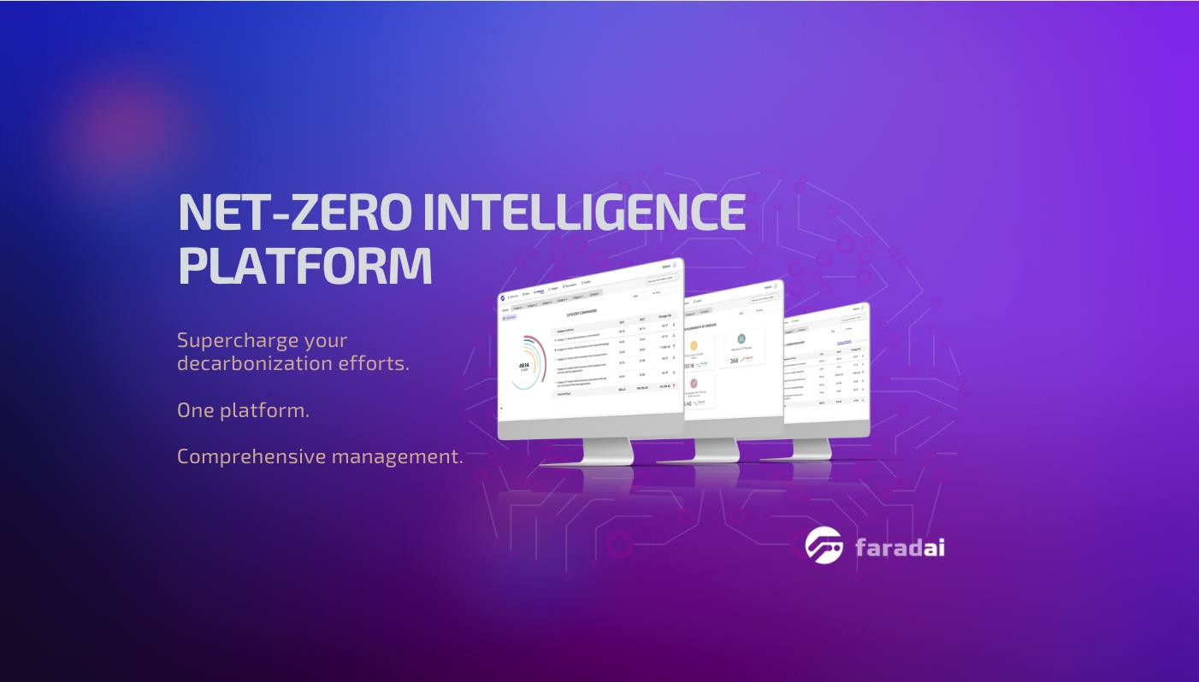

Faradai provides multi-agent AI platform to accelerate decarbonization of business operations and supply chain.
www.faradai.ai

Slide 3
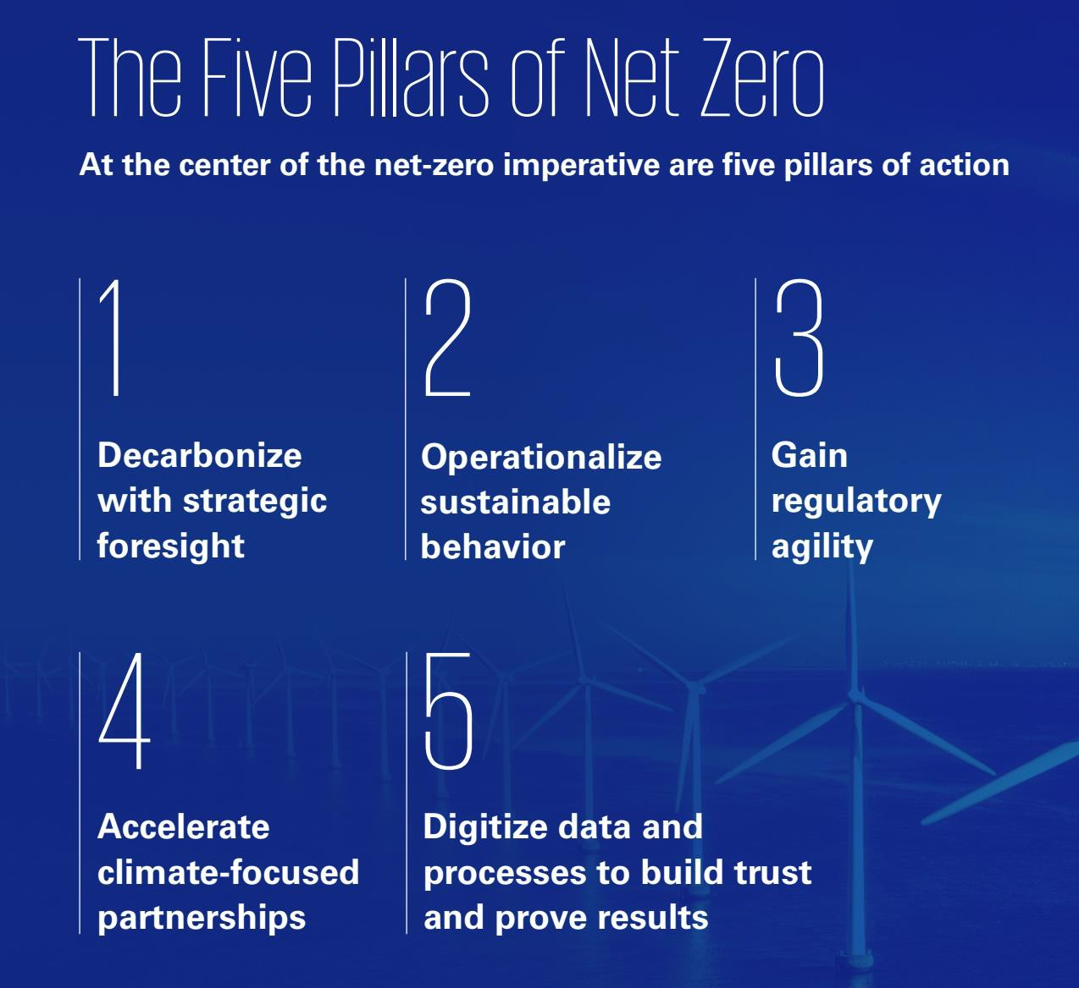


Big Opportunity & Challenge Ahead
At the centre of the net zero transition imperative, there are 5 pillars of actions
Problems in Digital Pillar of Decarbonization
Complexity of Fragmented and Granular Data Acqusition & Verification
Labor intensive & costly Hard to automate the data flow Difficulty in real time IoT data
acqusition
Challenges of Effective Analytics Because of the Data Silos – Lack of Trust in LLMs
Challenges in enterprise LLM adoption because of the hallucinations
Hard to integrate all data sets
Lack of Decarbonization Intelligence in the Value Chain
Static carbon accounting is not enough, the real need is Continuous Decarbonization Intelligence
Missing link between Carbon, Energy, ESG and Finance Data Operations
Each function operates independently without any bridges or single source of truth
KPMG The Decarbonization Journey Report, 2022

Slide 4

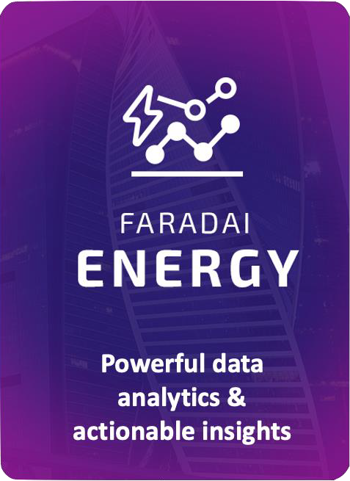

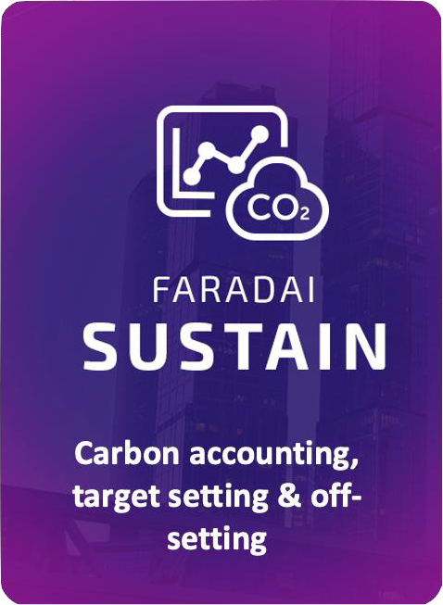


Enterprise Decarbonization Management Platform Architecture – Data Acquisition
Utility
Bills
Monthly
Manuel Bill Entry/Upload
Utility Systems
Automated Bill Reader (.pdf)
Integration with Accounting Systems
Building & Facilities Management
SCADA
Data Acquisition & Aggregation Layer
For Scope 1-2-3
OCR
IoT APIs AMR
Web Services DB Integrations ERP Integrations Excel Import Manual Entry
GHG Data
Quality Control
&
Audit Tools
Smart
Meters
Real-Time
Utility Systems (automated - hourly data)
3rd Party Meters (electricity,
water, gas)
Fleet Management
Enterprise Resource Planning (ERP)
Accounting System
Warehouse Energy Consumption Transportation, Logistics Data
Emission
Sources
Monthly
Manuel Entry
Integrations (ERP, Accounting, Waste,
Vehicle Tracking etc.)
Internal & Suppliers
Datacenter Energy Consumption
Employee Business Travel
ESG
Framework
Supplier Product Footprint
Manuel Entry
Internal & External/Suppliers
Other ESG data, APIs, Utility Metering Systems, Equipment, Renewables Portfolio, Grid Emission Intensity, Bills
Integration with 3rd Party Enterprise Systems
Data inputs
Net Zero Cloud
(Data Integration & Management)

Slide 5
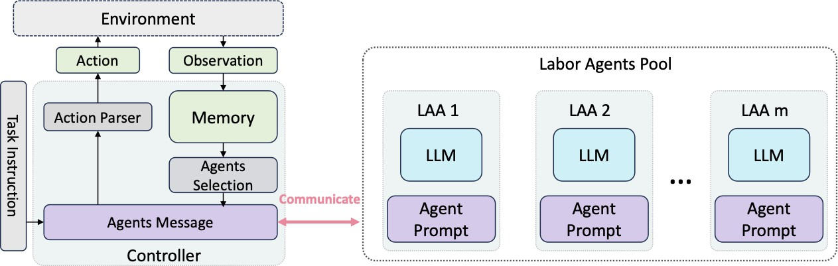

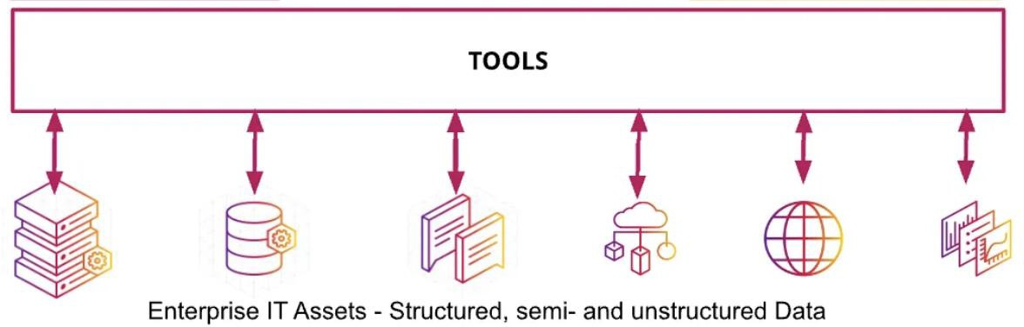
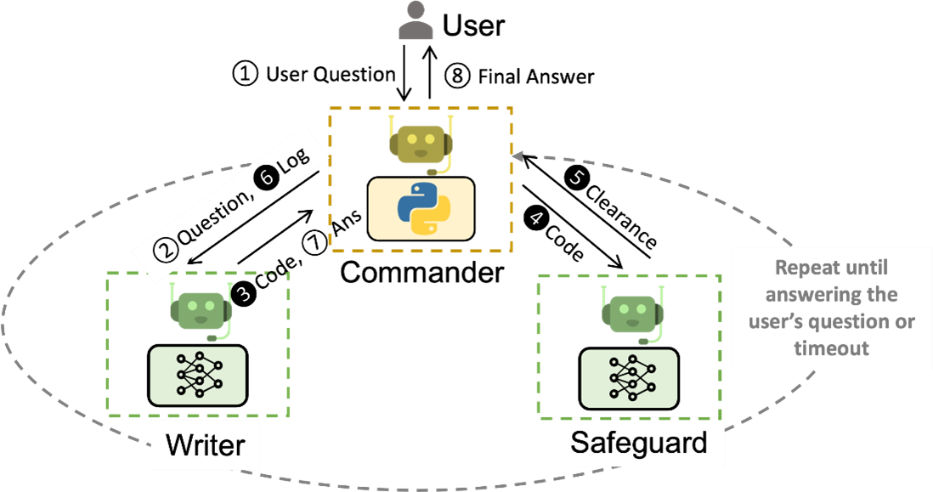
DecarbonAI – Multi Agent AI Co-Pilot for Net Zero
The agent conversation-centric design has numerous benefits, including that it:
LLM Response Evaluation/Minimum Hallucination: DecarbonAI utilizes an innovative algorithm for bringing the most accurate results to the user.
Naturally handles ambiguity, feedback, progress, and collaboration.
Enables effective RAG-based tasks, like tool use with back-and-forth
troubleshooting.
Allows users to seamlessly opt in or opt out via an agent in the chat.
Achieves a collective goal with the cooperation of multiple specialists.
Orchestrator
ESG
Agent
Supply Chain Agent
Compliance Agent
An example workflow to address any question:
The Commander receives user questions and coordinates with the Writer and Safeguard.
The Writer crafts the code and interpretation, the Safeguard ensures safety
The Commander executes the code.
If issues arise, the process can repeat until resolved.
Shaded circles represent steps that may be repeated multiple times.

Slide 6









Active Research Activities on AI Agents Development
Compliance
Navigation
Supply Chain
Benchmarking
ESG Data
Extraction
DecarbonAI
Decarbonization
Project Recommendation
Carbon Footprint
Hotspot Detection
Open for Collabration:
Research Institues
Need Owners
Sustainability Experts
Industrial Organizations
Automated Emission
Factor Matching
Sustainability
Scorecards

Slide 7
Multi-Agent AI Solutions for Decarbonization
Dogukan AYCI – Innovation Lead dogukan.ayci@faradai.ai

