Slide 1
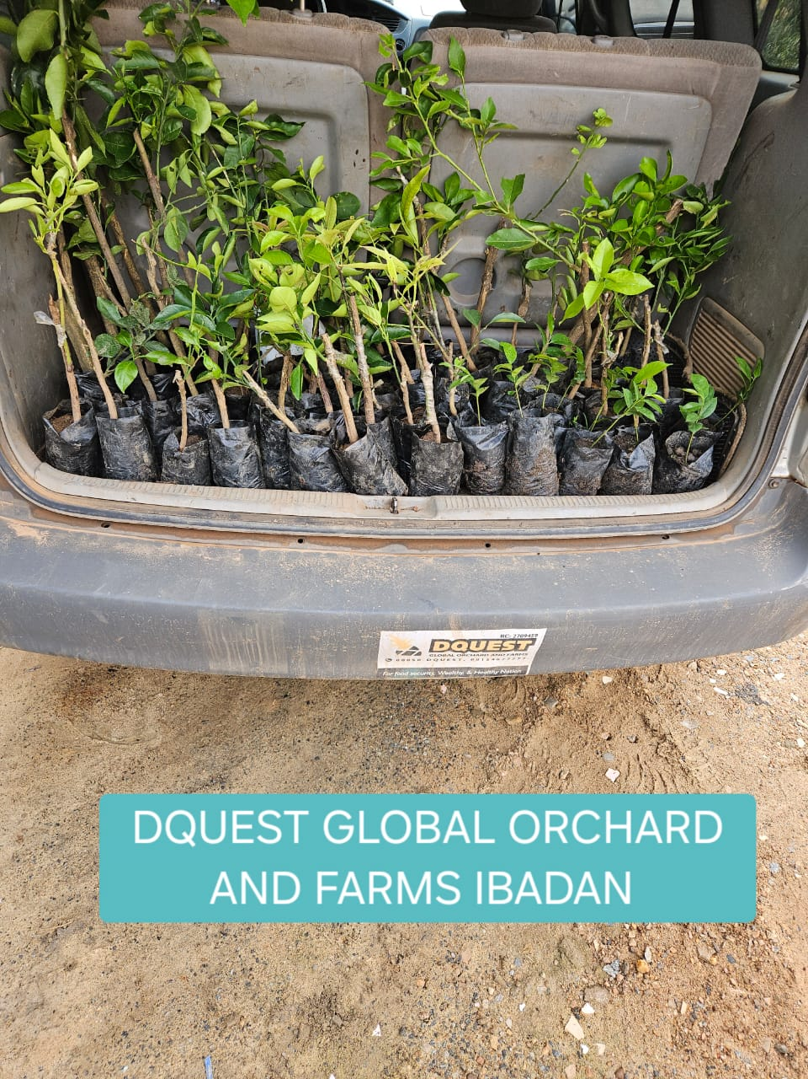
Digitalise, Decarbonise , and develop the future of Energy
OCEAN MINT UK LIMITED
STRATEGIC INVESTMENT PROCESS FOR
CLEAN ENERGY STRATEGY SOLUTION

Slide 2
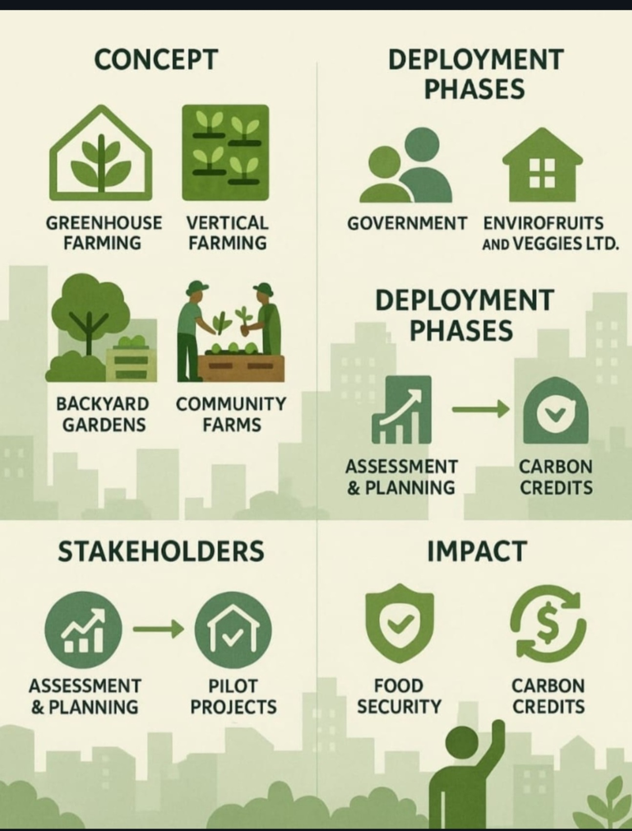
Global high impact Solutions
Material Efficiencies Research Innovation Development
Focus on global challenges within SME’s and industry
Initiative to address the problem, through knowledge transfer

Slide 3
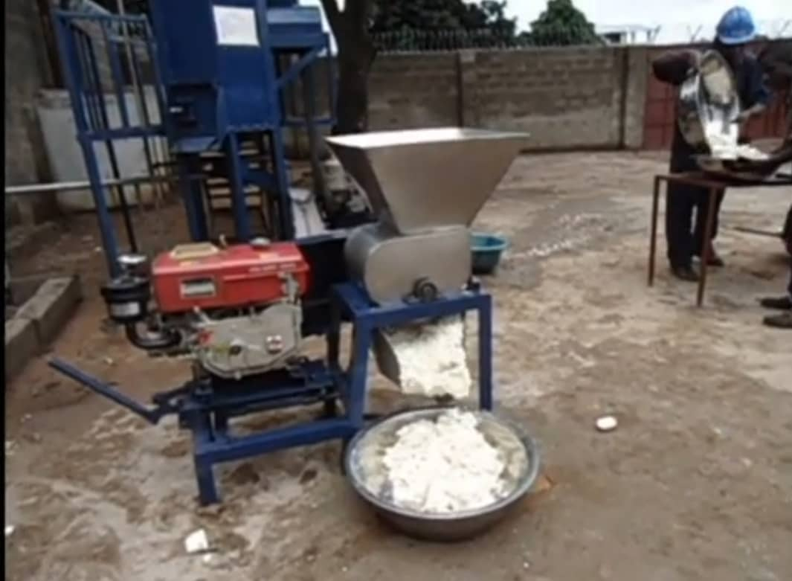
Insightful-led - Innovation ( Pre-MVP) strategy
Strategic planning applications processes
Technology development, applications tools, and element discovery from cassava byproducts Material.
Digitalise processes for improving marketing plans.
Technology development and pilot plant scale up partnership

Slide 4
Benefits
Allows globa decision making
Transformation. Revolutionary solution, planning and global practice technologies and infrastructure.
Cross- functional teams, and colleagues.
Enterprise-wide initiative.
Energy strategy and Transformational change services, consulting, technologies, regulatory policy decision.
Data analysis, sharing and interpration to strategic global practice decision making

Slide 5
Thank you more information contact
Dr Tony Owatemi
Advisory Services and Deliverables development
Cassava Crop & peel Eco-friebdly recycling centre HEIFAF initiative, Nigeria
wewemtonglgmail.com
Ms Ololade Olubunmi kumolu
Project Coordinator
Ocen Mint Consortium & WADAS Enterprise
loladekumolu@gmail.com
+447563558895
UK-African ( Nigeria & Brazil) Trilateral partnership to drive innovation in climate – smart agriculture .
Mrs Olufunke Dawodu
Independent Project Manager
gfunk12001@yahoo.com
+447939848256

