Slide 1
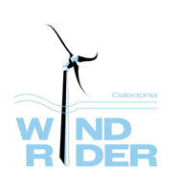
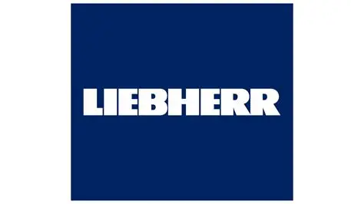

Aerodynamic Rotatable Integrated Support for Wind Turbine Systems
Lead: Wind Rider Caledonia Limited
Partner: Liebherr – Germany Lieberrh
Subcontractor: Darwind B.V. - Netherlands,
Dr Wangwen Zhao, Director, Wind Rider Caledonia Limited 20th November 2025
Notes:
“Good morning. My name is Dr. Wangwen Zhao, representing Wind Rider Caledonia Ltd. Today, I’m excited to present ARIS-Wind—a feasibility study that reimagines how offshore wind turbines interact with the wind itself. This is not just an incremental improvement; it’s a paradigm shift designed to cut LCOE by up to 9.6% and solve one of the sector’s most persistent pain points: structural inefficiency. The projectwill have three parties WRC, Liebherr and DArwind

Slide 2

About Wind Rider Caledonia
Wind Rider Caledoina is dedicated to develop the groundbreaking innovation of rotatable turbine tower, offering a paradigm shift of smart tower design leading to 10% wind farm LCOE reduction by reducing wind loads, tower weight, and foundation construction costs, O & M cost while enhancing safety and boosting energy production.
Our VISION
  Become the main supplier of tower for all wind turbine support in the global offshore and onshore wind market.
Our Mission
  Unlocking the true potential of wind: We are committed to bringing our innovative wind turbine technology to market, delivering a 10% LCOE reduction and a brighter future for onshore and offshore wind..
  Website: www.wind-rider.co.uk

Slide 3
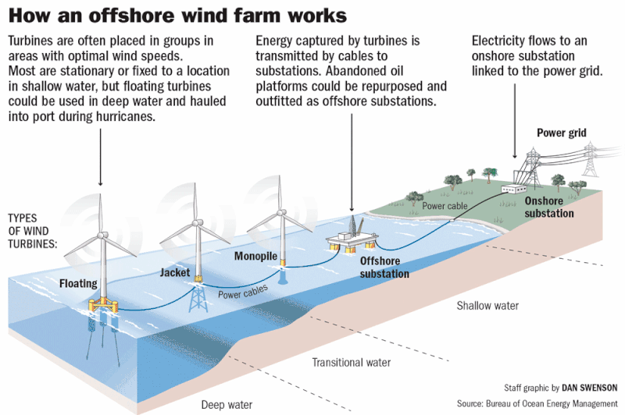
  Background
Industry Pin Point
High Construction Cost, for constructing offshore wind foundation in the harsh marine environment. Large turbines were introduced to reduce unit cost but it also increase the foundation cost disproportionally, overwhelms turbine savings, together with its limitation from installation and fabrication.
Deep Water, previous easy sites of shallow water are filled. New sites such as those Scotwind sites are further offshore and in deeper waters and have more complex site conditions. Flaoting solution is proposed but cost is the main issue
High Operational Cost. Particular for being offshore and at turbine hub height.
Tower Design:
Nacelle yaw systems rank among the top 3 causes of offshore downtime
Cylindrical towers create high drag and bending loads, leading to costly foundations
Floating wind economics are especially sensitive to substructure weight
Repowering legacy sites demands lighter, smarter solutions
Strategic Imperative:
“Reduce LCOE, enable larger turbines, and simplify O&M—all while cutting steel and CO₂.”
Notes:
Speaker Notes:
“The industry has been stuck in a design paradigm for 30 years: fixed tower, active yaw, circular cross-section. That’s no longer sustainable. Developers are now targeting 18–20 MW turbines in 100m+ water depths—conditions where every tonne of steel matters. Meanwhile, the UK and EU aim to install over 270 GW of offshore wind by 2030. If we don’t innovate now, costs will plateau—or worse, rise. ARIS-Wind offers a path to break through this ceiling.”

Slide 4
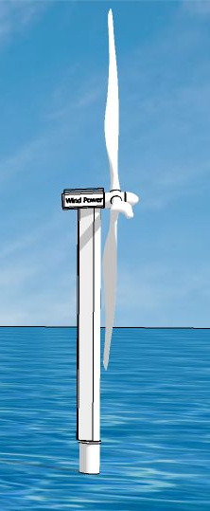
  Project Summary
Objective:
Advance the Wind Rider Rotatable Tower System from TRL 3 → TRL 5–6 through high-fidelity simulation and design validation.
Core Innovation:
A aerodynamic shaped tower with a passive, base-mounted yaw system that:
Eliminates nacelle yaw drives (reducing failures & O&M)
Up to 78% reduction in tower base bending moments
Cuts drag by >90% vs. conventional cylindrical towers
Platform-independent: works for fixed & floating offshore
Lowers LCOE by 6.7% (fixed) and 9.6% (floating)
The feasibility will depend on its aerodynamic properties for which two variatants will be tested in this project.
Duration: 18 months | Start: 1 Jan 2026
Total Cost: €350,000.00 | Consortium: UK–NL–DE
Notes:
“ARIS-Wind tackles a core bottleneck in offshore wind: as turbines grow beyond 15 MW, the cost and complexity of foundations and yaw systems are skyrocketing. Our solution eliminates the need for heavy, failure-prone nacelle yaw mechanisms by allowing the entire tower to passively self-align with the wind—like a weather vane—using a streamlined tower and a low-friction slewing bearing at the base. Early feasibility work, supported by Scottish Enterprise, already shows dramatic load reductions and LCOE savings.”

Slide 5
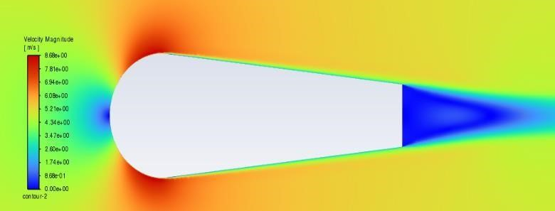
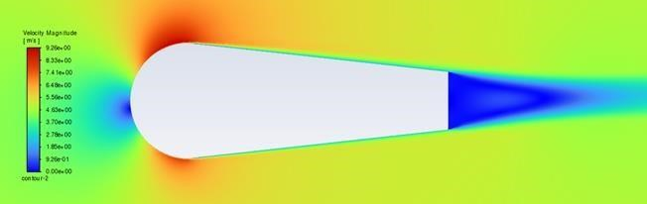
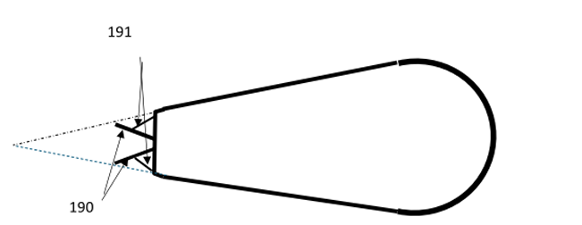
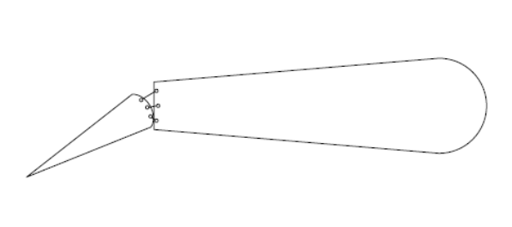
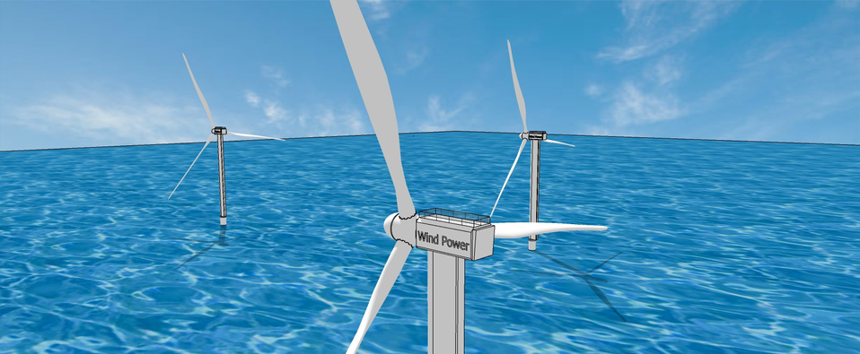
  Innovative
✅ Passive self-yaw – no motors, no nacelle yaw drives
✅ Aerofoil tower – >90% drag reduction vs. cylindrical
✅ Restoring moment via eccentric aerodynamic centre
✅ New simulation methodology – Bladed + ANSYS coupling for rotating bases
✅ Safer Operation and Cheaper Offshore Maintenence
✅ Patented design – UK patent granted (GB 2630296.8, May 2025); PCT filed, new pending patenet
(
c
)
(
b
)
Notes:
We’ve structured the project to front-load risk. Months 1–3 focus on aerodynamics—answering: Can we generate enough passive restoring moment? Months 4–7 tackle the biggest technical hurdle: instability in turbulent wind. By integrating passive damping and geometry refinements, we aim to achieve stable self-alignment. The final phase delivers not just data—but a blueprint for a physical prototype, co-developed with our industrial partners.”

Slide 6
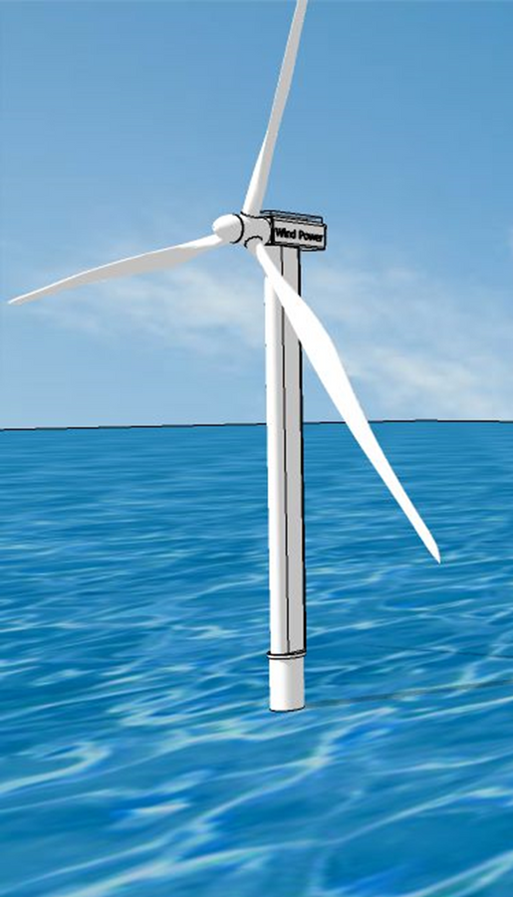
  Project Objective(s) + Project Description
Project Objectives
Explore tower variants for wind rider system: Flap System & Fixed Fin System for the feasible solutions
Build a coupled aero-servo-elastic model for base-rotating towers (ANSYS + Bladed)
Quantify load reductions under full IEC 61400-1/-3 load cases
Co-design tower, bearing, and control interface with Liebherr & Darwind
Deliver TRL 5–6 validation and a prototype roadmap
Long term vision is to achieve the potential of the Wind Rider System --- 10% LCOE reduction
Notes:
Speaker Notes:
“This project is not about building hardware—it’s about de-risking the physics and engineering. We’ll refine two new tower concepts that enhance restoring moments, solve stability issues seen in early simulations, and integrate feedback from our partners. XEMC-Darwind will ensure our model aligns with real turbine dynamics, while Liebherr will validate bearing feasibility under extreme offshore loads.”

Slide 7
PROJECT DESCRIPTION
To enhance the Technology Readiness Level (TRL), this project will
Assess tower design feasibility
Design suitable bearing,
Overcome yaw instability
Simulate wind load for detailed substructure design
Recommend prototype options
Set up a commercialization roadmap to ensure market adoption.

Slide 8
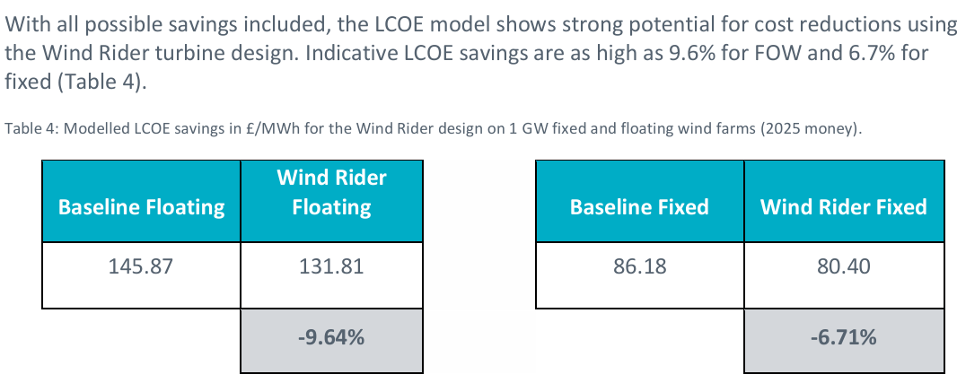
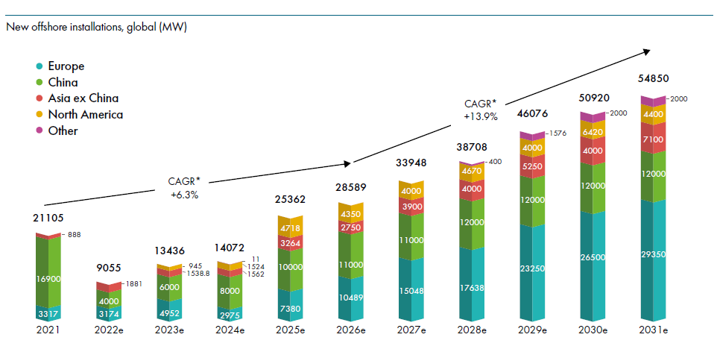
  Market
Floating offshore (LCOE ↓ 9.6%)
Fixed-bottom offshore (LCOE ↓ 6.7%)
Repowering (UK/EU legacy farms)
High-wind onshore sites
Target Markets:
Total Cost saving for offshore new build to 2031 could be:
$1,005*10% ≈ $ 100 billion
Estimated ROI > 20%
Revolution is worth taking as it Pays!!!!!!
Also there is the additional application in onshore wind and retrofit
Notes:
We see three immediate entry points. First, floating wind—where every kilogram saved on the tower cascades into massive foundation savings. Second, repowering: many UK farms from the 2000s can’t support modern 15 MW turbines on their old foundations—but ARIS-Wind’s lighter loads make it possible. Third, onshore in high-wind zones like Scotland or Patagonia, where O&M costs dominate. Our roadmap prioritises licensing and joint development, with UK projects as first movers.”

Slide 9
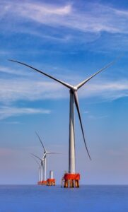
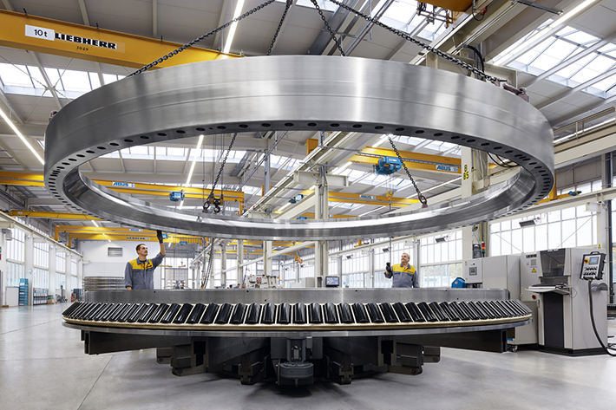
  Consortium
Partner | Role | Contribution
(UK) | Lead | Core IP, CFD, system integration, TRL advancement
(NL) | OEM Subcontractor | Leading Turbine OEM, Turbine specification, aeroelastic simulation, control design
(DE) | Partner | Leading bearing OEM, Base-mounted slewing bearing design & offshore validation
Notes:
This isn’t just a technical consortium—it’s a commercial launchpad. Wind Rider brings the disruptive concept. XEMC-Darwind, an established turbine OEM, ensures industrial relevance and certification alignment. Liebherr, the world leader in offshore slewing bearings (used in FPSOs and wind turbines), guarantees our base system is not just theoretical—but buildable, reliable, and serviceable. Together, we bridge invention to industrialisation.”

Slide 10
  Financial plans
Why EUROGIA 2030?
High Risk:
First-of-a-kind large scale rotatable turbine tower with new physics together with requirements for developing new tools for wind load simulation
High Impact:
  5,000 t CO₂ saved per GW
  Worldwide applications
  100+ R&D jobs; 2,000+ manufacturing roles in Europe
  Strengthens EU/UK supply chain sovereignty
No private funding at this TRL— public support bridges the “valley of death”
Next: Prototype demonstration (2027) budgetd for 20 million Euro, UK / EU pilot, global licensing
High reward: 10% LCOE saving for billion Euro OWF project
Notes:
Speaker Notes:
“Let me be clear: this is pre-competitive R&D. No turbine OEM will fund a base-rotating tower until the physics are proven. That’s where EUROGIA2030 steps in. With your support, we’ll generate open validation data that de-risks €20M+ in follow-on investment—from Innovate UK, EIC Accelerator, or private capital. This project keeps European innovation in Europe and positions our consortium at the forefront of the next generation of wind technology.”

Slide 11
Intereted Parties
Offshore wind developers , who can use the system to reduce the cost of energy of the developed wind farm
Turbine OEM, Wind Rider provides a competitive advantage to save the final LCOE.
Wind EPCI(Engineering, Procurement, Construction, and Installation) companies, for a cost effective solutions.
Government agencies, for carbon footprint reduction, lower electricity costs, better employmenet and fatster economic growth
The Wind Rider system’s differentiated value proposition—lightweight, lower-cost towers; foundation cost reduction; and simplified O&M—positions it well to target both fixed and floating submarkets, in the UK and abroad.
Routes to market include:
Licensing,
Joint development
Tower fabrication.
The technology has strong export potential to international markets

