Slide 1




GEOTWIN CCS
CO₂ Storage powered by AI.
In Real Time
DIGITAL TWIN
MACHINE LEARNING
DECARBONIZATION
Notes:
GeoTwin CCS Project: a proposal for an innovative solution that uses artificial intelligence to transform CO₂ storage. One of the biggest challenges for decarbonization in CCS/CCUS processes is subsurface uncertainty and operational risk. Digital Twin and Machine Learning technology not only optimizes, but also helps ensure the safety and efficiency of carbon storage.

Slide 2


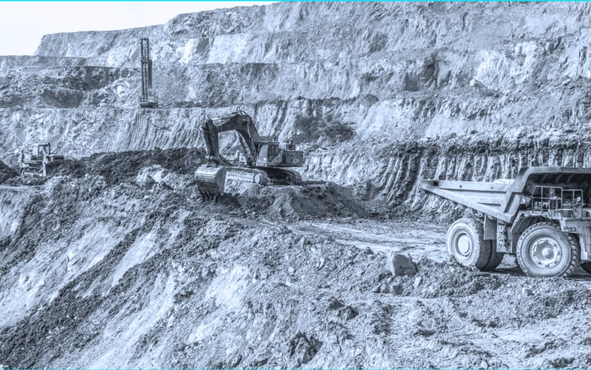



THE CRITICAL CHALLENGE: UNCERTAINTY AND OPERATIONAL RISK
1. Static Monitoring
3D/4D seismic campaigns conducted every 2–5 years.
High Cost: R$ 2–5 million per campaign, producing only sporadic "snapshots."
2. Geomechanical Risk
Continuous injection increases pore pressure in the reservoir.
Integrity Threat: Risk of caprock fracturing and undetected CO₂ leakage.
The Field Reality: Operations involving geological storage deal with high subsurface complexity, where decisions must be made based on limited, time-spaced data.
3. Operational Inefficiency
Lack of real-time data forces conservative operation.
Economic Impact: Underutilization of storage capacity, limiting project viability.
Notes:
The problem is clear: geological storage operations today are expensive, slow, and risky. There is currently a dependence on static monitoring, with 4D seismic campaigns that cost millions and provide only sporadic "snapshots" of subsurface conditions. Geomechanical risk remains significant, as continuous injection can fracture the caprock and cause undetected leaks. And operational inefficiency is glaring: the lack of real-time data forces conservative operation, underutilizing storage capacity.

Slide 3





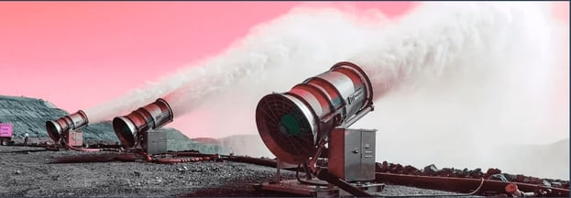
THE SOLUTION: INTELLIGENT REAL-TIME MONITORING
1. Multimodal Integration
2. Predictive Digital Twin
3. Dynamic Control
Reinforcement learning algorithms (Deep Q-Networks) controlling the well.
Deep Neural Network models (LSTM, Transformers) trained on compositional simulations.
■
■
Real-time optimization of injection rates and Bottom-Hole Pressure (BHP).
■
3D/4D seismic, fiber-optic sensors (DAS/DTS), microseismic and pressure data.
■
■
Forecasts the spatial evolution of the CO₂ plume with a latency of hours, not months.
Use of the Ensemble Kalman Filter for continuous data assimilation.
■
Maximizes storage while ensuring the structural integrity of the caprock.
Accuracy above 95%, rigorously validated against historical reservoir data.
■
■
Geological uncertainty reduced by more than 50%.
■
Notes:
The solution: intelligent real-time monitoring, integrating multimodal data from seismic, fiber-optic, and microseismic sources. Sophisticated mathematical algorithms are used for continuous data fusion and assimilation, reducing geological uncertainty by more than 50%. With the Predictive Digital Twin, Deep Neural Network models forecast CO₂ plume evolution accurately within hours or days, not months. Finally, Dynamic Control, using reinforcement learning algorithms, optimizes injection rates in real time, maximizing storage while ensuring caprock integrity. All of this leads to measurable impact.

Slide 4


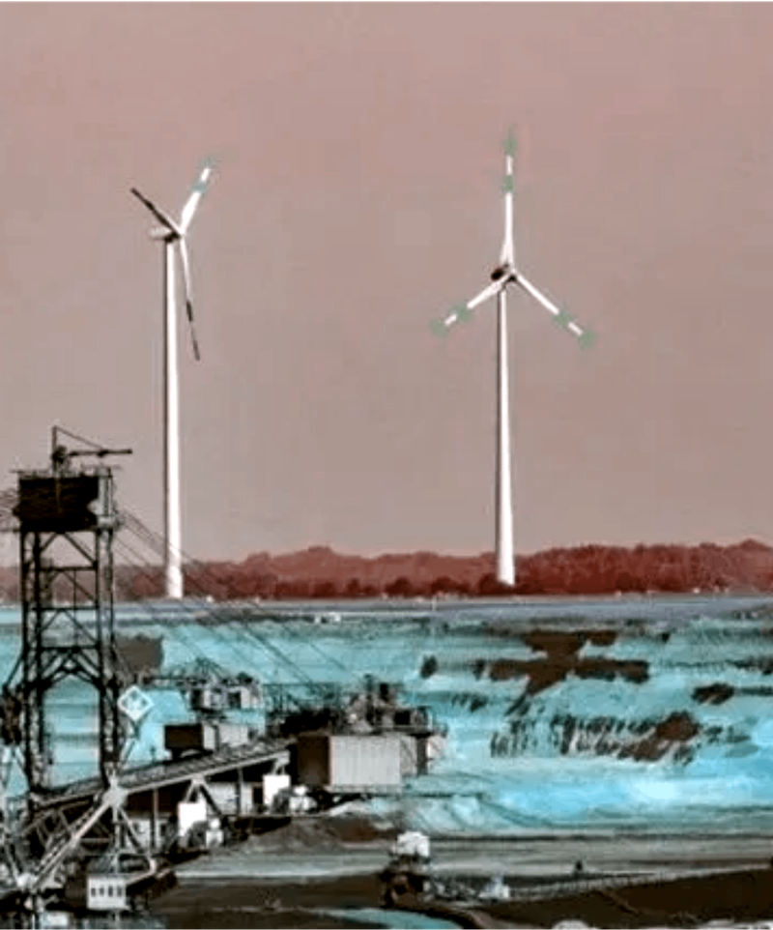
MEASURABLE IMPACT: COST AND RISK REDUCTION
OPEX REDUCTION
-70%
Eliminates reliance on frequent 3D/4D seismic campaigns. Estimated savings of R$ 8–12 million/year in large-scale projects, with payback in under 18 months.
CAPACITY INCREASE
+25%
Dynamic optimization enables a higher safe injection rate. More CO₂ stored per well, substantially improving project economics.
Integrated Sustainability
OPERATIONAL RISK REDUCTION
Optimizing geological storage enables the energy transition and large-scale integration of renewable sources.
-40%
Early anomaly detection (48–72h before a critical event). Lower risk of caprock fracturing and automated regulatory compliance (ANP).
Notes:
GeoTwin CCS's impact is direct and measurable: OPEX reduction, eliminating the need for frequent 4D seismic campaigns. This represents savings of millions of reais per year in large-scale projects. In addition, storage capacity is estimated to increase by up to 25%, allowing more CO₂ per well and substantially improving project economics. Most importantly, operational risk is reduced by detecting anomalies early and ensuring regulatory compliance. The solution is not just technological — it is a pillar for integrated sustainability.

Slide 5






ROADMAP (TRL 3 TO 6): FROM CONCEPT TO COMMERCIALIZATION
Phase 1: Geology
Phase 2: AI & Twin
Phase 3: Engineering
Phase 4: Validation
MONTHS 1–8
MONTHS 9–15
MONTHS 16–19
MONTHS 20–24
Building the AI-based geocellular model
›
Training algorithms with historical data
›
Coupling the simulator with AI
›
Testing with real operational or pilot data
›
Laboratory geomechanical testing
Injection optimization module
›
Sensitivity analysis
›
Digital Twin architecture
›
›
Milestone: Validated Static Model
Milestone: Trained Predictive Algorithm
Milestone: Integrated Prototype
Milestone: Final Validation & Contract
TRL 3 → 4
TRL 4 → 5
TRL 5
TRL 6
Notes:
The roadmap details the journey from TRL 3 to TRL 6, turning an innovative idea into a commercializable solution. Phase 1 focuses on geology, building an AI-based geocellular model and conducting geomechanical tests, with a validated static model raising the TRL from 3 to 4. Next, in Phase 2, algorithms are trained with historical data and the Digital Twin architecture is developed. The milestone here is a trained predictive algorithm, which leads to TRL 5. Phase 3, engineering, couples the simulator with AI and develops an injection optimization module, delivering an integrated prototype. Finally, in Phase 4, validation with real operational or pilot data is carried out, along with sensitivity analyses. The goal is final validation and a contract, reaching TRL 6. This is a clear, executable plan with well-defined milestones, fully aligned with current funding opportunities and future partnerships.

