Slide 1




2M m³/day
produced water generated
in Brazil's mature fields
GH2 FROM MATURE
FIELDS
GH2
Green Hydrogen certified
< 1.5 kg CO₂eq / kg H₂
Turning the water liability
of the oil industry into
certified Green Hydrogen
400+
onshore mature fields
in Brazil — potential for scale

Slide 2


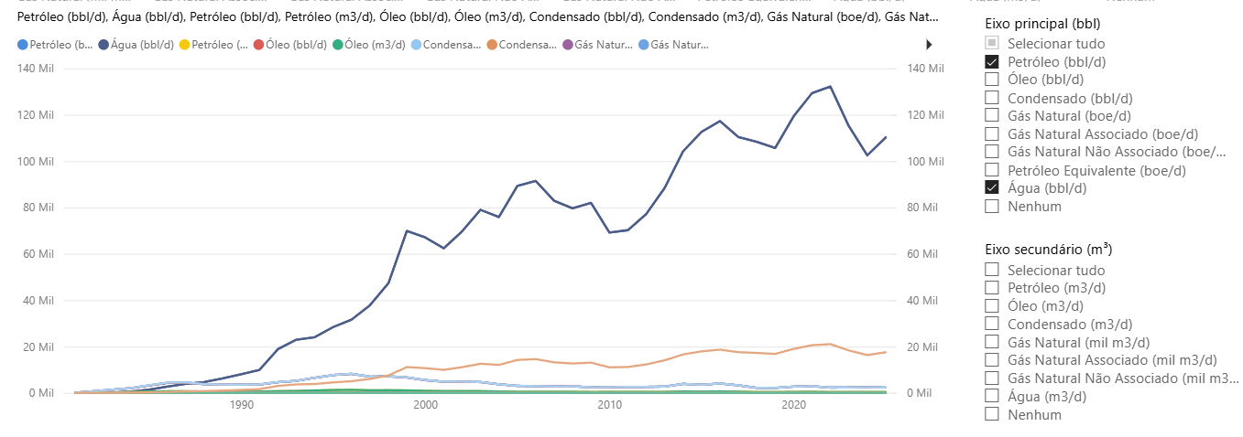


THE PROBLEM
Mature oil fields — a massive water liability with no strategic destination
10:1
High operating cost
Produced water management accounts for 20–35% of total OPEX in mature fields
barrels of water per
barrel of oil produced
(advanced mature fields)
Growing environmental liability
Stricter ANP/IBAMA regulation makes reinjection and surface disposal increasingly costly
Disposal wells at capacity
Limited reinjection capacity creates operational bottlenecks that force production cuts
WATER
Zero value generated
OIL
2 million m³/day of water discarded in Brazil with no productive use
Meanwhile, the industry pays a high price to dispose of a resource that could be turned into clean energy.

Slide 3






THE SOLUTION
PRODUCED
WATER
PRE-
TREATMENT
ELECTROLYSIS
AWE / PEM
H₂V
CERTIFIED
▶
▶
▶
Mature fields
(10–250k mg/L TDS)
DAF + Filtration
+ Selective RO
Renewable energy
(solar + wind)
Purity ≥ 99.5%
< 1.5 kg CO₂eq/kg
Circular Economy
Adaptive Pre-treatment
National Scale
Liability (produced water) becomes an asset (feedstock for H₂V) — unique worldwide
Modular system calibrated to the physicochemical variability of each mature field
Replicable across 400+ onshore mature fields in Brazil and the international O&G market

Slide 4


TECHNOLOGY & IMPACT
TRL 3→5
99.5%
from kickoff to bench scale, to be
validated over 24 months
purity of the H₂ to be produced
(ISO 14687)
MODULAR PRE-TREATMENT
< 1.5 kg
3 fields
DAF · Filtration · Selective NF/RO · UV Polishing
Adaptive to the composition of each mature field
CO₂eq per kg of H₂
minimal carbon footprint
to be analyzed in
Phase 1 (BA, RN, ES)
AWE + PEM ELECTROLYSIS
AWE + PEM
2 patents
Bench units at SENAI CIMATEC (AWE)
and SENAI-ER (PEM) facilities · Solar + wind energy
technologies to be evaluated
at bench scale in parallel
INPI filings planned
+ PCT evaluation

Slide 5

OPPORTUNITY & NEXT STEPS
ROADMAP
Immediate Market
400+ mature fields
in Brazil
PHASE 1
2026–2027 · 24 months
Operators pay R$ 2–8/barrel to dispose of produced water — a cost that can become GH2 revenue
R&D&I — Laboratory Bench Scale
PoC and validation at SENAI CIMATEC + SENAI-ER · Modular pre-treatment · AWE + PEM · LCA · 2 patents
Global Market
USD 8.2 Bn
PHASE 2
2028–2029
produced water management (2025)
Field Pilot
Argentina, Colombia, Mexico, Angola — countries with significant mature fields and growing H₂V demand
500–1,000 kg H₂/day in-situ · Partnership with a mature-field operator · BNDES + equity financing
Strategic Partners
PHASE 3
2030–2031
Petrobras
+ independent operators
Commercialization
Access to field data, existing infrastructure, and H₂V offtake for refining and green fertilizers
Commercial plant 10–30 t H₂/day · SPV with industrial partners · IRR 14–18% p.a.

Slide 6

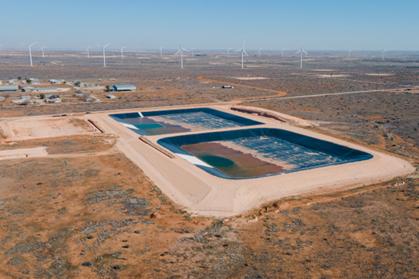
OPPORTUNITY & PARTNERSHIPS
We are seeking mature-field operator partners, co-investors, and H₂V offtakers
Access to field data, existing infrastructure, and GH2 offtake for refining and green fertilizers

