Slide 1
THE ATLANTIS LABS
AEMP
DC power & batteries
Health + remaining life
AI-Powered Energy and Asset Management Platform
Cooling / HVAC
Setpoint optimization
Lower your energy costs, extend hardware life, and secure operational continuity.
UPS
Anomaly detection
Generators
Dispatch + fuel
50,000+
500K+
30%
devices integrated
real-time records / day
energy cost reduction*
Solar / meters (OSOS)
Load forecasting
*Reduce energy costs by up to 30% while increasing service continuity. Based on a large-scale telecom deployment.

Slide 2
THE PROBLEM
Sector challenges
Inefficient devices raise energy costs and late-detected faults cause operational outages; post-failure maintenance is the most expensive kind. Merely monitoring devices prevents none of this.
1
High energy consumption
2
Late-detected hardware failures
Fixed setpoints and manual operation create unnecessary consumption.
Batteries, rectifiers, and cooling systems lose performance unnoticed — until they fail.
3
Network outages
4
Rising operations & maintenance cost
Hundreds of remote sites with limited visibility delay fault detection.
Emergency interventions and unplanned site visits drive up O&M spend.
AEMP

Slide 3
AEMP
The solution
AEMP integrates directly with your existing infrastructure — no additional hardware. AI models run on-premises; your data stays in your own environment. We don't just display data — our models turn it into better decisions and autonomous action.
1 · Real-time monitoring
2 · Anomaly detection
Ranks alarms by severity — fewer false alarms, faster intervention.
Learns each asset's normal operating behavior; identifies deviations before they become failures.
3 · Predictive maintenance
4 · Energy forecasting & control
Assesses device health and remaining useful life; predicts faults before they happen.
Forecasts load and consumption; plans and dispatches energy sources optimally.
AEMP

Slide 4
COVERAGE
AEMP devices & assets
Our platform integrates 50,000+ devices and processes over half a million real-time records per day — 85+ device types across 14 asset categories. Any hardware, any vendor, one platform.
DC power systems & rectifiers
13 types
Cooling — precision AC & free cooling
25 types
UPS
9 types
Delta · Huawei (SMU family) · ZTE · Emerson-Vertiv · Eltek Smartpack · Başarı · Argus · Datakom
YORK · Johnson Controls · STULZ · Uniflair · Airsys · Airedale · Coolaer · Denco · FläktGroup · Barantech
Schneider · Socomec · Makelsan · Huawei · Legrand Keor · Emerson-Liebert · Inform · CET Power
Generators
22 types
Solar
4 types
Smart meters (OSOS)
5 types
Woodward 3200 · ComAp · Datakom · Telem · PowerWizard · Transam · İlk Adım · Messenger GP — incl. vehicle-mounted units
Delta 3000 W · DPC 3000 W · Huawei — inverter and controller telemetry
Makel · Kohler · Satec (branch-level) · GDZ Elektrik · MQTT-based collection
Also under management: lithium batteries (Orbit) · external alarm monitors (Comet, Baran) · grounding measurement (GESK) · branch energy analyzers (CET) · power analyzers (Janitza) · network switches
AEMP

Slide 5
PROOF
AEMP PoC results
In a six-month PoC we achieved measurable results in energy consumption, operational efficiency, and hardware life. 30% energy · 33% performance · 4× hardware life.
30%
33%
4×
Energy savings
Performance gain
Hardware life
Idle HVAC units and generators are shut down automatically; setpoints are optimized by AI.
Fewer site visits; teams are guided by system alerts instead of manual checks.
Anomaly and degradation trends are detected early; replacements are planned by actual asset health.
Results from a six-month proof of concept with a tier-1 telecom operator; savings depend on operating conditions, configuration, and usage.
AEMP

Slide 6
MARKET
Market outlook: energy demand is accelerating
The market is shifting away from dashboards that only visualize data — toward autonomous energy software that interprets data, anticipates risk, and generates action.
2×
Expected increase in data center electricity demand by 2030 (IEA)
+17%
Data center power-use growth in 2025 — vs. a global average of just 3%
2–3×
Increase in power per telecom site under 5G — energy is 5–10% of OPEX
15–30%
AI-driven energy savings proven in real production deployments
AEMP

Slide 7
POSITIONING
Atlantis' position in the market
Multi-vertical
ABB
Schneider
Honeywell
Siemens
Atlantis AEMP
Johnson Controls
Vertiv / Eaton
Nokia AVA
Galooli
BrainBox AI
Ericsson
GridPoint
Huawei
EkkoSense
Single-vertical
Rule-based monitoring
AI-driven autonomous optimization
AEMP

Slide 8
COMPARISON
Head-to-head: capability scorecard
No competitor combines autonomy, multi-vertical coverage, and hardware independence in one platform.
Company | AI autonomy | Verticals | HW-independent | Deployment speed | Savings
Atlantis AEMP | ●●● | 4/4 | ●●● | ●●● | up to 30%
Schneider | ●● | 3/4 | ● | ● | 10–20%
Honeywell | ●● | 3/4 | ● | ● | 10–20%
Siemens | ●● | 3/4 | ● | ● | 10–15%
BrainBox AI | ●●● | 1/4 | ●● | ●●● | 15–25%
Galooli | ●● | 1/4 | ●●● | ●●● | 10–20%
Vertiv | ● | 2/4 | ● | ●● | HW-led
Dots indicate strength: ●●● strong, ●● moderate, ● weak. Company assessment based on public information.
AEMP

Slide 9
MOATS
Product advantage
Three durable advantages set Atlantis apart from its competitors — and they are hard to copy.
DATA ADVANTAGE
HARDWARE-INDEPENDENT
ON-PREMISES
Cross-sector AI
Integrates with your existing infrastructure
Local and secure
Our models continuously learn and improve from data across different vendors and hardware types.
Whatever your installed base, AEMP integrates with it — no new hardware investment required.
AI models run in your own environment (on-premise); data never leaves your organization.
AEMP

Slide 10
OPPORTUNITY
Market size (2024, USD)
~$43.1B
TAM
Industrial EMS (~$39.4B), DCIM (~$3.0B), and telecom energy software (~$0.7B). Scope overlaps AEMP: telecom networks, data centers, and industrial energy management.
TAM
~$13.0B
SAM
Initial geographies: Europe, Türkiye, and GCC (~30% of TAM). Europe represents ~44% of global EMS; Türkiye and GCC add a moderate contribution.
SAM
~$130M
SOM
SOM
Three-year target: 8–12 telecom operators, 30–50 data centers, and 60–120 industrial fleets — ~1% of SAM, with upsell across modules and sites. Illustrative ACVs: telecom $1–2M; data center $0.2–0.4M; industrial $0.1–0.2M.
Figures are conservative estimates; 2024 USD basis.
AEMP

Slide 11
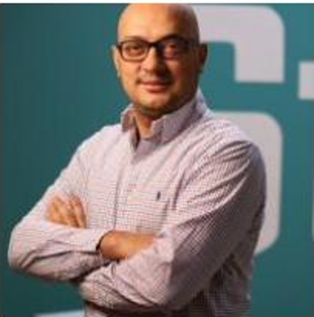
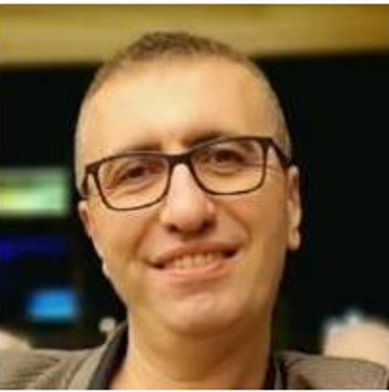

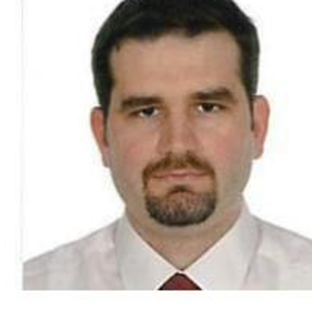
WHO WE ARE
Team
Ali Yılmaz
Metin Tüzün
Serdar Demirağ
Ömür Ersop
Founder & Sr. Software Engineer
Software Development Lead
Senior Software Engineer
Business Development
Touro University · MSc Information Technology
Istanbul University · BSc Computer Engineering
Istanbul University · BSc Computer Engineering
Işık University · BSc Electronics Engineering
The Atlantis Labs · theatlantislabs.com/aemp · Istanbul, Türkiye
AEMP

