Slide 1

RETROFLEX-EU
Sensor-Lean Building Decarbonization Platform
RETROFLEX-EU is a sensor-lean building decarbonisation platform that identifies real energy performance, losses and priority measures using data that already exists: public registries, GIS, EPCs, bills, main meters, smart-meter feeds and weather. It enables building owners, housing companies, ESCOs, utilities and portfolio managers to achieve and verify 10–25% operational savings without installing dense sensor infrastructure. The platform closes the loop between predicted and measured savings through IPMVP-compliant measurement and verification, improving recommendations across future buildings and supporting credible decarbonisation decisions.

Slide 2
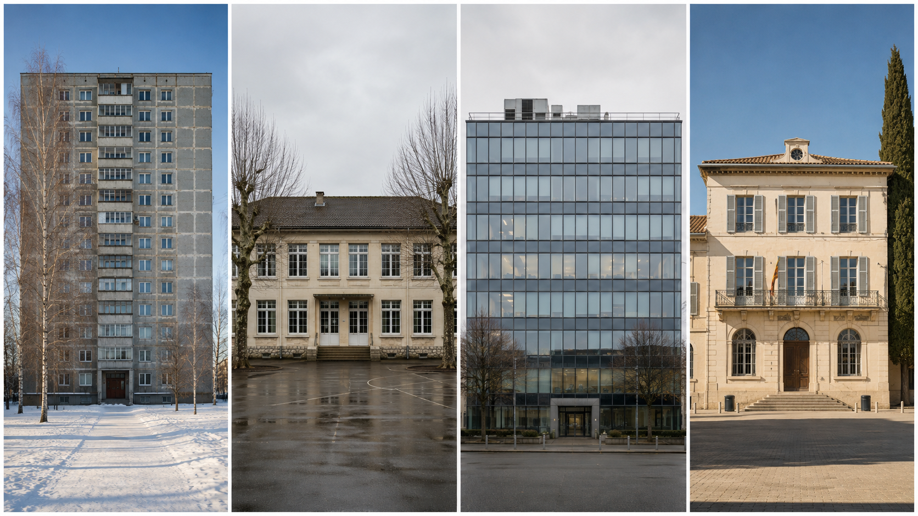

Challenge
Buildings account for around 40% of EU energy consumption, but most existing buildings — especially multi-residential blocks, schools, hotels and smaller commercial assets — do not have dense submetering or a modern BMS and are unlikely to receive one at scale. Owners and operators therefore rely on static EPCs, annual bills, main meters and manual audits, which do not show how the building actually performs, where losses occur, or which intervention should be implemented first.
This creates a practical bottleneck for decarbonisation: energy savings are difficult to verify, renovation budgets are allocated with limited evidence, and portfolio owners cannot prioritise buildings or measures consistently. Current energy-management platforms mainly serve sensor-rich buildings, while IPMVP measurement and verification remains largely consultancy-driven and hard to scale across the existing European building stock.

Slide 3
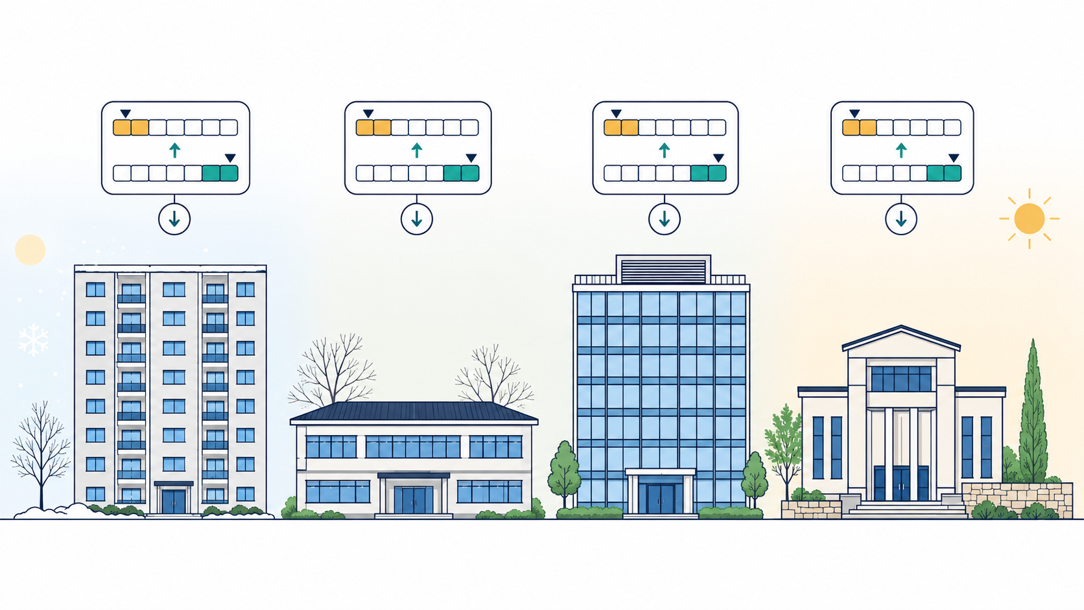
Solution
The project will develop an inference engine that fuses public building data, operational consumption data and weather information to estimate actual building performance rather than relying on static asset ratings. It will generate weather-normalised IPMVP baselines, disaggregate consumption into key end uses such as heating, cooling, domestic hot water and base load, and identify likely sources of losses linked to the envelope, controls, schedules or ventilation.
A recommendation-first optimisation engine will translate each diagnosis into a prioritised action plan, starting with no- or low-investment operational measures and then proposing capital measures with expected impact and payback. For buildings with little or incomplete historical data, typology priors based on TABULA/EPISCOPE, GIS embeddings and ARVIO’s existing energy-efficiency modelling will support cold-start estimation.
The innovation lies in solving the inverse problem of deriving actionable and verifiable energy performance insights from sparse, heterogeneous data, and in closing the prediction-to-measurement loop. Verified savings from implemented measures will be fed back into the models, improving future baselines, recommendations and portfolio screening; the same evidence can also support carbon accounting and, secondarily, green finance and valuation use cases.

Slide 4
Partners sought
Data partner — Provides public-register, GIS, EPC, transaction and building-typology data models for portfolio screening and cold-start priors. Contributes explainable audit trails and links verified savings to property valuation or green-finance exploitation, while keeping AVM core development outside the Eurogia scope to avoid double funding.
Pilot owner — Gives access to real buildings, historic bills or meter data, operational context and decision-makers for recommended measures.
Utility partner — Enables smart-meter or billing-data integration, tests data access workflows and supports replication through utility customer channels.
Retrofit partner — Translates diagnostic outputs into feasible operational and retrofit measures, cost estimates and payback assumptions. Supports validation.
Carbon partner — Implements carbon-accounting logic and reporting outputs aligned with ESG, CSRD-style portfolio reporting and decarbonisation KPIs.

Slide 5

Project team
Proposal coordinator
Irena Mesarič
M +386 31 828 629
E irena.mesaric@replika-pro.eu

