Slide 1

STRUCTURAL DIAGNOSIS & PROGNOSIS

Slide 2






STRUCMEDICA Mission
"To offer a predictive, fast, and quality diagnosis through an automated and
non-invasive measurement of durability indicators"
Precise Diagnosis
Predict the future
Secure the asset

Slide 3



Diagnostic Journey
1. Scan & mesure
2. Processing
3. Prescription
Rapid mobile inspection on-site with data
geolocation.
Correlation of indicators and degradation
modeling.
Automatic report with actionable
maintenance scenarios.

Slide 4
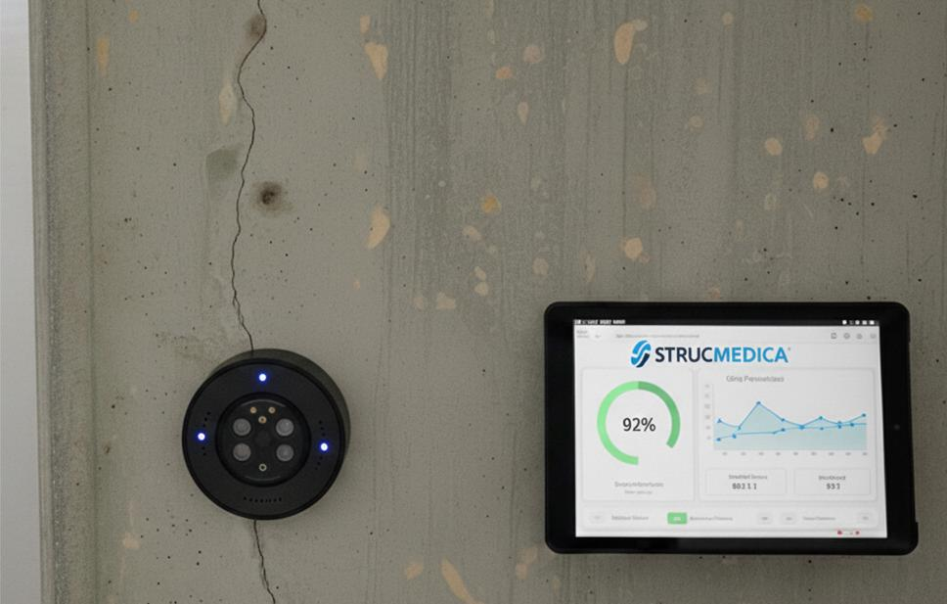
Non-invasive technology
An approach combining sensors and analysis algorithms.
100% non-destructive (NDT)
Acquisition speed < 30 min Multi-physical analysis Connectivity

Slide 5






The complete health check
Carbonation
Hydric
Cracking
Corrosion
Depth of the front, CO₂ uptake
Water/chloride content profile
Early detection of cracks
Probability and kinetics
following measured indicators
For more technical information, contact us

Slide 6
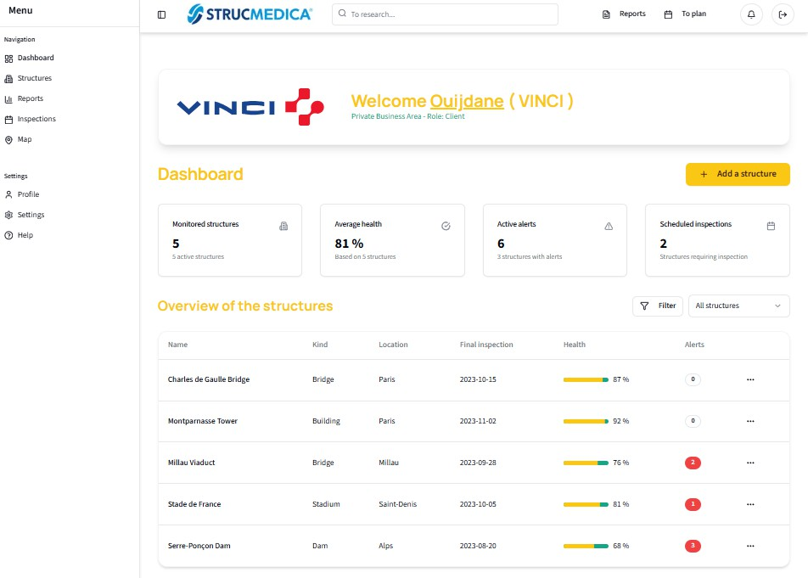
Deliverable: Intelligent & actionable report
More than an observation, an action plan.
We transform raw data into a clear maintenance strategy.
Current health status: Global score and risk mapping.
Prediction of evolution: Durability parameters in real
conditions.
Material recommendations: Adapted technical solutions (inhibitors, coatings).
Planning: Prioritization of interventions to smooth the investment.

Slide 7
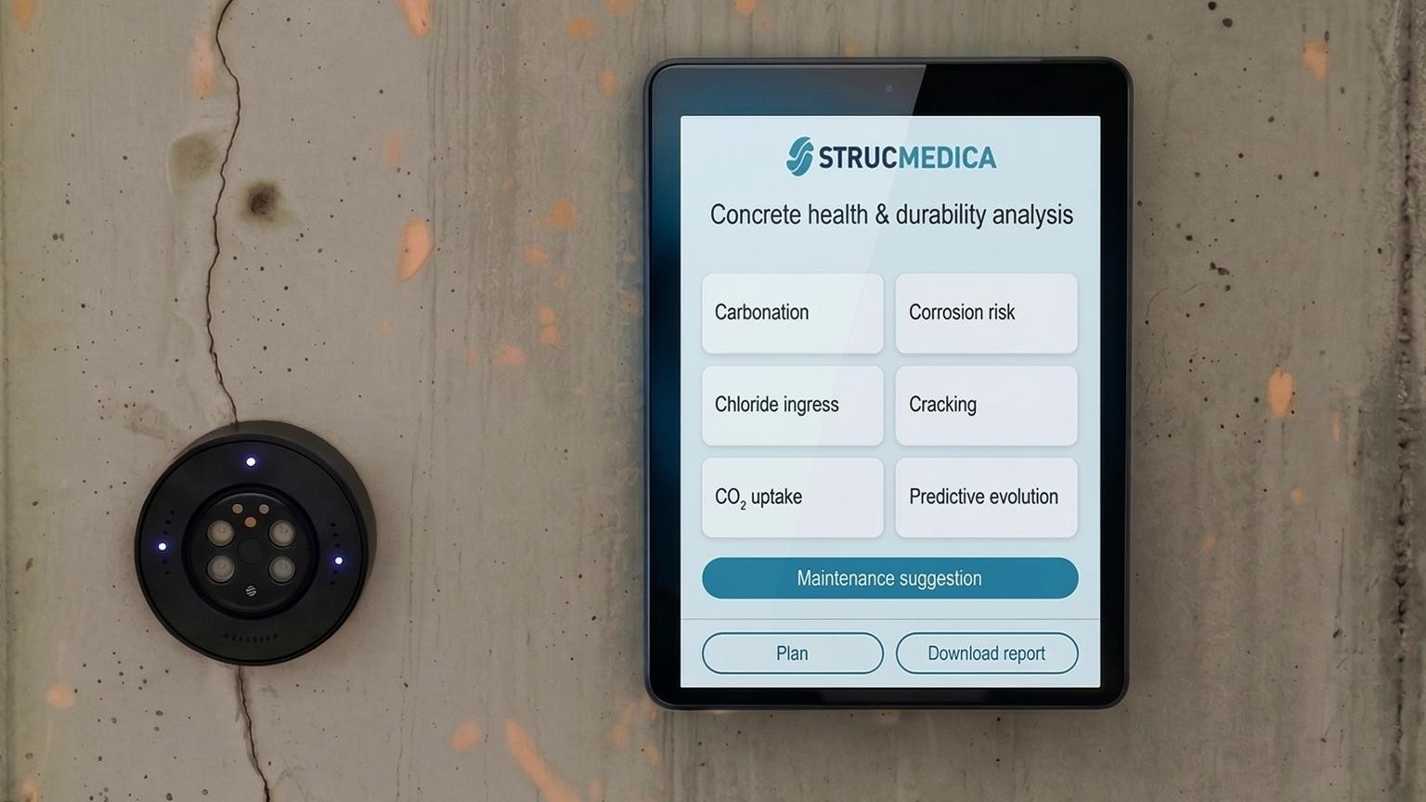


Request a Demo www.strucmedica.com team@strucmedica.com

